Slide 1

Socrates v2 (Web App) Release 4 – Training Pack

Slide 2
Overview
On Tuesday 15 September, a new release of the Soc v2 will introduce this functionality:
What is it | What it does | Who it applies to | Slide(s)
General Updates
Improved Email Notifications | Notifications have been significantly restructured to reduce volume and improve usefulness Person Identifiers will be included in the notifications Notifications will be sent when the IR is calculated not after it is confirmed Moderators will receive notification when an assessment has been assigned | All roles | 4
Improving Dashboard Filters | Filter dropdowns will match the Next step label- "Continue Indicative Range" instead of "Indicative Range in Progress“ The "Ready for IR" option has been removed from the dropdown as there are no next steps for NASC/EGL users | All roles | 5
Status Consistency | Statuses shown in the Recent People list now match the statuses on the Assessment page | All roles | 6
Change between Organisations | Users assigned to multiple organisations can now switch between them using the dropdown on the dashboard | Managers | 7
Design Improvements | All mandatory field asterisks are now red (previously a mix of black and red) The workflow bar now more accurately reflects progress The notes free text box on the moderation page has been expanded to 4000 characters. Assessment versioning has also been introduced. Reflection, Support Profile, and Important Information sidebars are now consistent ‘[Cancel] [Save]’ | All roles | 8
Assessment Updates
New/Updated Questions Wording | The wording of some assessment questions will be updated to make them clearer | All roles | 9 - 15

Slide 3
Overview
What is it | What it does | Who it applies to | Slide(s)
Assessment Updates
Updating Assessment Status | Manager’s will be able to move an assessment back to a previous status e.g. ‘Ready for IR’ to ‘Moderation in progress’ | Managers | 16 – 18
New “Confirm IR” status | Assessments with IR calculated and returned to the NASC will now show as ‘Confirm IR’ instead of ‘continue indicative range’ ‘Continue Indicative Range’ status will still be used to show the IR is being calculated by the IR support team This will enable Managers to now reassign assessments once they have been returned form the IR team | Allocators/ Managers | 19
End Assessment Enhancements | The status label will change from ‘Abandoned’ to ‘Closed’ in the assessments page The button will be added to the Allocation and the MyDSS Funding plan pages | All roles | 20
Assessment ID and Assignee Column | Assignee column will replace the assessor column in the assessment page Assessment ID is a new column available to view, also included in downloads | All roles | 21
Download Assessments in any status | Assessments can now be downloaded in any status from the assessments page | All roles | 22
Assessment Audit History | The assessment history (peer review, status changes, notes) is now accessible from the Assessment Grid via a history drawer | All roles | 23
MyDSS Funding Plan
Create multiple MyDSS Funding Plans for an assessment | Users can now create multiple MyDSS Funding Plans for an assessment MyDSS Funding Plans can be duplicated from the previous created plan MyDSS Funding Plans can be worked on (but not completed) before the Indicative Range is confirmed | All roles | 24 - 26

Slide 4
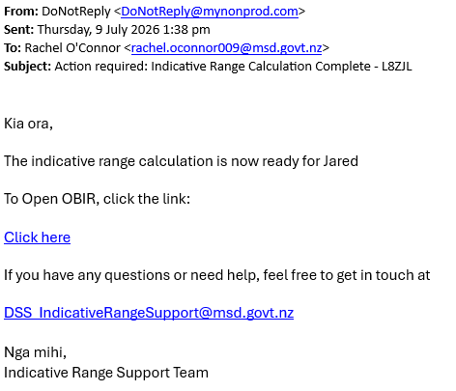
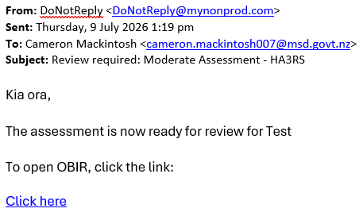
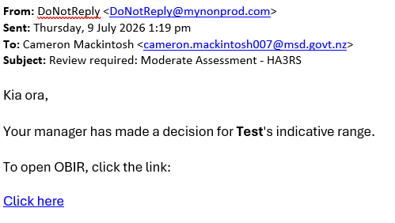
Web App Release 4
Manager Role Enhancements
OBIR Notification Updates
Notification created | Sent to
Info requested | Assessor
Ready for review | Allocator
IR Calculation done | Allocator
Manager review required | Manager
Manager decision made | Allocator
Reducing volume, increasing relevance, and improving efficiency.
  Reduced Clutter
  Users with multiple roles now receive only ONE notification
  No notification is sent if assigning to yourself
  Context
  Notifications now include Assessment IDs and First Name of the person
  More Relevant
  Notification sent when the indicative range is returned, not when confirmed
  New notification sent when an assessment needs a review

Slide 5
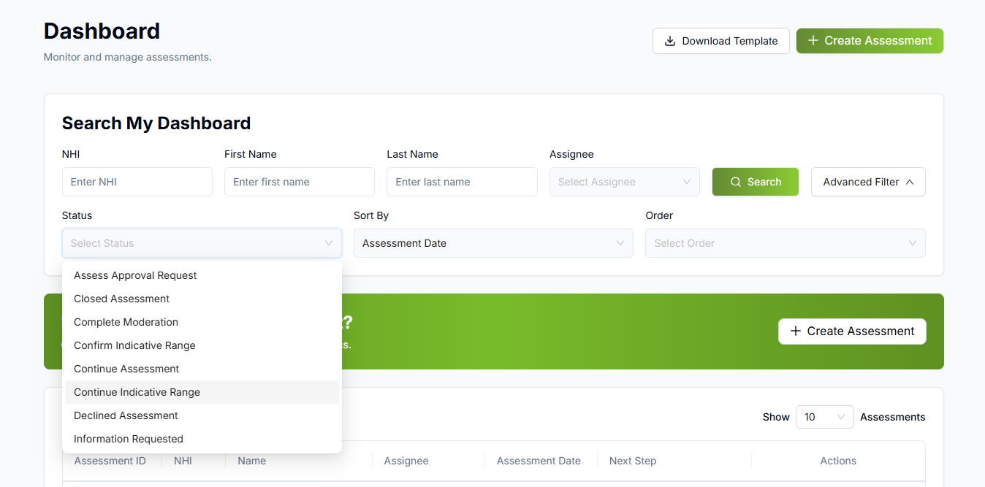
Web App Release 4
Improving Dashboard Filters
Manager Role Enhancements
Aligning filters with status labels
Label Alignment
Filter dropdowns now perfectly match the Next Step labels seen on Action Required list.
Recent people and Action Required now have matching statuses.
Reduced Clutter
  We have removed non actionable items from the dropdown list.

Slide 6
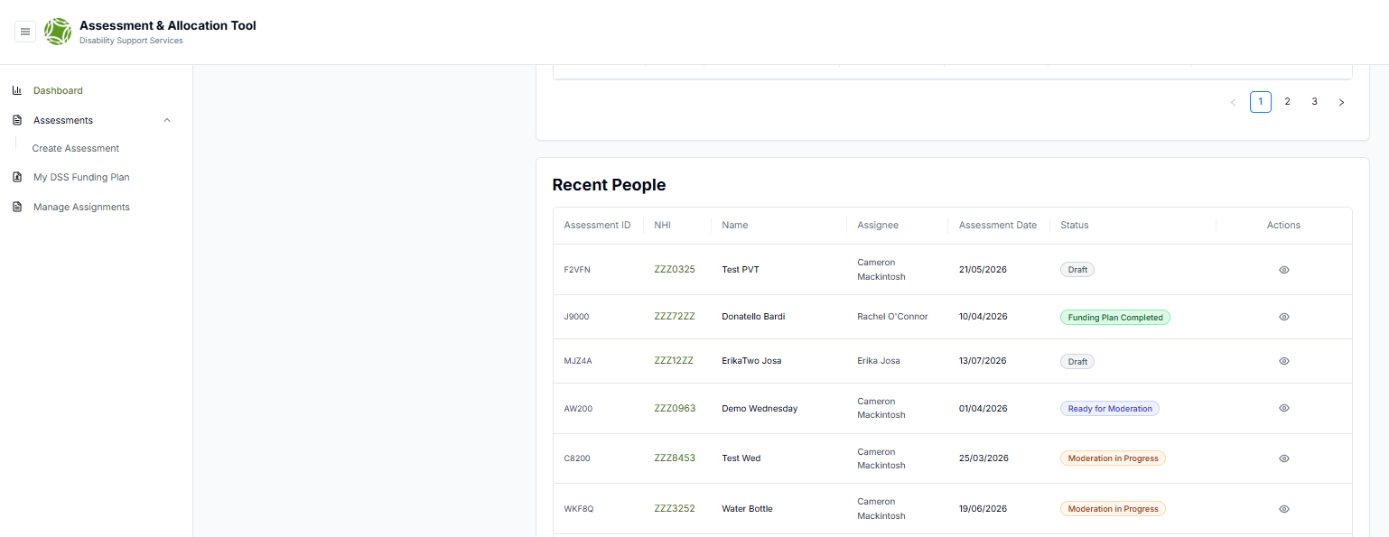
Web App Release 4
Improving Status Consistency
Manager Role Enhancements
Recent People Statuses
Recent people statuses now match the same status as ‘Assessment Page’.

Slide 7
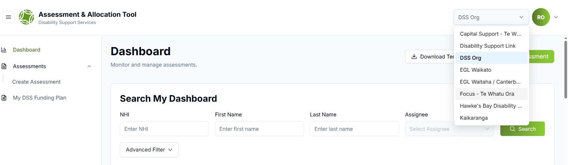
Web App Release 4
Change Organisations
Manager Role Enhancements
Enhancing usability for multi-org users
Organisation Switch
Easily switch between your organisations using the dropdown menu at the top of the dashboard.

Slide 8
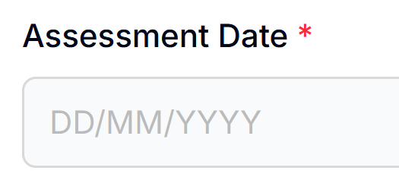
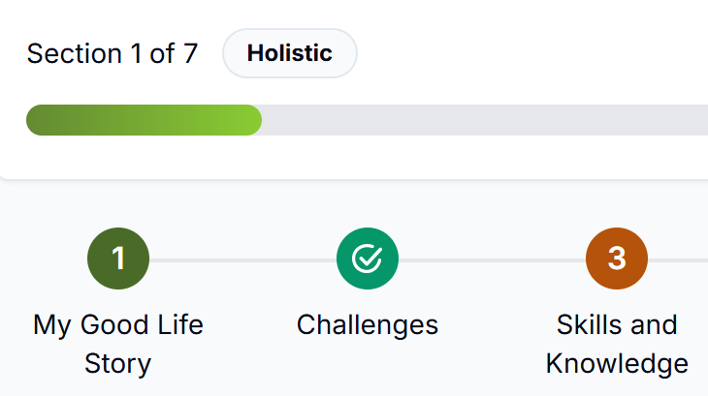
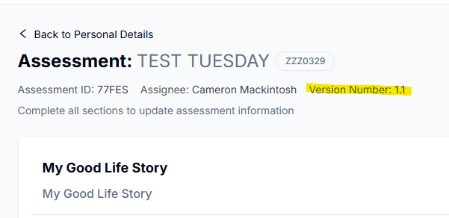
Web App Release 4
Manager Role Enhancements
Assessment Enhancements
Mandatory Information Labels
These boxes now all have red stars to highlight they are required
Assessment Date is now mandatory field
Progress Bar Update
This now updates based on the status of all the questions linked to the holistic section
Moderation Notes
This free text box character limit has been increased to 4000
4. Versioning Introduced
Assessments now show an Assessment versioning ID

Slide 9
Web App Release 4
Responding to feedback - New/Updated Questions
Manager Role Enhancements
Support Profile
What you said | What we've done
It's not always clear how to best reflect constant or near constant support requirements for physical disabilities | Added another question, specifically for risks and support related to mobility (similar to BAT)
Definitions differ over what is 'acute medical' | Changed this question to acute risks of physical harm, and dropped the examples that were confusing whether the question was limited only to the examples
There aren't enough options for the incidence of the risk | Added more options
The support options are task focussed and that isn't always appropriate or clear | Redrafted these as being about the level of focussed attention required

Slide 10
Web App Release 4
Responding to feedback - New/Updated Questions
Manager Role Enhancements
Reflections
What you said | What we've done
There needs to be clarity about when the question is asking about the contribution of primary caregivers', immediate family etc, and extended support networks being available to support primary caregiver | Split into two questions
There needs to be more distinction between Behaviour reflection question and support profile question | Rewritten this question to ask about behaviour that is time consuming or intensive to manage, rather than 'unsafe'
There are too many ideas in some questions | Edited the community engagement question, to reduce the number of ideas involved

Slide 11
Web App Release 4
New Questions
Life Stage | Question Type | Question
Before school | Reflection | We are [ ] available to provide the level of support our child requires
 | Support Profile (Mobility and Balance) | I [ ] experience challenges with balance, or other harms related to my mobility
 |  | This might occur []
 |  | Supporting me to be safe requires [ ] at the times I'm most likely to experience this risk
School to end of intermediate | Reflection | We are [ ] available to provide the level of support our child requires
 | Support Profile (Mobility and Balance) | I [ ] experience challenges with balance, or other harms related to my mobility
 |  | I can experience these events at least [ ]
 |  | Supporting me to be safe requires [ ] at the times I'm most likely to experience this risk
High school to leaving school | Reflection​ | I can [ ] draw on my extended network for support, when those who usually support me are less available
 | Support Profile (Mobility and Balance) | I [ ] experience challenges with falls, balance, or other harms related to my mobility
 |  | These events occur [ ].
 |  | Supporting me to be safe requires [ ] at the times I'm most likely to experience this risk
Adulthood | Reflection | I can [ ] draw on my extended network for support, when those who usually support me are less available
 | Support Profile (Mobility and Balance) | I [ ] experience challenges with falls, balance, or other harms related to my mobility
 |  | This might occur []
 |  | Supporting me to be safe requires [ ] at the times I'm most likely to experience this risk

Slide 12
Web App Release 4
Updated Questions – Adulthood
Question Type | Category | Current Question | Updated Question | Updates
Reflection | Developing and expressing my identity | I have [] enduring roles and activities that support me to demonstrate my strengths, be valued, and maintain connection with others | I have [] enduring roles and activities that support me to demonstrate my strengths and maintain connection with others | Question Wording
 | Preparing me to have a wide range of options | The way I express my emotions [ ] is in a way that is safe for me and for others | The way I express my emotions [] is in a way that is time consuming or intensive to manage | Question Wording
 | Creating sustainable expectations of care for the future | There are people in my life who [ ] are available to provide the level of support I require to achieve the things that are important to me | There are people in my life who [] are available to provide the level of practical support I require to achieve the things that are important to me. | Question Wording
Support Profile | Number of People | How many people do you usually require to carry out support? |  | Answer Values
 | Expressing myself | These events occur [] |  | Answer Values
 | Expressing myself | I may require [] to support me to be safe | Supporting me to be safe requires [ ] at the times I'm most likely to experience this risk | Question Wording and Answer Values
 | Acute medical | I can experience acute medical events (eg. seizure, aspiration risk etc.) at least [] | I can experience acute risks of physical harm at least [] | Question Wording
 | Acute medical | These events occur [] |  | Answer Values
 | Acute medical | I may require [] to support me to be safe | Supporting me to be safe requires [ ] at the times I'm most likely to experience this risk | Question Wording and Answer Values
 | Exploring my environment | This might occur [] |  | Answer Values
 | Exploring my environment | I may require [] to support me to be safe | Supporting me to be safe requires [ ] at the times I'm most likely to experience this risk | Question Wording and Answer Values
 | Managing boundaries with others | This might occur [] |  | Answer Values
 | Managing boundaries with others | I may require [] to support me to be safe | Supporting me to be safe requires [ ] at the times I'm most likely to experience this risk | Question Wording and Answer Values

Slide 13
Web App Release 4
Updated Questions – Highschool to Leaving School
Question Type | Category | Current Question | Updated Question | Updates
Reflection | Developing and expressing my identity | I am [] developing and pursuing my interests, in ways which can create opportunities to build on them and be valued | I am [ ] developing and pursuing my interests, in ways which create opportunities to build on them | Question Wording
 | Preparing me to have a wide range of options | The way I express my emotions [ ] is in a way that is safe for me and for others | The way I express my emotions [] is in a way that is time consuming or intensive to manage | Question Wording
 | Creating sustainable expectations of care for the future | There are people in my life who [ ] are available to provide the level of support I require to achieve the things that are important to me | There are people in my life who [] are available to provide the level of practical support I require to achieve the things that are important to me. | Question Wording
Support Profile | Number of People | How many people do you usually require to carry out support? |  | Answer Values
 | Expressing myself | These events occur [] |  | Answer Values
 | Expressing myself | I may require [] to support me to be safe | Supporting me to be safe requires [ ] at the times I'm most likely to experience this risk | Question Wording and Answer Values
 | Acute medical | I can experience acute medical events (eg. seizure, aspiration risk etc.) at least [] | I can experience acute risks of physical harm at least [] | Question Wording
 | Acute medical | These events occur [] |  | Answer Values
 | Acute medical | I may require [] to support me to be safe | Supporting me to be safe requires [ ] at the times I'm most likely to experience this risk | Question Wording and Answer Values
 | Exploring my environment | This might occur [] |  | Answer Values
 | Exploring my environment | I may require [] to support me to be safe | Supporting me to be safe requires [ ] at the times I'm most likely to experience this risk | Question Wording and Answer Values
 | Managing boundaries with others | This might occur [] |  | Answer Values
 | Managing boundaries with others | I may require [] to support me to be safe | Supporting me to be safe requires [ ] at the times I'm most likely to experience this risk | Question Wording and Answer Values

Slide 14
Web App Release 4
Updated Questions – School to end of intermediate
Question Type | Category | Current Question | Updated Question | Updates
Reflection | Developing and expressing my identity | I am [] developing and pursuing my interests, in ways which can create opportunities to build on them and be valued | I am [ ] developing and pursuing my interests, in ways which create opportunities to build on them | Question Wording
 | Preparing me to have a wide range of options | Our child [] expresses their emotions in a way that is safe for them and for others | Our child [] expresses their emotions in a way that is time consuming or intensive to manage | Question Wording
 | Creating sustainable expectations of care for the future | Family and friends are [] available to support our child and us | Extended family and friends are [ ] available to support our child and us | Question Wording
Support Profile | Number of People | How many people do you usually require to carry out support? |  | Answer Values
 | Expressing myself | These events occur [] |  | Answer Values
 | Expressing myself | I may require [] to support me to be safe | Supporting me to be safe requires [ ] at the times I'm most likely to experience this risk | Question Wording and Answer Values
 | Acute medical | I can experience acute medical events (eg. seizure, aspiration risk etc.) at least [] | I can experience acute risks of physical harm at least [] | Question Wording
 | Acute medical | These events occur [] |  | Answer Values
 | Acute medical | I may require [] to support me to be safe | Supporting me to be safe requires [ ] at the times I'm most likely to experience this risk | Question Wording and Answer Values
 | Exploring my environment | This might occur [] |  | Answer Values
 | Exploring my environment | I may require [] to support me to be safe | Supporting me to be safe requires [ ] at the times I'm most likely to experience this risk | Question Wording and Answer Values

Slide 15
Web App Release 4
Updated Questions – Before School (All)
Question Type | Category | Current Question | Updated Question | Updates
Reflection | Preparing me to have a wide range of options | Our child [] expresses their emotions in a way that is safe for them and for others | Our child [] expresses their emotions in a way that is time consuming or intensive to manage | Question Wording
 | Creating sustainable expectations of care for the future | Family and friends are [ ] available to support our child and us | Extended family and friends are [ ] available to support our child and us | Question Wording
Support Profile | Number of People | How many people do you usually require to carry out support? |  | Answer Values
 | Expressing myself | These events occur [] |  | Answer Values
 | Expressing myself | I may require [] to support me to be safe | Supporting me to be safe requires [ ] at the times I'm most likely to experience this risk | Question Wording and Answer Values
 | Acute medical | I can experience acute medical events (eg. seizure, aspiration risk etc.) at least [] | I can experience acute risks of physical harm at least [] | Question Wording
 | Acute medical | These events occur [] |  | Answer Values
 | Acute medical | I may require [] to support me to be safe | Supporting me to be safe requires [ ] at the times I'm most likely to experience this risk | Question Wording and Answer Values
 | Exploring my environment | This might occur [] |  | Answer Values
 | Exploring my environment | I may require [] to support me to be safe | Supporting me to be safe requires [ ] at the times I'm most likely to experience this risk | Question Wording and Answer Values

Slide 16
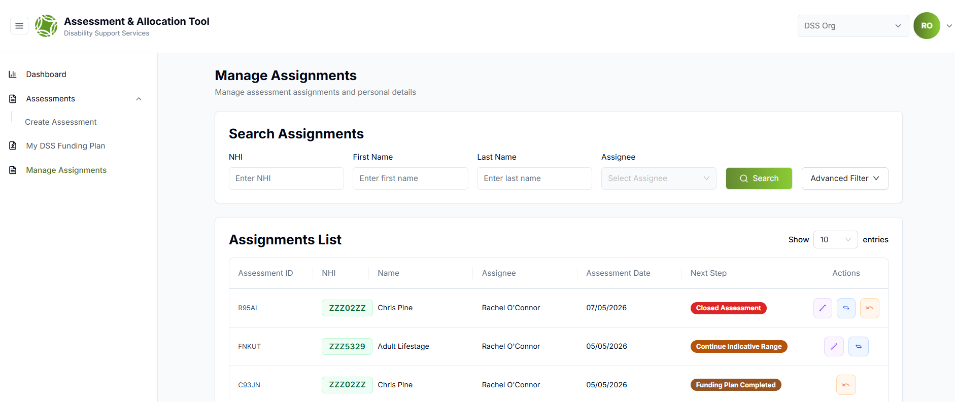
Web App Release 4
Workflow Updates
Manager Role Enhancements
Changing Assessment Status
Manager’s can now return most assessments to a previous status from the manage assignments page.
Assessments can not be reverted once the status changes to "Continue Indicative Range". However, you can still contact DSS_IndicativeRangeSupport@msd.govt.nz to request changes or updates.

Slide 17

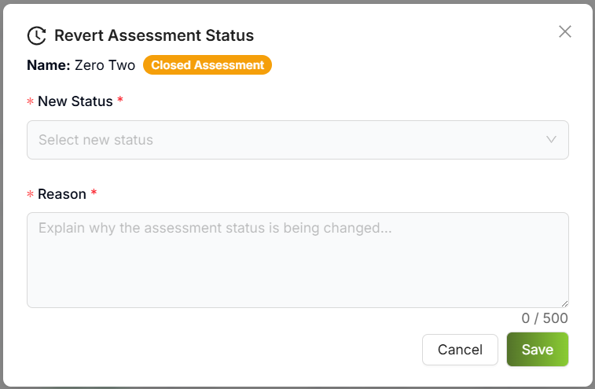
Web App Release 4
Workflow Updates
Manager Role Enhancements
Changing Assessment Status
After selecting the revert button choose the status from the dropdown, enter a reason and select save
You will no longer need to email DSS_Support – reducing the delay time for assessment completion

Slide 18
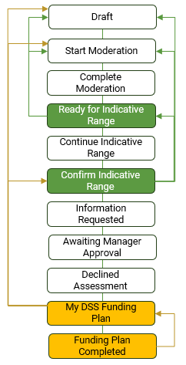
Web App Release 4
Workflow Updates
Manager Role Enhancements
Assessment Workflow
Status Change Options
Here is an overview where the assessment action required steps can change to:
Draft
Start Moderation
Complete Moderation
Ready for Indicative Range
Continue Indicative Range
Confirm Indicative Range
Information Requested
Awaiting Manager Approval
Declined Assessment
My DSS Funding Plan
Funding Plan Completed

Slide 19
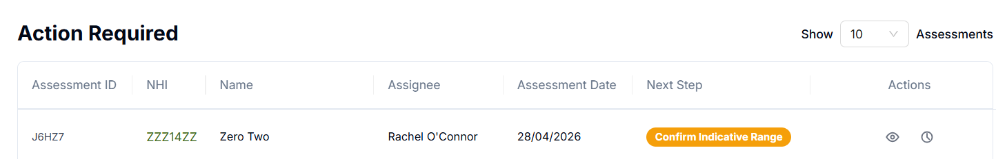
Web App Release 4
Workflow Updates
Manager Role Enhancements
New Status
Assessments with a calculated IR now show as "Confirm Indicative Range"
You can now reassign assessments at any stage except, when with the IR Support team.
Confirm Indicative Range

Slide 20
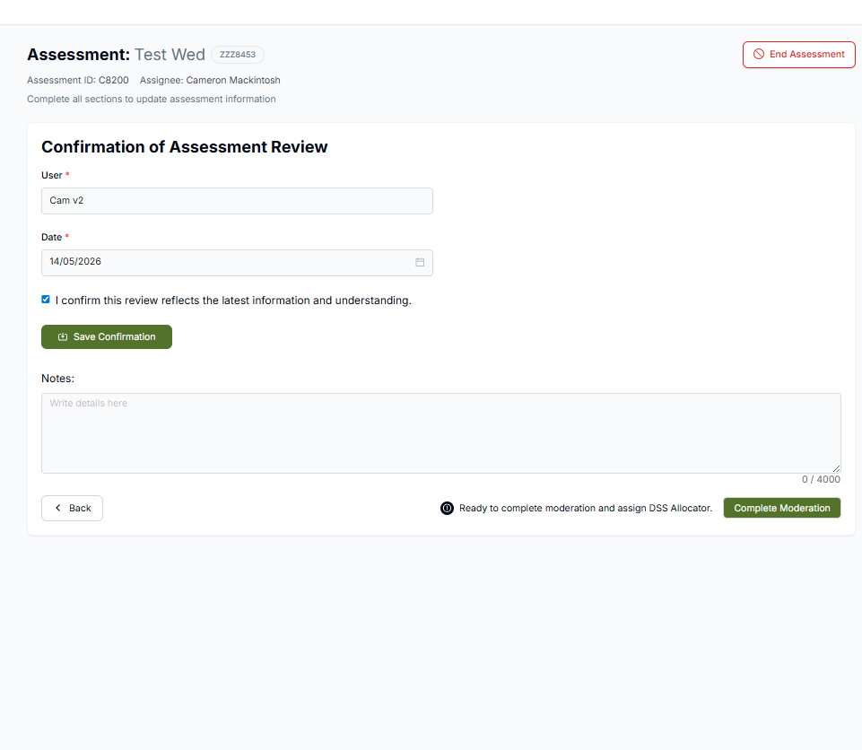
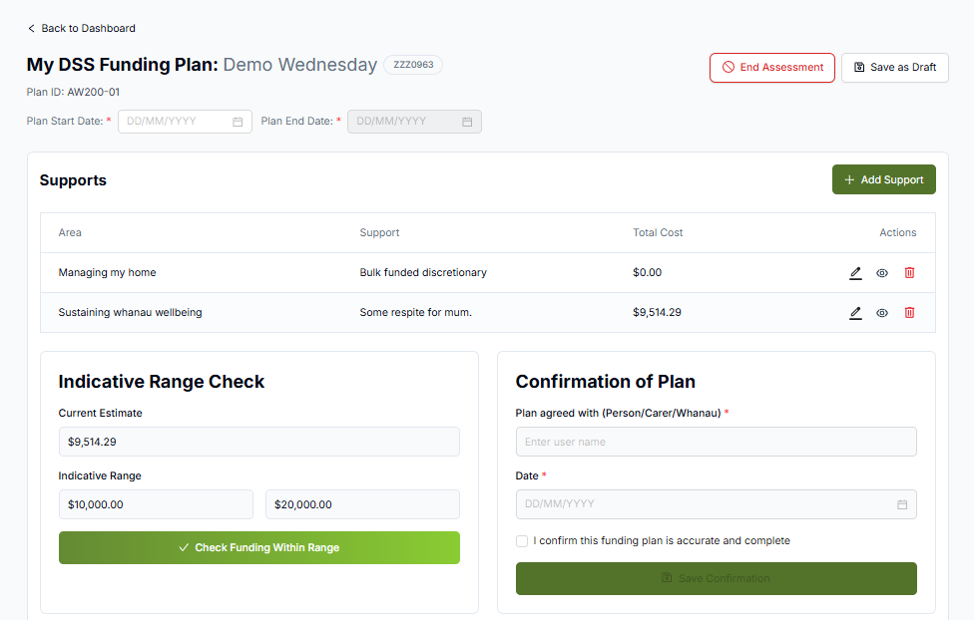
Web App Release 4
Workflow Updates
Manager Role Enhancements
Ending Assessments
The “End Assessment” button has now been added to the Moderation, Allocation and the MyDSS Funding Page to allow assessments to be closed without completing all steps at any point

Slide 21
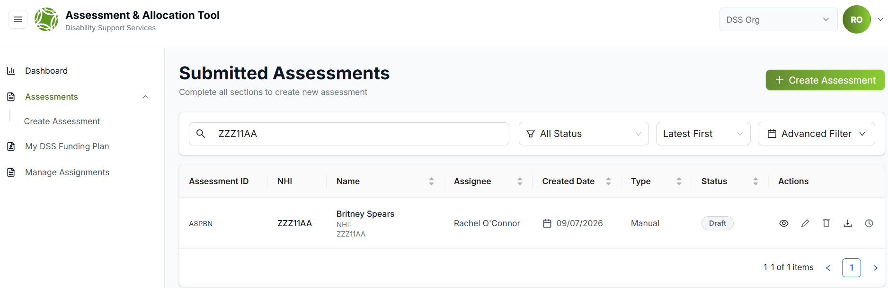
Web App Release 4
Assessments Page Enhancements
Manager Role Enhancements
New Assignee & Assessment ID Columns
The new Assignee column tracks who is currently responsible for the assessment, replacing the assessor column
The Assessment ID is a unique identifier that is system generated

Slide 22
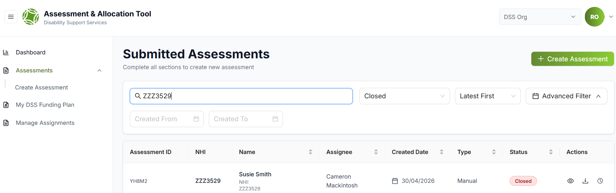
Web App Release 4
Assessments Page Enhancements
Manager Role Enhancements
Updated Status Label
The “Abandoned” status has been changed to “Closed”
This more accurately reflects the nature of these assessments

Slide 23


Web App Release 4
Assessments Page Enhancements
Manager Role Enhancements
Assessment Download & History View
Available at all times from the assessments view
The download and history button are the same as the action required view

Slide 24
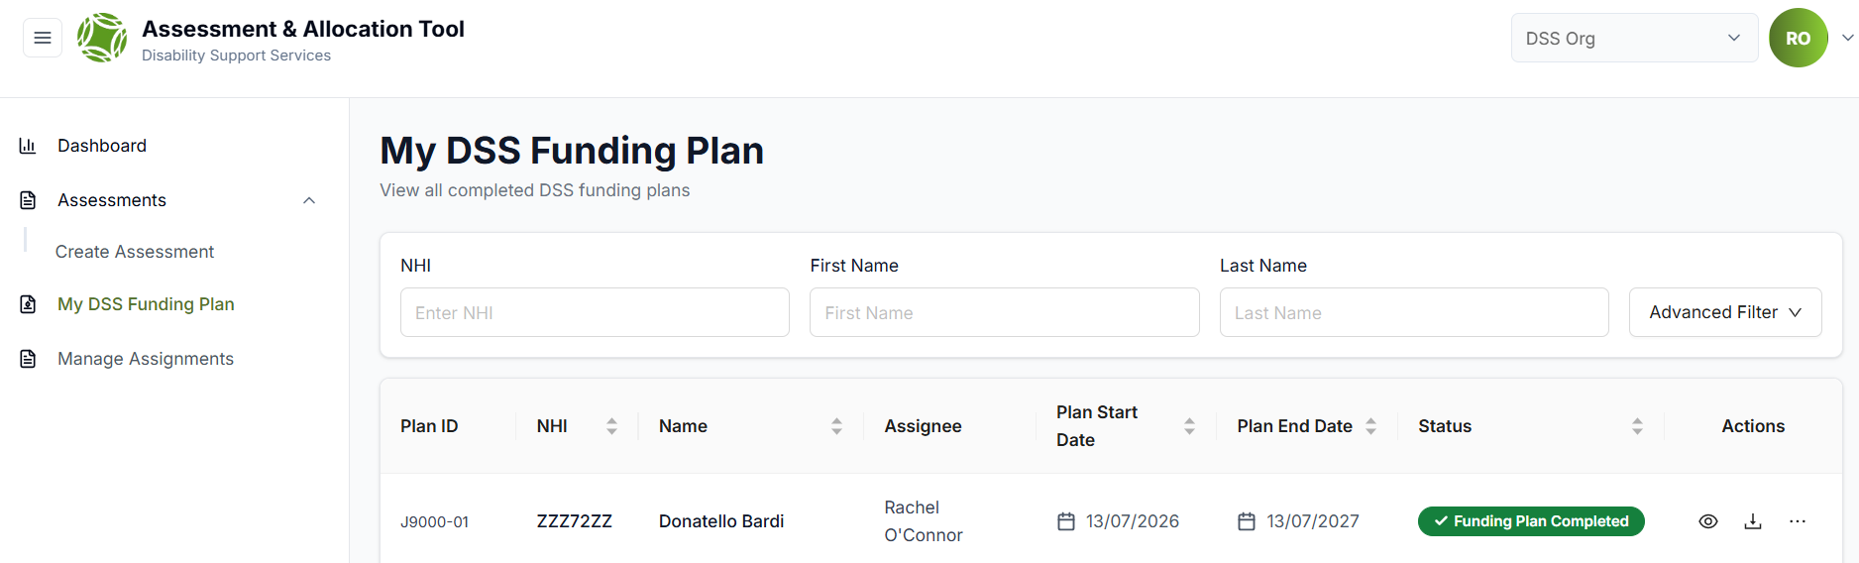

Web App Release 4
MyDSS Funding Plan Updates
Manager Role Enhancements
Multiple MyDSS Funding Plans
Multiple Funding plans can now be created and/or duplicated for each assessment
Instructions:
Select the 3 dots under the actions
Choose either duplicate or create new

Slide 25
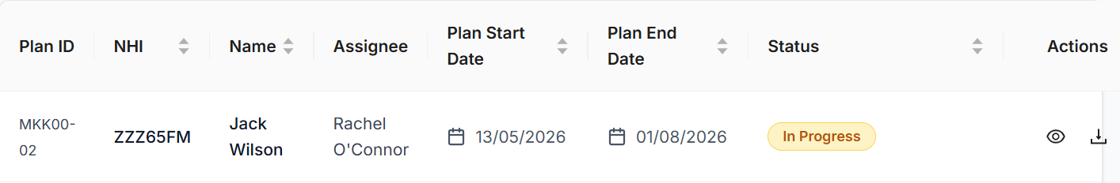
Web App Release 4
MyDSS Funding Plan Updates
Manager Role Enhancements
Multiple MyDSS Funding Plans
If duplicated: click the “In Progress” to edit the plan
If create new: the funding plan page will open and support can be added
Only one “In Progress” funding plan can be open at a time
Note: the plan ID number reflects the number of plans created per assessment:
Assessment ID
Plan Line
MKK00 – 02 - 01
Plan Number

Slide 26
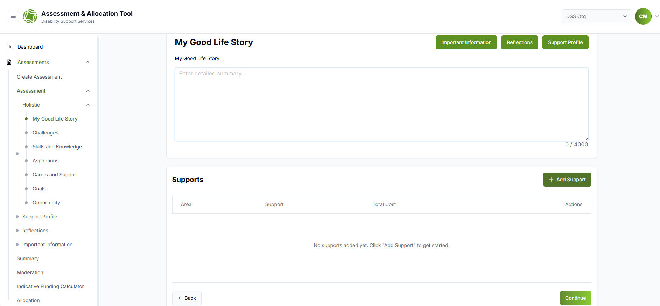
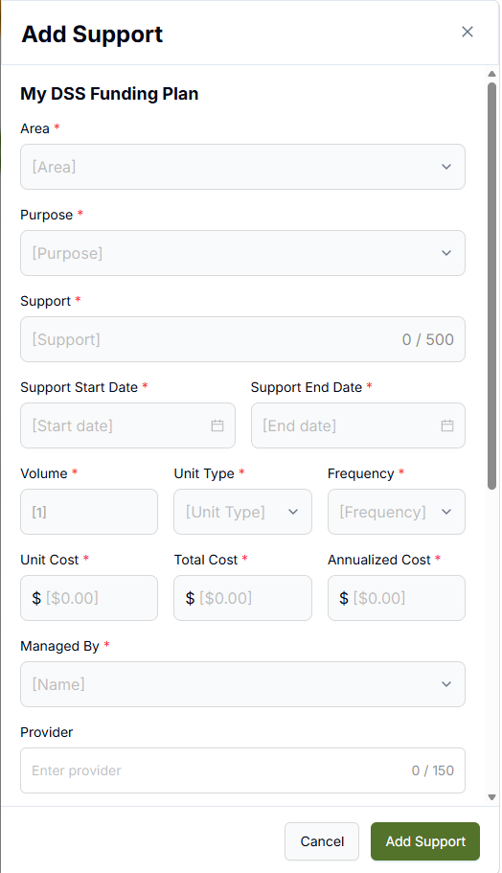
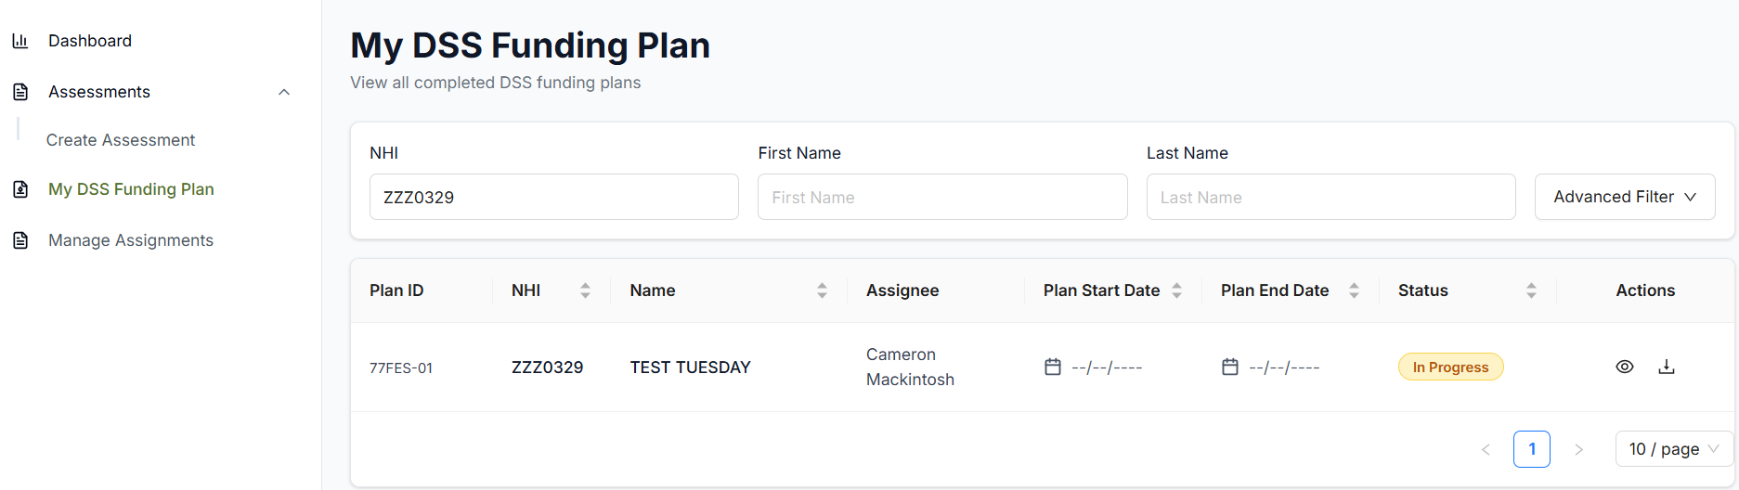
Web App Release 4
MyDSS Funding Plan Updates
Manager Role Enhancements
Starting a Draft MyDSS Funding Plan
A draft MyDSS Funding Plan can now be started and updated before a Indicative Range has been calculated/returned.
Open an assessment before it has been sent to the Indicative Range Team e.g., when it’s in draft or moderation.
Add a support the same as you would previously.
Once added, go to the MyDSS Funding Plan tab and search the NHI.
Select “In Progress” to open the plan and update it.
Note: Plans cannot be completed until the Indicative Range is confirmed.

Slide 27
Thanks
For any Socrates v2 (Web App) related queries (including training) reach out to:
DSS_socrates@msd.govt.nz

