Slide 1
Peer-visiting service
for disabled adults and tāngata whaikaha Māori.

Slide 2
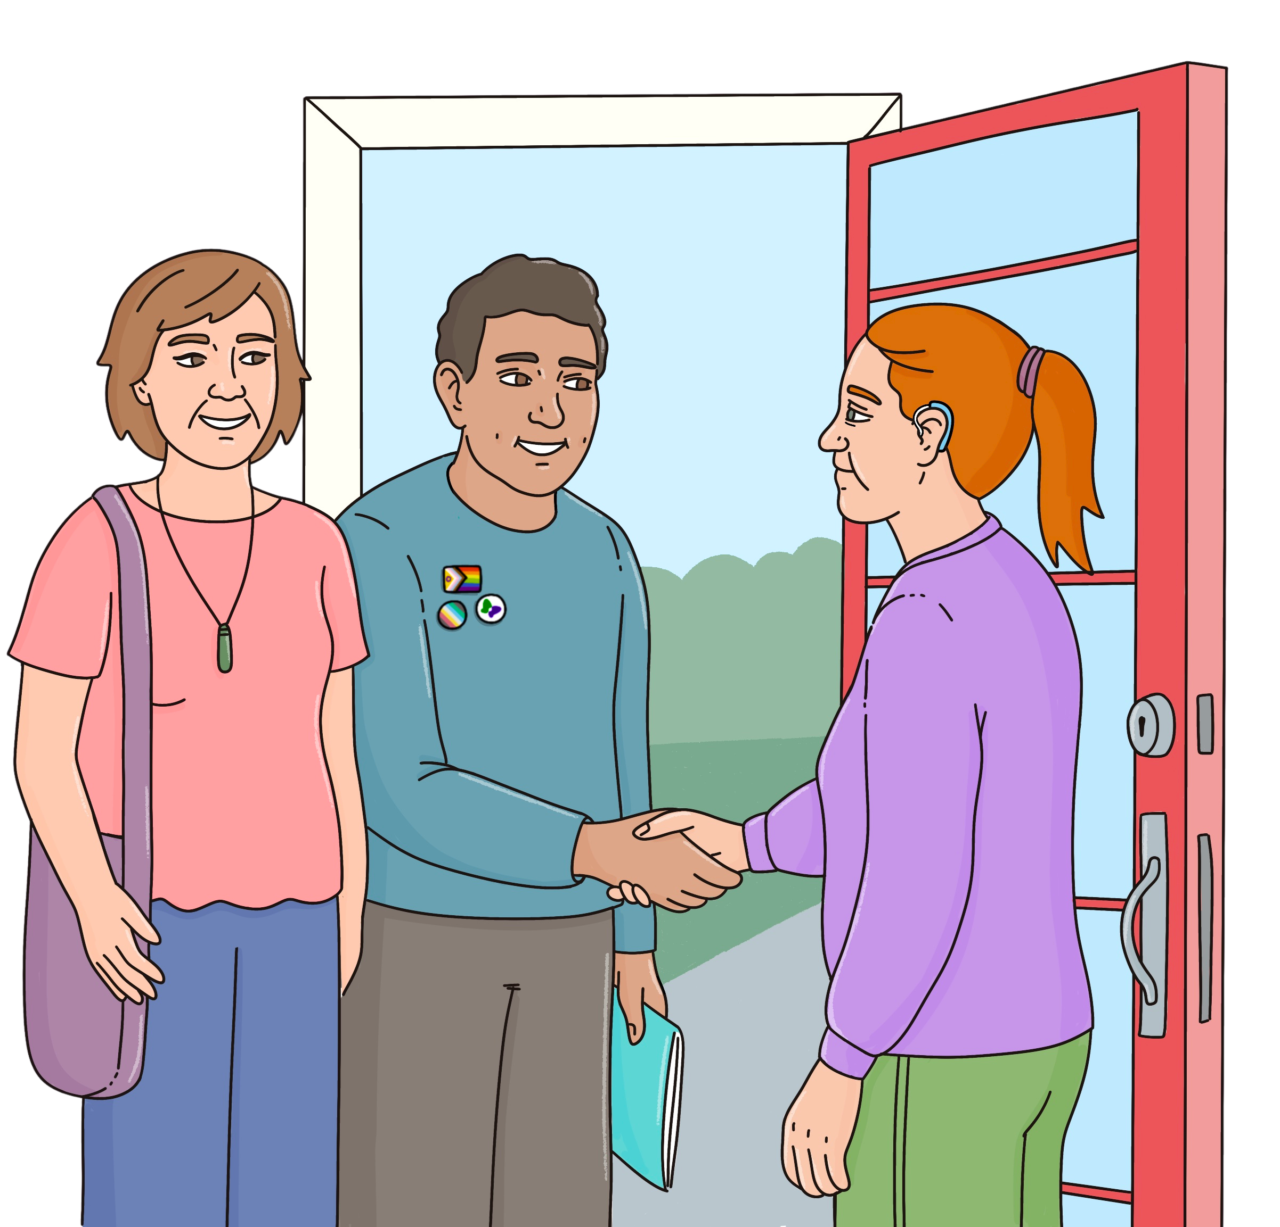
What is People for Us
People for Us is a peer visiting service who visits disabled adults and tāngata whaikaha Māori who live in who live in homes funded by Disability Support Services to find out if they are:
living their good life
getting good support
safe.

Slide 3
Why has People for Us been created?
The Royal Commission of Inquiry into Abuse in State Care found that people with disabilities were abused while living in residential care.
People for Us was created to make sure that disabled people are safe and get good support.
The Royal Commission said that more needs to be done to stop the abuse of disabled people in care.
People for Us will focus on the human rights of disabled people and tāngata whaikaha Māori.

Slide 4



Our Role
People First New Zealand Ngā Tāngata Tuatahi is one of three organisations delivering this service, alongside:
Te Ahi Kaa (visiting Tangata Whaikaha Māori in Waikato and South Auckland)
Vaka Tautua (visiting Auckland’s Pacific communities).
People First is at the forefront of this service doing visits across Aotearoa New Zealand.

Slide 5
Outcomes
Outcomes of the People for Us service are:
Disability Support Services will gain an understanding of the voice and experience of disabled people, tāngata whaikaha Māori within the services they procure (as well as those of their families and whānau)
issues of safety and wellbeing for the group of disabled people and tāngata whaikaha Māori visited by Kaiārahi are identified and responded to at an earlier stage.
Disability Support Providers deliver safer services that are aligned with the Enabling Good Lives vision and principles.

Slide 6
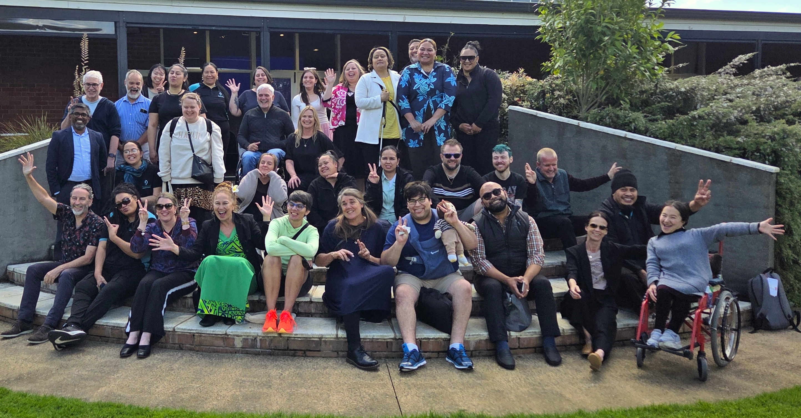
People for Us partners

