Slide 1




Disability Support Services: Enhanced Audit Provider Forum Session
10 February 2026

Slide 2

Agenda
1
Meet the Team
03
2
04
Strategic Audit Partner Approach
3
06
High-Level Plan on a Page
4
08
Key Messages
5
09
Q&A

Slide 3



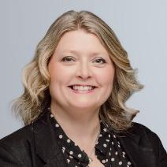

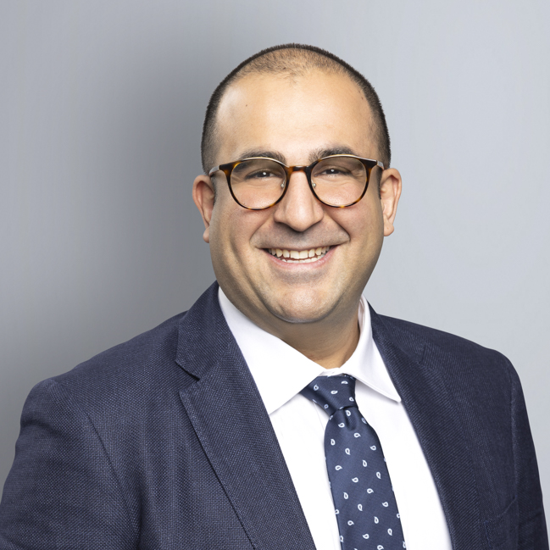

Meet the team
Peter Chew
Lead Partner
Kirill Voronchev
Excellence Lead
Success relies on having a team you can trust, rely on and who is invested in your success.
James Poskitt
Design Lead
Emma Williams
Delivery Lead
Kirsten Pulbrook
Disability Audit SME
Abtin Maghsoodi
Analytics Lead
Timoti Brown
Pou Whakatere

Slide 4
Goal
What does ‘Enhanced Audit’ mean?
Outcomes
To ensure that the safety and wellbeing of disabled people under the care of our contracted providers is of the highest quality.
Short-term
Medium-term
Long-term
Strengthened and consistent tools aligned with the sector.
Improved consistency of services.
Continuous improvement culture.
Objective
Emerging sector trends identified.
High quality, safe and equitable service delivery.
Enhanced visibility over provider service delivery and performance.
Enhanced audit services that support the delivery of high-quality, safe, and person-centred disability support services across Aotearoa.
Enhanced audit services will provide independent, robust, and timely assessments of provider performance against national standards and contractual requirements, with a particular focus on safeguarding, service quality, and continuous improvement.
Improved feedback loops and provider engagement.
Increased public trust and confidence.
Ability to take immediate actions to address and triangulate issues.
Improved workforce and provider capability.
A risk proportionate approach to the audit programme.
Timely and clear feedback to providers.
Better outcomes for disabled people.
Data informed decision making.
Awareness of rights, risks, and quality gaps.

Slide 5
High-level plan on a page
 | 2025 | 2026
 | Dec | Jan | Feb | Mar | Apr | May | Jun | Jul | Aug | Sep | Oct | Nov | Dec
Step 0: Programme Initiation
Step 1: Design Audit Framework
Step 2: Test and Validate Audit Framework
Step 3: Build Data Collection Audit Tool
Step 4: Plan & Schedule Audits
Step 5: Train Team
Step 6: Deliver Audits
Step 7: Reporting and Insights
Programme Set Up
Programme set up completed
Build audit framework
Test framework
Identify, schedule and undertake initial audits; refine framework, if required
Build digital tools and reporting
Develop scheduling approach
Agree audit schedule
All audits scheduled with providers
Develop material and train team
Ongoing training
Audits progress in a staged approach
2027 - 2028
Provide reports and system level insights to providers, group homes and services
Timelines subject to change

Slide 6






Beyond Audit
01
02
03
04
Commitment to partnership.
KPMG has a proven track record of long-standing relationships with our clients, based on our commitment to integrity, objectivity, and the highest quality standards.
System level improvement.
The outcomes of this vital work are to ensure that disabled people are safe in their homes with opportunities and choices to enable them to live their best lives.
As such the programme will enable us to identify where improvement opportunities exist to ensure that the sector is well-equipped to meet the level of quality and performance to deliver on these outcomes.
Depth of leadership.
We offer a single point of accountability with a leadership team balanced for delivery optimisation, audit excellence, sector relationships, clinical experience, cultural capability and innovative analytics.
A proven delivery team and method.
We have a national delivery team with proven capability in delivering audits with complex requirements and diverse environments. The team will be supported by extensive Australian expertise and global best practice.

Slide 7
Stated Priorities
Strategic objectives
Ensure contracted providers are delivering care of the highest quality to disabled people, with a strong focus on safety and wellbeing
An approach that strengthens both the quality and safeguarding of disability support services and the commercial and contracting practices that underpin delivery
Independent, robust, and timely assessments of provider performance against national standards and contractual requirements
A particular focus on safeguarding, service quality, and continuous improvement
The overarching goal is to ensure that the safety and wellbeing of disabled people under the care of contracted providers is of the highest quality.
Enhanced audit services’ that support the delivery of high-quality, safe, and person-centred disability support services across New Zealand.
Domains
People
Environment
Organisation
Staff Capability & Conduct
Recruitment and training
Management practices
Cultural competency
Rights & Person Directed
Treated with respect
Able to make decisions
Safeguarding
Seclusion and restraint
Protection from abuse and neglect
Service Leadership & Quality Systems
Governance practices
Quality and risk management processes
Cultural Safety
Kaupapa Māori approaches
Culture is respected and valued
Health & Wellbeing
Medication and nutrition
Service management
Environment & Safety
Accident and Injury prevention
Business Viability
Financial Management
HR management
Continuous improvement plans

Slide 8
Q&A

Slide 9

Ngā Mihi

