Slide 1
Aligning DSS critical incident reporting to the Te Tāhū Hauora healing, learning and improving from harm events policy
DSS Quality Forum
20 May 2025
Lara Penman, DSS Quality Team
Purpose
Provide an overview of the current critical incident reporting for DSS contracted services.
1.
Current approach
Present high-level proposed updated critical incident criteria and supporting DSS critical incident form.
2.
Future proposal
Confirm timelines
Send your feedback to quality@msd.govt.nz by Tuesday 3 June 2025.
3.
Next steps

Slide 2
Current approach
1.
All DSS contracted providers must report critical incidents within 24 hours
Critical incident: an event where there is severe or major harm to the person.
DSS, as part of our stewardship and commissioning functions, checks that providers are delivering safe and quality supports, and are managing incidents well.
Approximately 75% of reported critical incidents come from community residential services.
We want to encourage a strong reporting culture to inform ongoing service improvement.
For more information see Reporting of critical incidents and deaths | Disability Support Services.
IN-CONFIDENCE

Slide 3
Current approach
1.
In the last year DSS has received an average of 282 critical incident reports each month
Table 1: Reported critical incidents by category (Jan-Mar 2025 quarter)
Incident Category (current categories) | Number reported | Percentage of total
Hospitalisation of a disabled person | 186 | 23%
Abuse or assault by a disabled person to a non-disabled person | 159 | 20%
Police or emergency services involved | 141 | 18%
Abuse or assault of a disabled person | 138 | 17%
Restraint or seclusion | 90 | 11%
Serious injury of a disabled person | 27 | 3%
Other | 63 | 8%
Total | 795 | 100%
IN-CONFIDENCE

Slide 4
Future proposal
2.
DSS is updating the DSS critical incident categories and severity threshold to align with Te Tāhū Hauora
DSS providers who are contractually or legally required to comply with Ngā Paerewa are also required to report harm events to Te Tāhū Hauora Health Quality and Safety Commission (Te Tāhū Hauora).
We are working with Te Tāhū Hauora and providers to align the reporting processes.
This project will:
improve targeting of the most high-risk incidents
align the process for providers
support learning and improvement for disability support services.
IN-CONFIDENCE
Notes:
DSS providers required to comply with Ngā Paerewa are:
Those certified under the Health and Disability Services Safety Act (legal requirement)
Those covered under the DSS contract outcome framework (contractual requirement) – The Tier one specification requires compliance with Ngā Paerewa, as part of ensuring quality and safety of services.

Slide 5
Future proposal
2.
DSS is proposing four changes to ‘go live’ from 1 July 2025
To raise the threshold of what we classify as ‘critical’ so it aligns with Te Tāhū Hauora severity assessment codes (SAC)
To update the DSS critical incident categories
To update the DSS critical incident reporting form
To support DSS contracted providers to report SAC 1 and SAC 2 harm events to Te Tāhū Hauora.
IN-CONFIDENCE

Slide 6
Future proposal
2.
Raising the threshold of what we classify as ‘critical’
Severe,
life-threatening or major harm
DSS Critical incidents
SAC 1 or 2
Non-critical incidents
Moderate or minor harm
SAC 3 or 4
IN-CONFIDENCE

Slide 7
Future proposal
2.
Criteria for DSS critical incidents and Severity Assessment Code (SAC)
 | Definition | DSS Incident Severity criteria | Te Tāhū Hauora SAC criteria
Critical incident (DSS always report critical incidents) | An event where there is severe, life-threatening or major harm to the person. | Severe or life-threatening harm: Death or harm causing severe loss of function and/or requiring lifesaving intervention. Includes, but is not limited to, incidents that meet the SAC 1 criteria. Major harm: Harm causing major loss of function, serious injury and/or requiring significant intervention. Includes, but is not limited to, incidents that meet the SAC 2 criteria. | SAC 1 Severe or life-threatening harm: Death or harm causing severe loss of function and/or requiring lifesaving intervention. Where the harm event was the result of a departure from the planned provision of support, differs from the immediate expected outcome of care or was not related to the natural course of illness or treatment. SAC 2 Major harm: Harm causing major loss of function, serious injury and/or requiring significant intervention. Where the harm event was the result of a departure from the planned provision of support, differs from the immediate expected outcome of care or was not related to the natural course of illness or treatment.
IN-CONFIDENCE

Slide 8
Future proposal
2.
Criteria for DSS critical incidents and Severity Assessment Code (SAC)
 | Definition | DSS Incident Severity criteria | Te Tāhū Hauora SAC criteria
Non-critical incident | An event where there is moderate or minor harm to the person. | Moderate harm: Harm causing short-term loss of function, injury and /or requiring moderate intervention. Includes, but is not limited to, incidents that meet the SAC 3 criteria. Minor harm: Harm causing no loss of function and requiring minimal intervention. Includes, but is not limited to, incidents that meet the SAC 4 criteria. | SAC 3 Moderate harm: Harm causing short-term loss of function, injury and /or requiring moderate intervention. Where the harm event was the result of a departure from the planned provision of support, differs from the immediate expected outcome of care or was not related to the natural course of illness or treatment. SAC 4 Minor harm: Harm causing no loss of function and requiring minimal intervention. Where the harm event was the result of a departure from the planned provision of support, differs from the immediate expected outcome of care or was not related to the natural course of illness or treatment.
IN-CONFIDENCE

Slide 9
Future proposal
2.
What do providers need to do?
Incident type | Provider action for DSS | Additional provider action for Te Tāhū Hauora
Critical incidents | Always report to DSS within 24 hours. Manage, review and learn from the incident. | Determine if incident meets SAC 1 or 2 criteria, and if so, notify Te Tāhū Hauora within 30 working days (Part A) with provisional SAC 1 or SAC 2 rating. Review and learn from the incident. Complete (Part B) report requirement to Te Tāhū Hauora within 120 working days.
Non-critical incidents | Reporting not required. Manage, review and learn from the incident. | Reporting of SAC 3 or SAC 4 not required. Review and learn from the incident.
IN-CONFIDENCE
Notes:
Choking example
If someone chokes and results in serious harm (e.g. requires hospital intervention), this meets the criteria for critical incident to be reported to DSS within 24 hours.
In the first 24 hours providers won't have had the time to fully review the incident to determine the cause, so wont be able to provide a SAC rating at this stage.
DSS reviews the critical incident report to check that providers are managing the incident well.
The provider must then undertake further review of the incident to determine if the choking meets the criteria for SAC 1 or SAC 2, by asking:
Was this severe or major harm event the result of a departure from the planned provision of support?
Did it differ from the immediate expected outcome of care?
Was it not related to the natural course of illness or treatment?
If yes to these questions, then it meets the SAC 1 or 2 criteria, and so you need to follow the Te Tāhū Hauora notification process.
So in the choking example, if the choking was:
the result of the natural progression of a person’s condition, such as from a seizure, it does not meet the SAC criteria, and therefore you do not need to notify Te Tāhū Hauora.
Or if the choking was the result of a departure from the planned provision of support, such as someone not following the safer eating and drinking plan, it does meet the SAC criteria, and therefore you need to notify Te Tāhū Hauora.

Slide 10
Future proposal
2.
Proposed updated DSS critical incidents categories
Death of a disabled person (as a result of an incident)
Serious medical event or serious injury of a disabled person
Self-harm by a disabled person
Abuse or assault of a disabled person by a disabled person
Abuse or assault of a disabled person by a non-disabled person
Abuse or assault of a non-disabled person by a disabled person
Restraint or seclusion
Unauthorised leave of a disabled person under a court order
Disabled person missing
Incident related to police involvement, external investigation or media
IN-CONFIDENCE
Notes:
We are moving from the 11 current categories to these proposed 10 categories.
We are proposing to remove the current categories that are more about the outcome of the incident, rather than the incident itself (hospitalisations; Police or emergency services called).
We are also removing neglect as a category as it was infrequently used, and we incorporated the ‘red flags’ for neglect into other category types.
We now have three types of abuse or assault categories depending on who the people involved were.
Restraint and seclusion: Seclusion is not permitted in any disability service except for hospital level RIDSS support. Service providers must follow the Ngā Paerewa standards for using restraint and seclusion.

Slide 11
Future proposal
2.
Examples of DSS critical incidents
DSS incident category | Severe / life-threatening harm | Major harm | Moderate harm | Minor harm
Serious medical event or serious injury of a disabled person | The disabled person requires life-saving intervention or will likely have a severe long-term loss of function from: a fall choking pressure injury accident medication or treatment error etc… | The disabled person has a major medical event or injury and is admitted to hospital from: a fall causing fractured bone, head injury serious cut or burn requiring a skin graft choking or recurrent aspiration pneumonia medicine or treatment plan error Stage 3 or 4 pressure injury. - etc… | The disabled person has a moderate medical event or injury and has a moderate medical intervention (unplanned visit to GP, ED or community health services; planned admission to hospital; admission to hospital for observation only). | A minor medical event or injury (or near miss) that results in: no loss of function, or requiring little intervention / first aid only.
IN-CONFIDENCE
Notes:
Based on what you know in the first 24 hours after the incident occurred.
A guidance document with a full list of examples will be published on the DSS website ahead of the 1 July ‘go live’ date.
The difference between these DSS harm definitions and SAC 1-4 is that for SAC you will have determined if the harm was the result of a departure from the planned provision of support, differs from the immediate expected outcome of care or was not related to the natural course of illness or treatment.

Slide 12
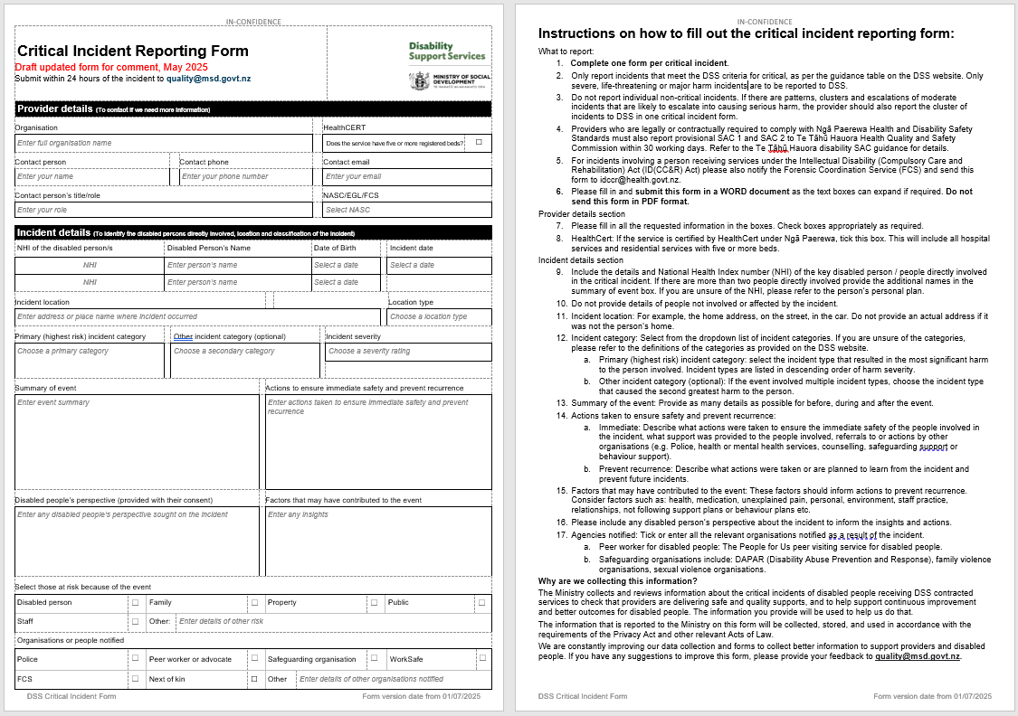
Future proposal
2.
Updated DSS critical incident form for use from 1 July 2025
Minor changes only.
Key changes to the form:
Updated incident categories
New: choose a severity level:
severe, life-threatening harm
major harm
New: boxes to indicate notification to next of kin, peer worker, or safeguarding organisation.
Rearranged to fit and flow better
Clearer instructions.
DSS will publish critical incident reporting guidance on the website.
IN-CONFIDENCE
Notes:
We have made minor changes to the form to reflect:
Feedback from providers about the current form
The changes to the DSS incident categories and aligning with SAC
The incident severity level that you choose for the incident in the first 24 hours is based on what you know at the time, and may change as events unfold and as you find out more information.
The new form will be uploaded to the DSS website ahead of the 1 July ‘go live’ date.

Slide 13
Next
Steps
3.
Action | Due by
Send your feedback to quality@msd.govt.nz. | 3 June 2025
DSS to publish the updated critical incident guidance and reporting form on the DSS website | 20 June 2025
‘Go live’: Providers use the new reporting forms from this date. DSS will accept new forms and old forms during the first 3 months transition period. | 1 July 2025
DSS contracted providers have 3 months to transition their incident processes to the new critical incident guidance, process, and reporting form | 30 September 2025
DSS funded providers must use new critical incident forms from this date. | 1 October 2025
IN-CONFIDENCE

