Slide 1
Improving recordkeeping in response to the Abuse in Care RCI – progress since August 2026
DSS Provider Quality Forum
12 August 2026

Slide 2
What you asked
What makes a “good” record? Structure? Examples?
Practical guidance, not general statements
How to manage large volumes of records that cannot be destroyed
Advice on digitisation of records – can the original be destroyed?
Best practice policy for NGOs re records management obligations
Offsite storage – is it OK?

Slide 3

The Care Records Framework
Principles for all care records processes
  Build trust – Proactive communication, follow up, and do what you say you’ll do
  Build organisational trust and competence in :
    Te Tiriti o Waitangi and relevance to care records
    Cultural competence and impacts of systemic racism
    Disability competence, responsiveness and understanding of impacts of systemic ableism
    Impacts of trauma and abuse in care in New Zealand and manage risk of vicarious trauma
Further principles for creating, managing and providing access to care records
  Emphasise co-creation, accuracy, respect, safety, and rights to access one’s own life story
  https://www.abuseinquiryresponse.govt.nz/about-us/crown-response/the-care-records-framework
Crown Response Programme

Slide 4

Working in partnership to lead change across recordkeeping in the care system
Leadership, collaboration, research, advice and guidance, standards-setting, monitoring
Working with Crown Response Office
Agency Records Working Group
Care records management working group
Other monitors – Ombudsman, Privacy Commissioner, Children’s Commissioner, etc
CAB – Kōnae; Survivor Experience Service - Records Support
Archives NZ’s own holdings
Research / analysis and reporting
General and more tailored advice
User friendly, accessible, discoverable
Taking our lead from survivors and checking back
In partnership with Māori knowledge-holders
Crown Response Programme

Slide 5
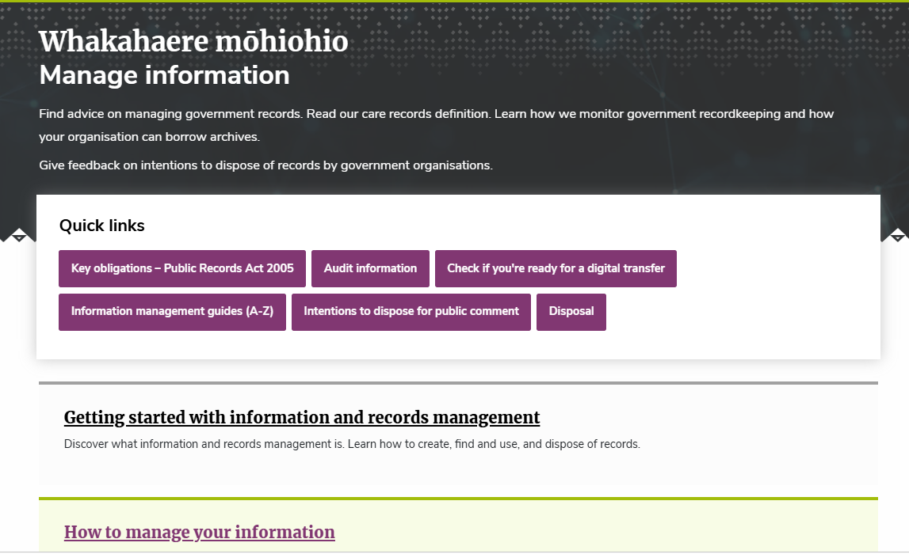
https://www.archives.govt.nz/manage-information

Slide 6


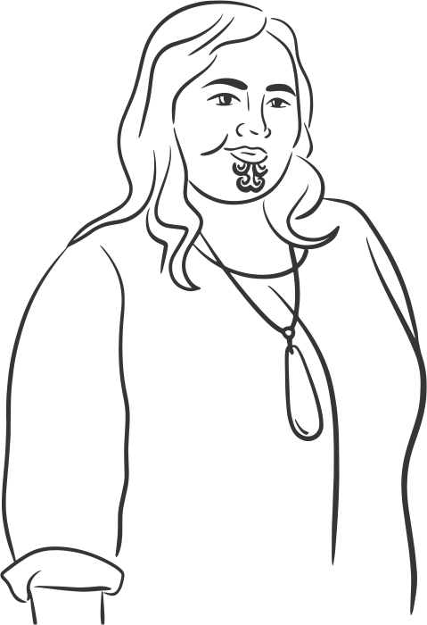


Te Rua Mahara Kāwanatanga | Archives New Zealand
Personae
Meet Aroha
The care sector service manager
Manages a diverse team with varying experience and expertise
Requires clear, practical guidance on storing care records
Significant funding and resource constraints
Needs simple, accessible communication without jargon
Guided by strong social values
Aroha is a service manager for a long-standing private care provider. She is responsible for ensuring her organisation’s record-keeping aligns with national care standards and contract specifications. She is dedicated to supporting people in their care to improve their quality of life, and to advocating for accessibility.
She needs to work within limited government resourcing. Aroha needs clear, practical guidance on how to comply with statutory requirements, particularly definitions of care records and explicit instruction on the obligations for independent/private providers.

Slide 7
Te Rua Mahara Kāwanatanga | Archives New Zealand
Top recommendations for prototyping and testing
I. Main website improvements
1
2
3
4
5
Improve the website search functionality
to be more user-friendly
and efficient, especially
for common care-related queries.
Create an easily discoverable, dedicated and prominent "Care Records" page under "Managing Information". This should be linked directly from the homepage.
Include an entry
and link under
“Care records” in
the A-Z list.
Clarify care records process with other agencies (e.g., who can request records, how they access them, and timelines for requests for inclusion in agency care record databases.
Provide explicit guidance for independent/private providers separate from the information for
"public offices".

Slide 8
Te Rua Mahara Kāwanatanga | Archives New Zealand
Top recommendations for prototyping and testing
Main website improvements
6
7
8
9
Make "how to manage records" information equally as prominent on the homepage as the "find a record" gateway.
Streamline language across the website to make it easier to read, remove jargon, and improve accessibility.
Overhaul the landing page to reduce information overload. Implement clearer routes into key sections instead of requiring significant scrolling.
Point individuals seeking care
records to Kōnae as their primary resource. Point providers to their lead government agency. It should be clear that Collections search is technical and more suited to someone with archival experience.

Slide 9
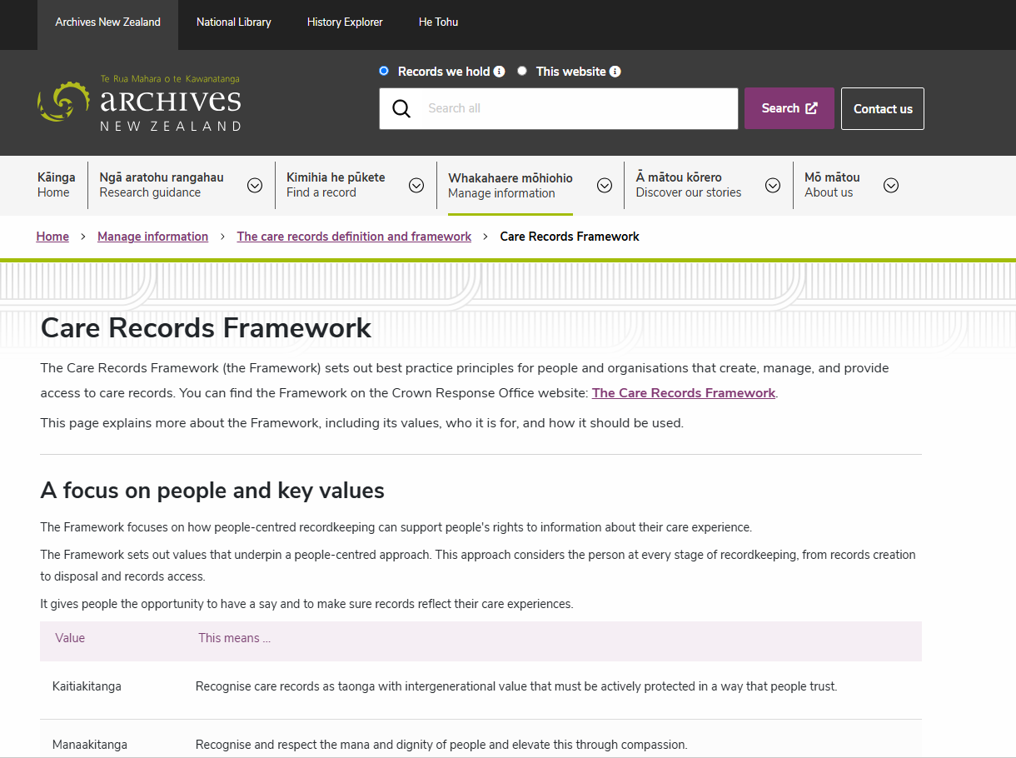
https://www.archives.govt.nz/manage-information/the-care-records-definition/care-records-framework

Slide 10
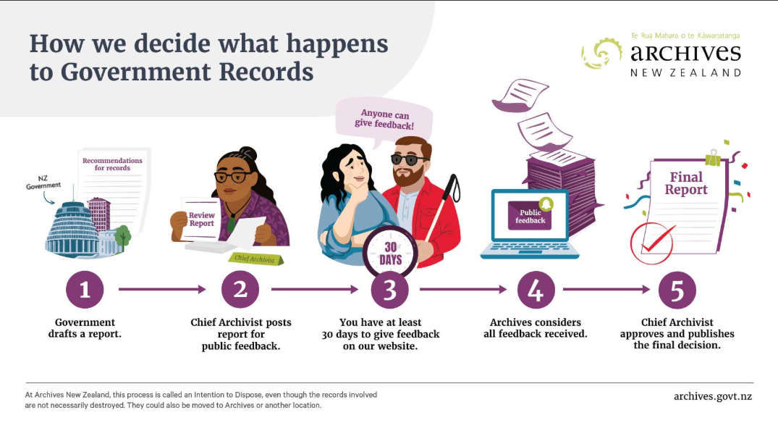

Slide 11
Disposal review – what should happen to care records?
RCI revealed problems with historic disposal of care records: too many “lost”
Barrier to justice, connection, life story
We are reviewing the rules – disposal settings
What should be kept?
For how long?
What happens to them afterwards?
Who has a say?
Crown Response Programme

Slide 12
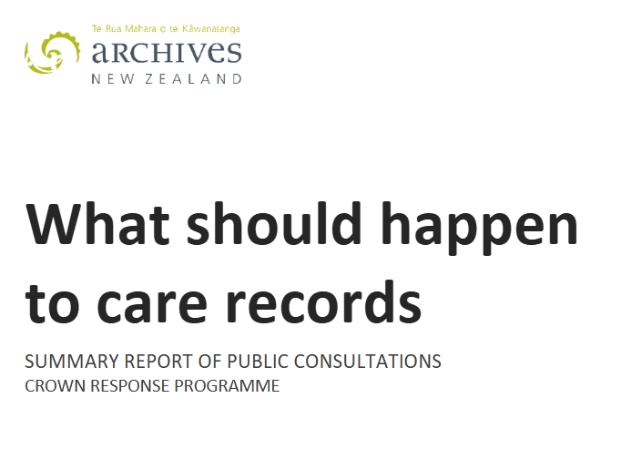
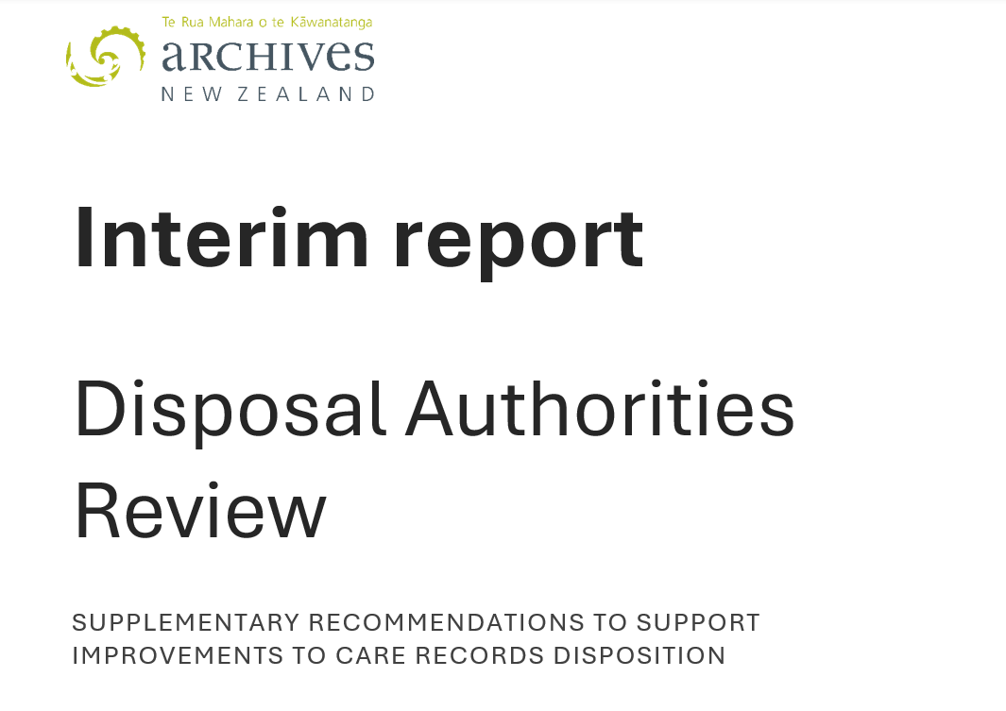

Slide 13
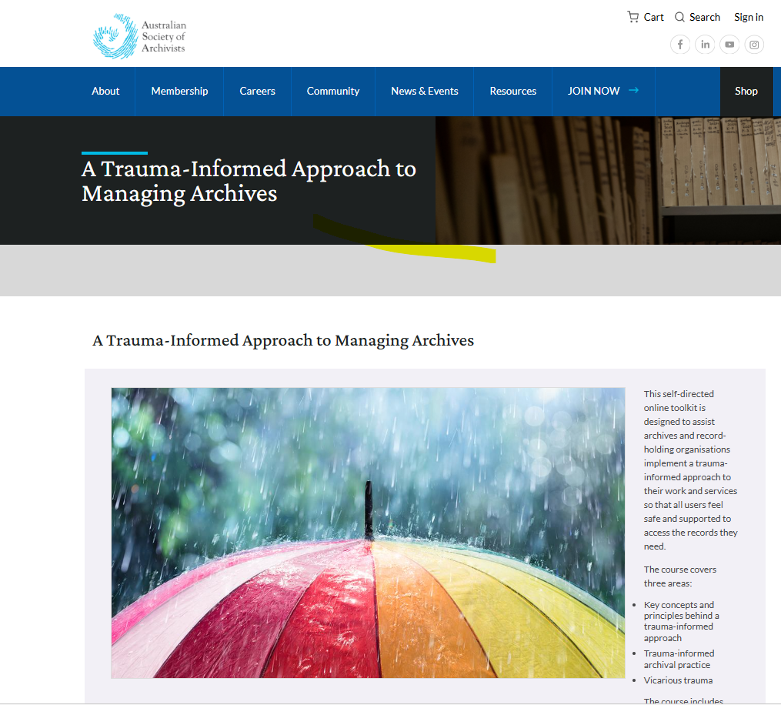
https://archivists.org.au/Web/Web/Careers/Professional-Training/A-Trauma-Informed-Approach-to-Managing-Archives.aspx

Slide 14
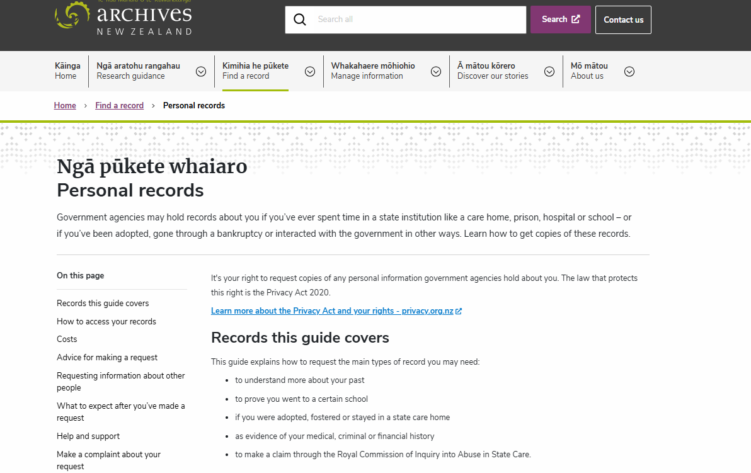

Slide 15
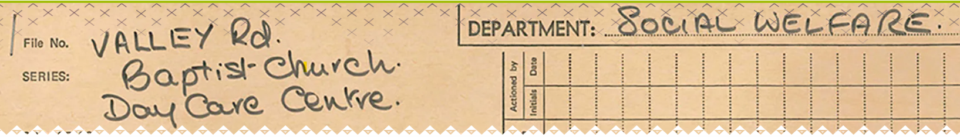
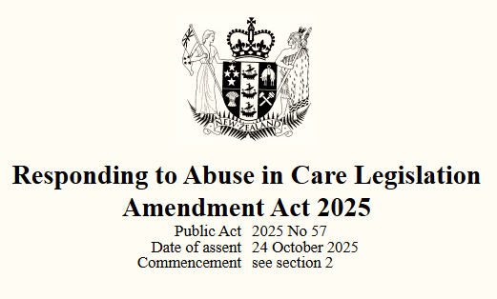
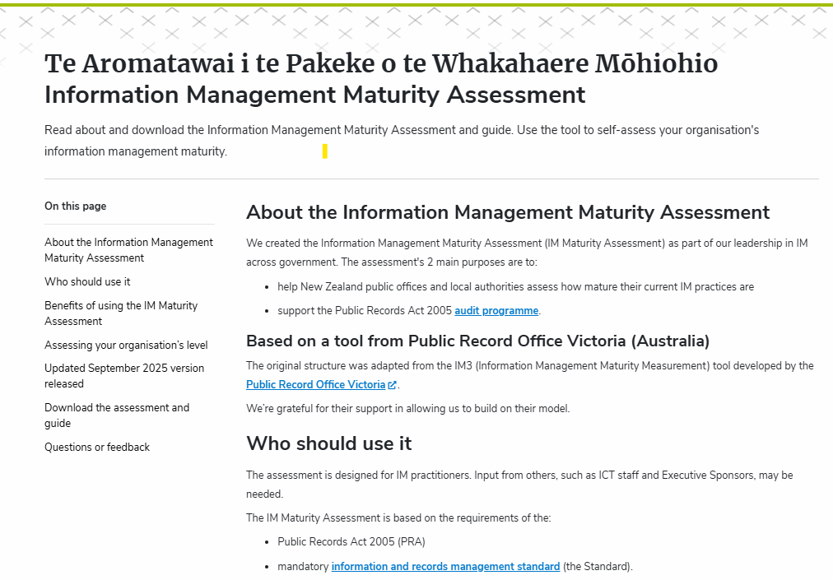
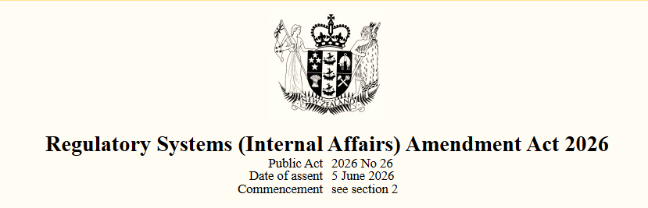

Slide 17
Care Records Framework - Purpose
The purpose is to support a care experienced person to:
Have their privacy protected and to have information about them kept safe
Be free from discrimination and to be treated with respect and dignity
Have access to information about them and their time in care
Maintain or re-establish connections with family, whānau, hapū, iwi, whakapapa, culture and community​
Preserve or reclaim identity
Hold organisations making decisions to account
Be involved in decisions that affect them and be supported to participate in those decisions
Be able to interact with, understand, challenge, and use information about their time in care, including reasonable accommodations for people with disabilities.

Slide 18

Care Records Framework - Values
Kaitiakitanga - Recognise care records as taonga with intergenerational value that must be actively protected in a way that people trust
Manaakitanga – Recognise and respect the mana and dignity of people and elevate this through compassion
He Tāngata - ​Keep people at the centre of all that you do
Tino Rangatiratanga – Uphold people’s rights and autonomy
Mahitahitanga - ​Work as equals to create and share knowledge
Whanaungatanga - Recognise and nurture the whakapapa, kinship and connections that exist between people
Ka mua, ka muri - Be open to new ideas and willing to continuously learn and improve
Whakatapoko​ - Actively promote accessibility for the whole population​

Slide 19
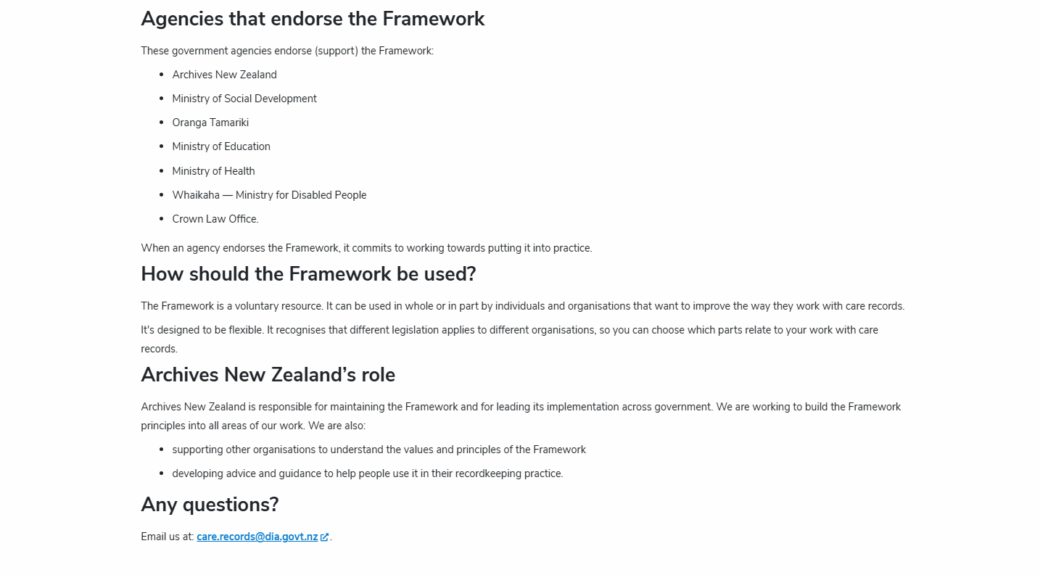

Slide 20
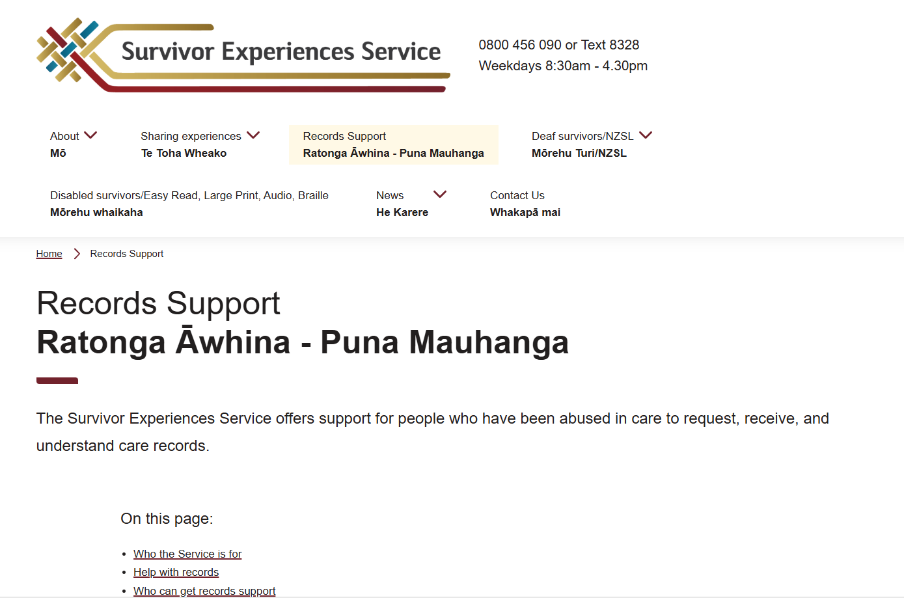

Slide 21
Te Rua Mahara Kāwanatanga | Archives New Zealand
Personae
Meet Aroha
The care sector service manager
Current experience and key tasks
Aroha is a hands-on leader who juggles many different responsibilities in her organisation, including recruiting and managing staff, liaising with government and other stakeholders, and managing funding applications.
She is responsible for ensuring her organisation’s record-keeping aligns with national care standards and contract specifications.
She needs clarity on whether her organisation is creating public records, which is complicated depending on the funding and contract for service.
Her organisation has a hybrid recordkeeping system, where current records are managed digitally in a CRM, but they still hold "boxes and boxes” of old, hard-to-access paper-based files, including handwritten notes, incident reports, and medical care records. Periodically her organisation has to try and sort through the boxes to find records.
She has never visited the Archives NZ website. If she is looking for information around care records, she’d refer to the national care standards for support services and their contract service specifications.
“My interest is around preserving a person's story really, along that journey, not just the provision of incidents a person had or what they had for breakfast. But more about the story of where their life has been, and them to being able to take that with them wherever they go as well.”
“We’re a charity and we don’t have the financial means to look after records in a fire-proof environment. It’s more by luck than design that we still have records.”

