Slide 1
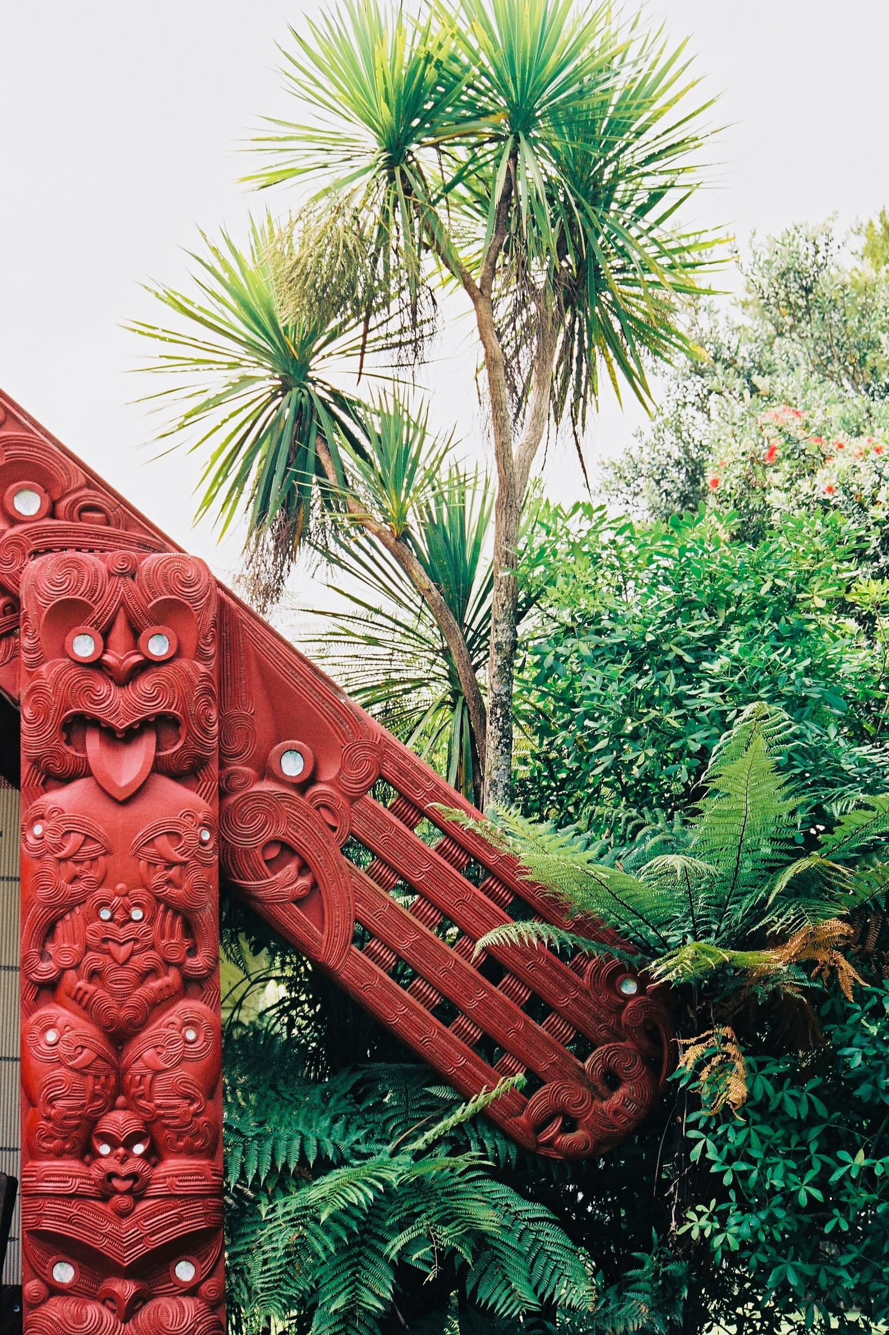
‘People for Us’
Notes:
Te Ahi Kaa

Slide 2
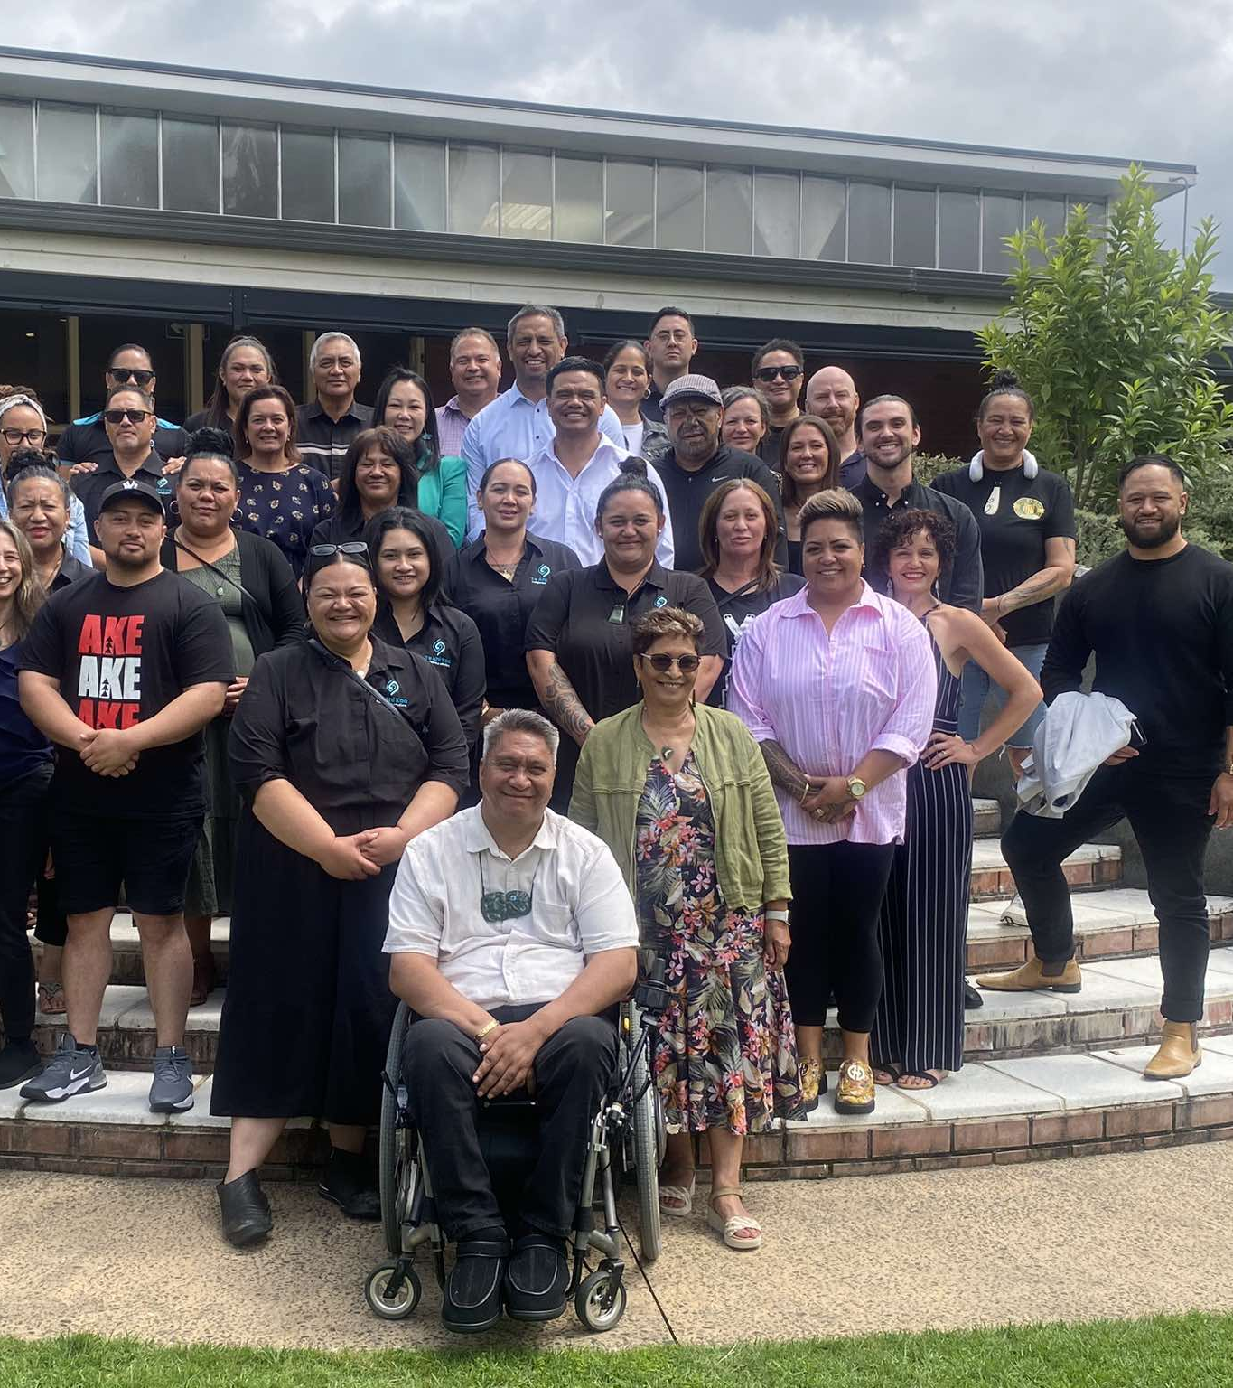
Who are we?
Kaupapa Māori provider located in Te Puaha o Waikato
Established in 2016 from the vision of our Kaumātua and whānau
Deliver health and social services including a rongoaa clinic
Services grounded in Mātauranga Māori, Te Puahatanga, Pūrākau
Notes:
Te Ahi Kaa Which extends from Mercer, Pukekohe, Down to Port Waikato.

Slide 4
How will we engage with providers?
1. Waharoa (Carpark)— Establishing Intentions and Trust
2. Karanga – Respect and inclusion through the recognition of each others role and contribution
3. Whakaeke (Entry) —Respectful and mindful entry into the space with openness and readiness to engage
4. Mihi (Speeches) — Sharing Stories and Intentions
5. Waiata (Song) — Supporting and Strengthening Connection
6. Hongi (Pressing of Noses) — Building Close Connection and Trust
7. Hakari (Feast) — Celebrating Partnership and Collaboration
8. Poroporoaki (Farewell) — Ending with Respect and Future Intentions
Notes:
1. Wero (Challenge) — Establishing Intentions and Trust
Use this stage to clarify the purpose of engagement and ensure all parties come with good intentions.
It can involve an initial conversation or meeting where providers express their goals, values, and commitment to partnership.
2. Karanga (Call) — Welcoming and Acknowledgment
It sets a tone of respect and inclusion, making providers feel valued and connected.
3. Whakaeke (Entry) — Moving into the Relationship Space
This stage represents the gradual building of the relationship and being ready to participate fully, sharing their perspectives and expertise.
It encourages respectful and mindful entry into the collaborative space, emphasizing openness and readiness to engage.
4. Mihi (Speeches) — Sharing Stories and Intentions
Share their backgrounds, aspirations, This deepens understanding and builds rapport by allowing each party to express their identity and intentions.
It can be done through presentations, storytelling, or dialogue sessions.
5. Waiata (Song) — Supporting and Strengthening Connection
affirming shared goals, celebrating milestones, or reinforcing commitment through positive feedback and encouragement.
It helps maintain morale and collective spirit.
6. Hongi (Pressing of Noses) — Building Close Connection and Trust
In engagement, this can be mirrored by moments of genuine dialogue, active listening, and empathy.
It encourages openness, vulnerability, and the building of strong relational bonds.
7. Hakari (Feast) — Celebrating Partnership and Collaboration
A shared meal or informal gathering can be used to celebrate the partnership.
This stage fosters informal relationship building, networking, and cultural exchange.
It reinforces the social and communal aspects of collaboration.
8. Poroporoaki (Farewell) — Ending with Respect and Future Intentions
Conclude meetings or engagements with formal farewells that acknowledge the time spent together.
This includes expressing gratitude, summarizing agreed actions, and setting intentions for ongoing collaboration.
It leaves the relationship on a positive note, encouraging future engagement.

Slide 5
A few things that might be helpful…
We will start in Kirikiriroa and over time expand ‘People for us’ through the greater Waikato Region
We want to start small and build….we want to get it right!
We will have our website up and running which will provide pathways into ‘People for Us’…any door will work!
We will have an established space in Kirikiriroa that we invite you to come and visit and have a cup of tea and if your lucky some hot fried bread ☺

