Slide 1


PEOPLE FOR US
Safeguarding our Pacific Communities
PRESENTED BY
TEVITA MANUOPANGAI TUITA

Slide 2


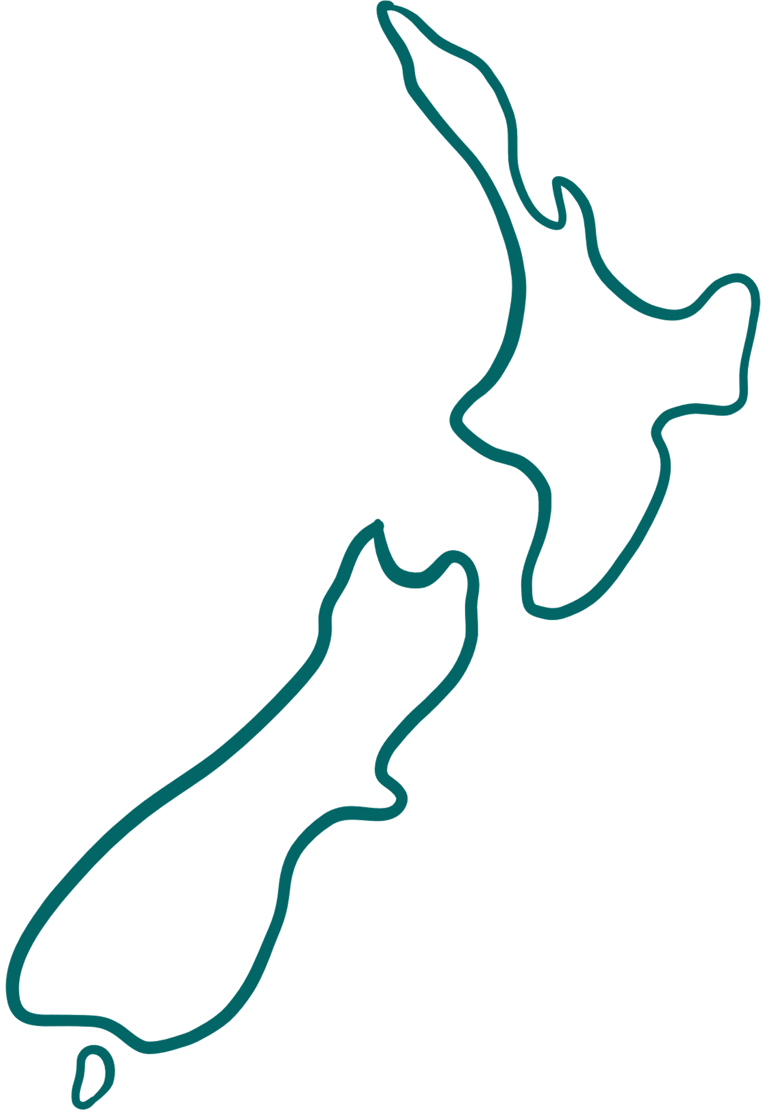





VAKA TAUTUA
Nofo a Kāinga - Families caring for families
AUCKLAND
Aiga Fiafia
Ola Fiafia
Matua Ola
Tupe Wise
Ola Lelei
Tagata Sa’ilimalo
Our mission:
Our mission is to strengthen ‘Nofo a Kāinga’ by connecting families with the services and supports they need to live their best life.
WELLINGTON
CANTERBURY
Aiga Fiafia
Ola Fiafia
Tupe Wise
Ola Lelei
Tagata Sa’ilimalo
Aiga Fiafia
Ola Fiafia
Tupe Wise
Ola Lelei
Tagata Sa’ilimalo
OTAGO
Aiga Fiafia
Ola Fiafia
Tupe Wise
Ola Lelei
Tagata Sa’ilimalo

Slide 3


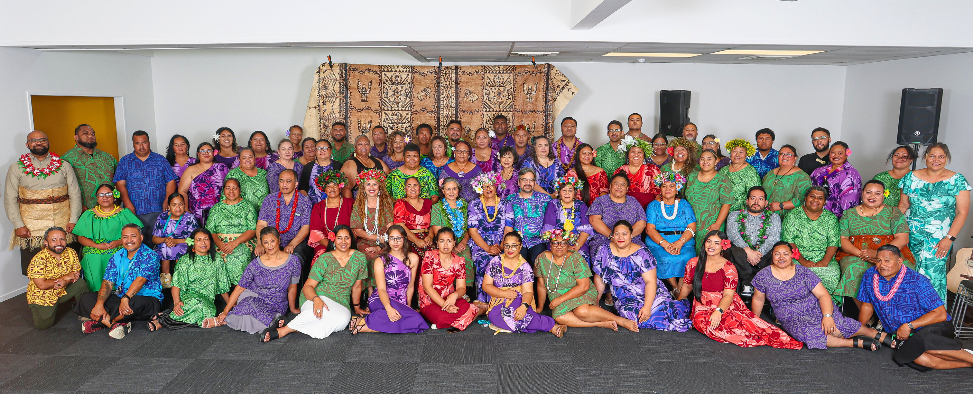
OUR PEOPLE
Skilled, Culturally Competent & Diverse

Slide 4



‘PEOPLE FOR US’
  Created in response to findings from the Royal Commission of Inquiry into Abuse in Care
  Designed to ensure safety and wellbeing inside residential disability homes
We prioritise:
  Listening to people who are often not heard
  Building trusted relationships
  Cultural and communication responsiveness

Slide 5


HOW DO WE DO THIS WORK?
  Peer workers with lived experience lead conversations with disabled people
  Use of easy-read resources, visuals, and culturally relevant tools
Engage with:
  Tagata Sa’ilimalo and their families
  Residential disability providers and whānau
  Support pathways when concerns are raised (Abuse Response Pathway)

Slide 6



OUR PACIFIC STRENGTHS IN ACTION
  We draw on Pacific shared values: alofa, respect, vā, talanoa
  Collaboration with families and providers
  Stories shared are treated with care and confidentiality
  Empowering people to recognise their rights and wellbeing

Slide 7


TOGETHER WE MAKE THE DIFFERENCE
  "People for Us" is not just a service – it's a movement of safeguarding
  We honour the voices of disabled Pacific people
  Let’s continue to uplift, protect, and stand alongside our communities

