Slide 1
Working as a Kaiārahi
Natasha Brown

Slide 2
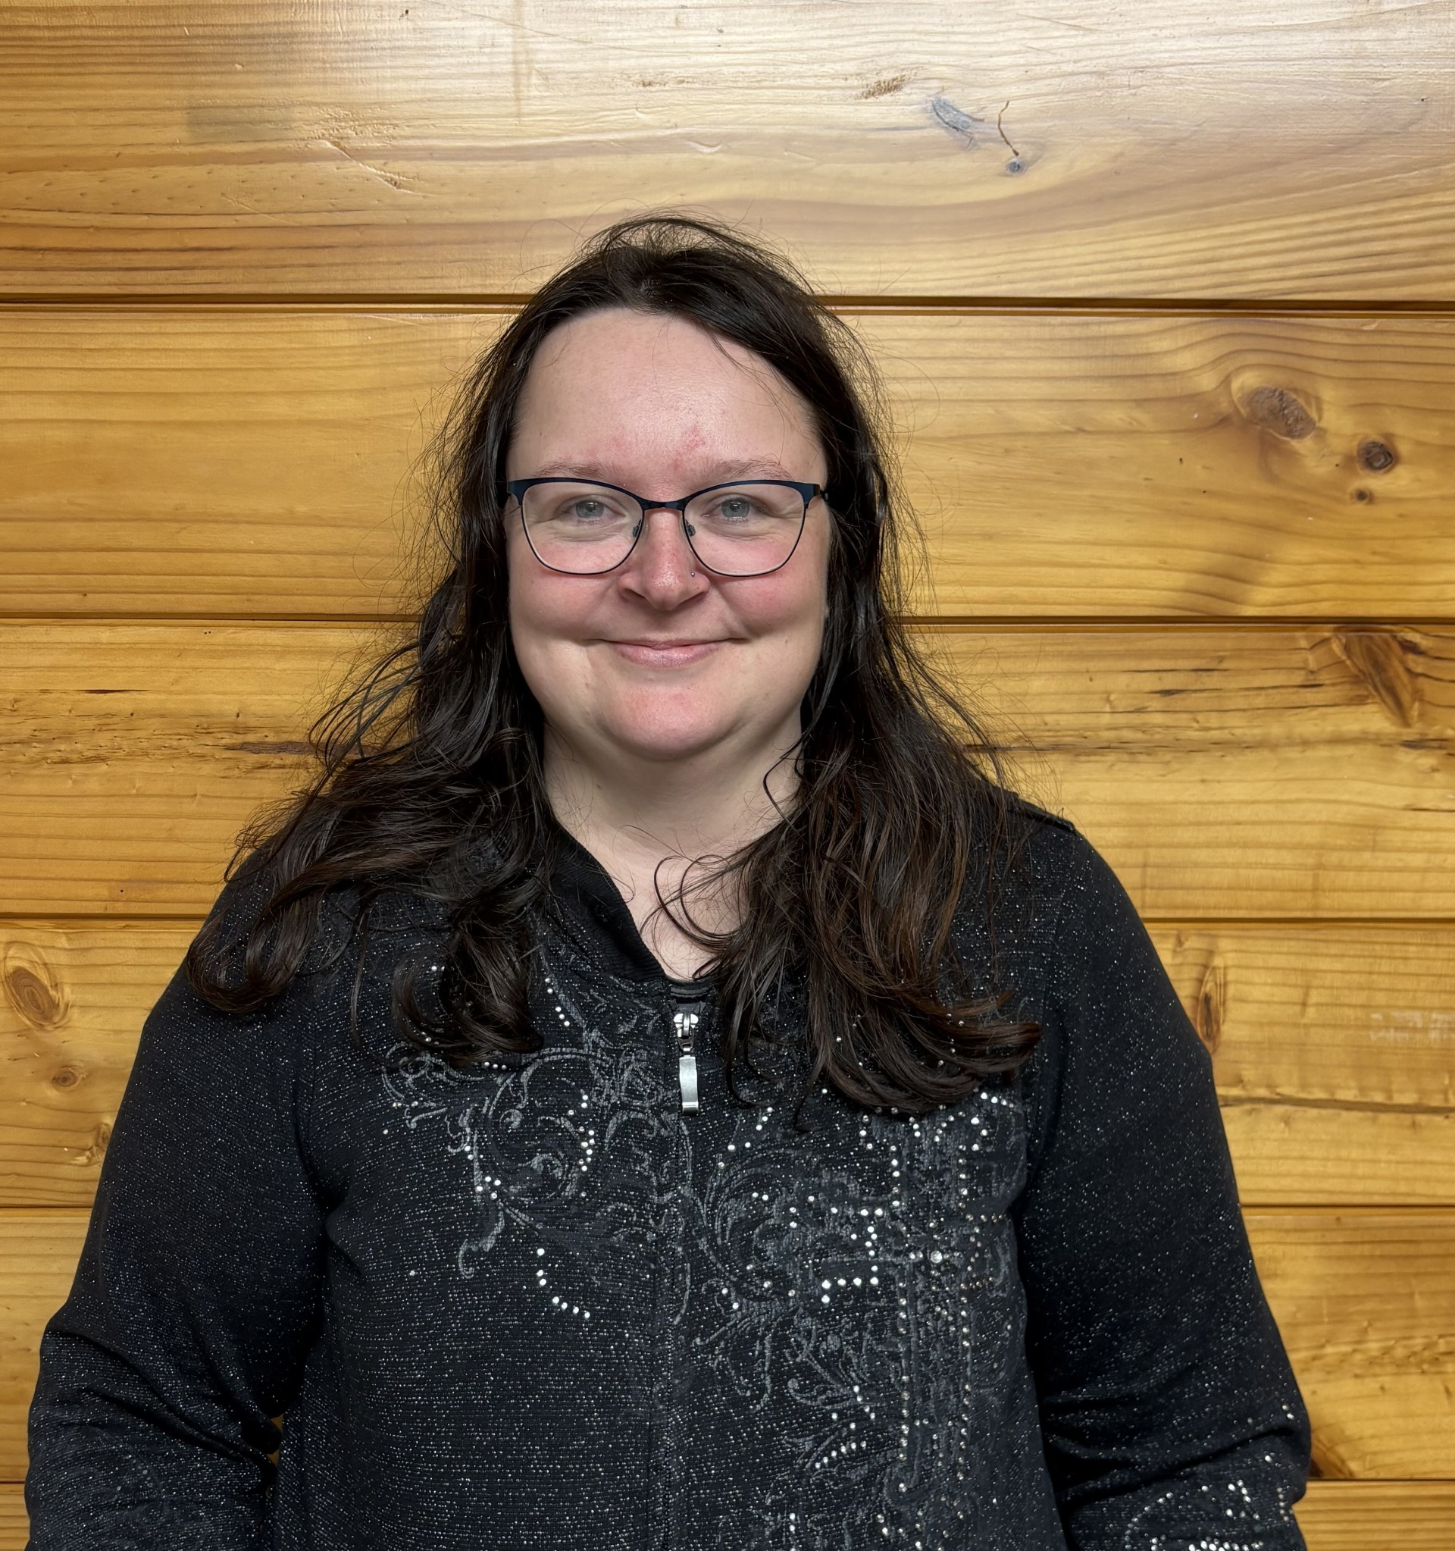
Who am I?
Natasha Brown.
Notes:
I am one of the 6 peer workers that are employed by people firsts People for us team.
Im also one of the peer workers that was first employed to be part of the pilot team.
All my life, I have wanted to help and advocate for other people with disabilities. People for us has given me that opportunity and Im glad to be able to share it with you today.
One thing that did make it hard is that fact that I have extra health needs that I have to manage while also doing my best to stay involved in the work but with support from the team, Ive been able to give it my best.

Slide 3
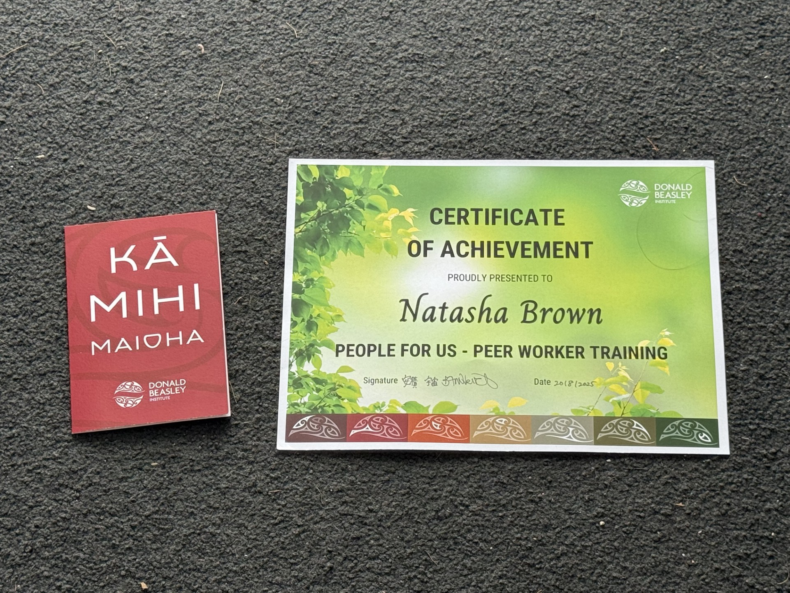
My certificate
Notes:
When we finished that training, we were all sent our certificates, which I am really proud of myself for. The training leader wrote a card and in it she said:
(Photo of the card and certificate)
I hear you are doing great of it, which is no surprise of course! Natasha, what can we say, you are a natural social justice warrior. Your energy for and commitment to this role are second to none. This training has just given you the tools to do what you have been working toward for a long time. Your passion for advocacy is so obvious and we know peoples rights will always be upheld, when you are around.

Slide 4
What it means to me
Notes:
Working alongside the first kaiārahi were the Kaiāwhina. My first was Kaysey and she lives in Auckland.
Its really good to get to know one another as it helps with the job. Communicating with each other is the key to our work, as understanding and learning happens at the same time. We have become quite close and this makes meeting our people much easier. When I spoke to Kaysey, the kaiāwhina I trained with and was also on the pilot team, she says its like being two sides of the same coin. We are doing one job but both sides are needed.

Slide 5
THANK YOU

