Slide 1



Disability
Support Services:
Enhanced Audit Provider Forum Session 2
29 April 2026

Slide 2

Agenda
1 | Timeline update | 03
2 | Overview of Communication Plan | 04
3 | Pre audit process | 09
4 | During audit process | 10
5 | Post audit process | 11
6 | Our KPMG Whānau | 12
7 | Q&A | 13

Slide 3
Overview of Timeline
 | 2025 | 2026
 | Dec | Jan | Feb | Mar | Apr | May | Jun | Jul | Aug | Sep | Oct | Nov | Dec
Step 0: Programme Initiation
Step 1: Design Audit Framework
Step 2: Test and Validate Audit Framework
Step 3: Build Data Collection Audit Tool
Step 4: Plan & Schedule Audits
Step 5: Train Team |  |  |  |  |  | Ongoing review and refinement as required
Step 6: Deliver Audits
Step 7: Reporting and Insights
Establish governance and reporting structures
Finalise project plan and timelines
Create stakeholder and provider communication plans
Ongoing review and refinement of communications and FAQs as required
Progress advisory groups to capture disability voice
Build audit framework
Test framework with advisory groups
Identify, schedule and develop initial audits
Ongoing review and refinement as required
Ongoing engagement with advisory groups
Refine and update framework post lessons learned
Define user requirements
Build, test and validate data collection tool with reporting capability
Build reporting layer
Develop scheduling approach
Agree audit schedule
Progress audit communications
Develop training material
Test training curriculum
Ongoing team training, debrief and lessons learned
Train team
Conduct type 2 audits
Conduct type 5 audits
Develop reporting template
Provide reports and system level insights to providers, group homes and services

Slide 4
Goal
Overview of Communication Plan
To provide assurance and clarity to DSS Providers and individuals about who is coming into their homes, why they are visiting, and what the audit involves, in order to build trust, support readiness, and enable cooperative participation.
Communication Packs | 5 weeks out (25 working days) | 4 weeks out (20 working days) | 1 weeks out (5 working days) | 1 week after (5 working days)
 | Advice of upcoming visit Validation of people and homes Desktop evaluation information request
 |  | Individual(s) communication – accessible & Easy Read Whānau communication
 |  |  | Reminder of audit & confirmation
 |  |  |  | Close out/follow up on factual accuracy
Pre audit
Post audit

Slide 5
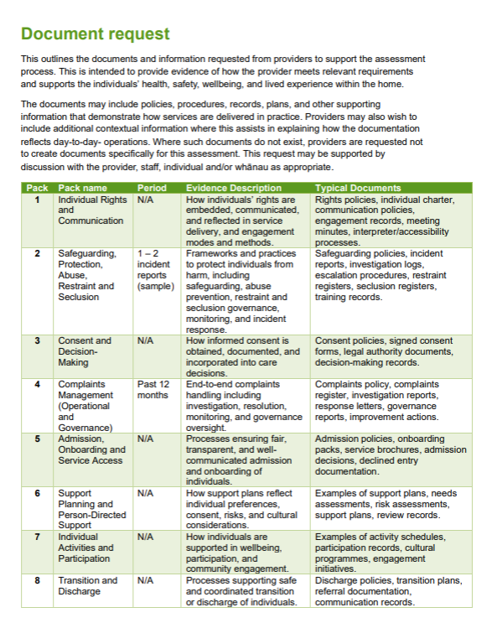

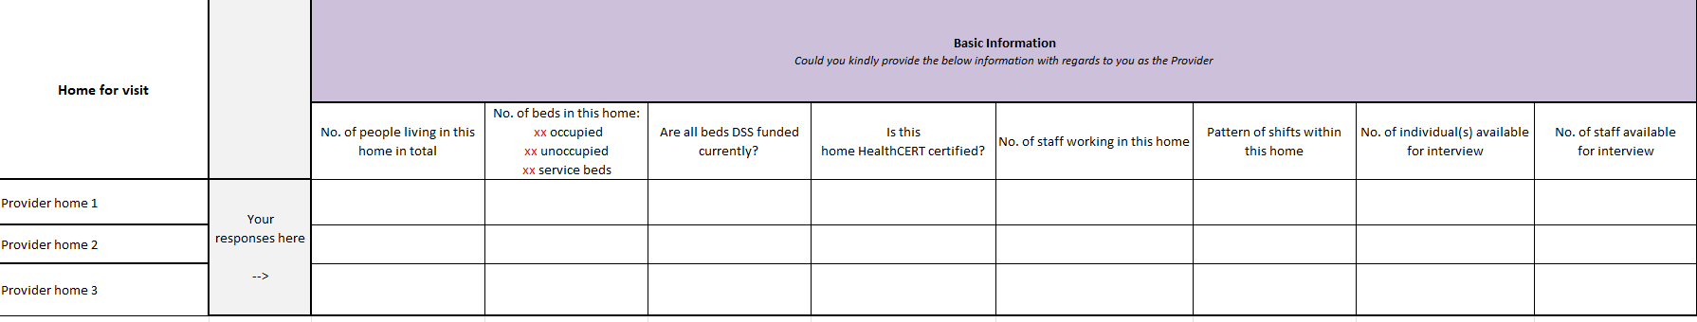
Communication Pack 1 sample
(E-mail)
Purpose: To inform
Provider information
Validation of people and homes
Information request

Slide 6

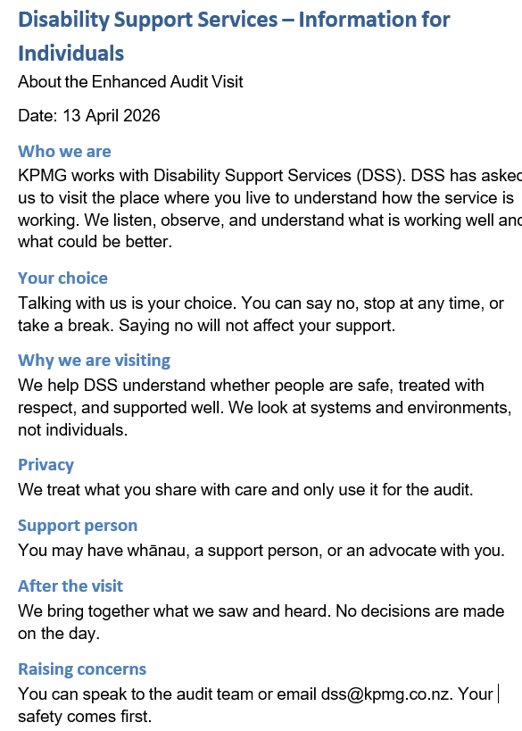


Communication Pack 2 sample
(E-mail)
Purpose: To prepare
Individual information
Whānau communication
Individual - accessible
Individual - easy read

Slide 7
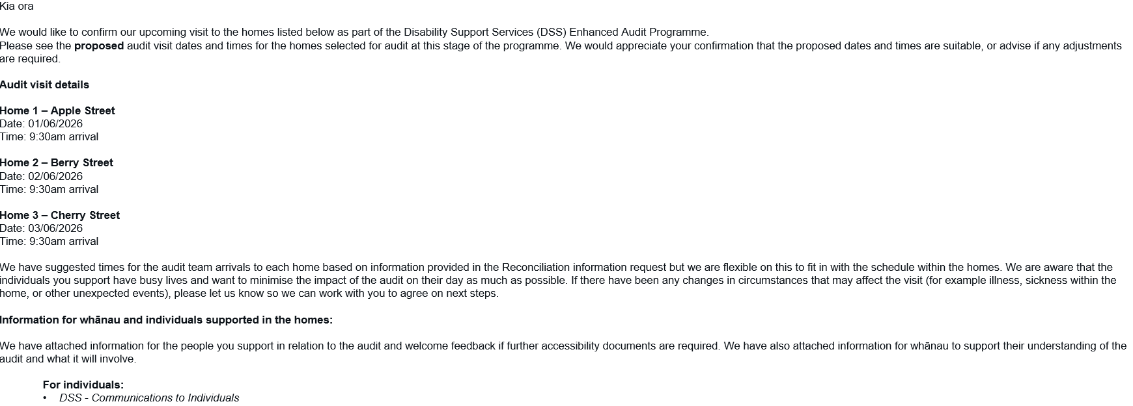
Communication Packs 3 sample
(E-mail)
Purpose: To remind
Reminder & confirmation email

Slide 8
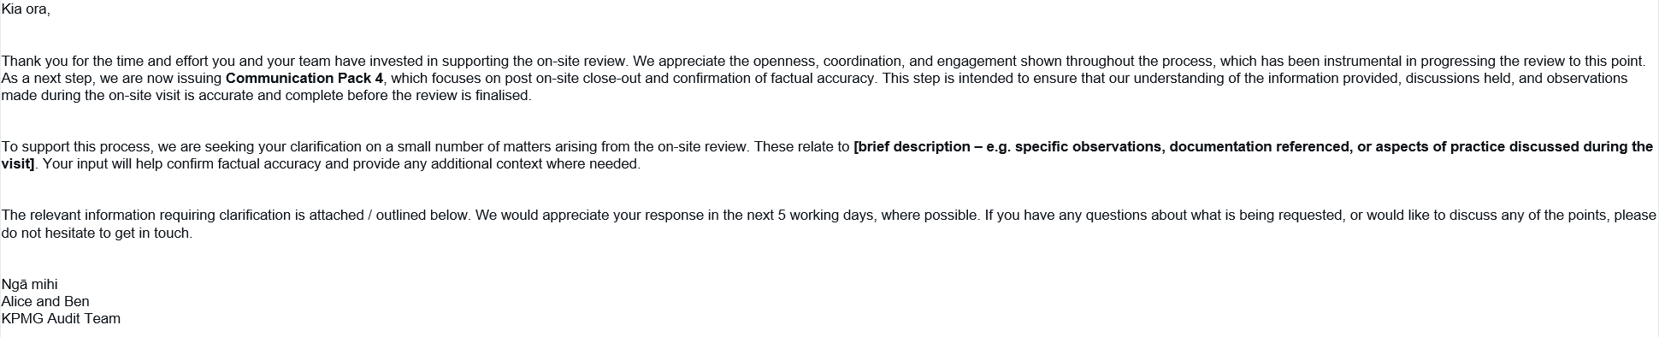
Communication Packs 4 sample
(E-mail)
Purpose: To clarify
Close out and factual accuracy check

Slide 9
Pre audit process
Communications Pack 1
Communications Pack 2
Communications Pack 3
KPMG
Circulate information to relevant staff
Respond to validation of people and homes request
Upload desktop evaluation information
Circulate information to Individuals and their whānau
Provider
5 weeks out
(25 working days)
4 weeks out
(20 working days)
1 week out
(5 working days)

Slide 10
During audit process
Perform audit
If audit team cannot complete audit by end of day
(see below)
Arrival on-site
Departure from site
KPMG
Notified of audit progress and the need to pause - schedule next best available time.
Provider
Scheduled time
Mid-way through audit
End of day

Slide 11
Post audit process
Communications Pack 4
Audit report finalized and shared with DSS
KPMG
Circulate information to relevant staff
Respond to any factual clarification(s)
Follow up on any documentation requests
Any recommendations addressed by the Provider and DSS
Provider
2 weeks post audit
(10 working days)
Monthly

Slide 12


































Our KPMG Whānau
Our KPMG team is proud to be involved in the Disability Support Services (DSS) Enhanced Audit, bringing together specialists from across Aotearoa New Zealand to support a nationally significant programme. Working collaboratively across regions, our team provides independent, robust assurance with a strong focus on safeguarding, service quality, and continuous improvement, while engaging respectfully with providers, whānau, and communities.
DSS Workstream Leads
Peter Chew
Lead Partner
Te Whanganui-a-Tara
James Poskitt
Design Lead
Te Whanganui-a-Tara
Emma Williams
Delivery Lead
Te Whanganui-a-Tara
Abtin Maghsoodi
Analytics Lead
Tāmaki Makaurau
Kirill Voronchev
Audit Excellence Lead
Te Whanganui-a-Tara
Timoti Brown
Pou Whakatere
Te Whanganui-a-Tara
Kirsten Pullbrook
Disability Sector Audit SME
Ahitereiria
Accountable for project quality and delivery
Disability SME
Clinical Insights Lead
Digital Tool SME
Audit Insights
Cultural Advisor
Provides insights into disability audit design and approach
Disability Voice
Advisory Group
Clinical Advisory
Group
Set up and build
Design Audit Framework Team
Planning and Logistics
Digital Tool Build
Danielle Brosnan
Te Whanganui-a-Tara
Neha Telang
Te Whanganui-a-Tara
Teina Williams
Tāmaki Makaurau
Lead
Ben Orr
Te Whanganui-a-Tara
Kate Riley
Te Whanganui-a-Tara
Nathaniel Charles
Ōtautahi
Emma Lomas
Te Whanganui-a-Tara
Training Lead
Sakila Wanigasinghe
Te Whanganui-a-Tara
Delivery Team
Sai Rahul Chowdavaram
Te Whanganui-a-Tara
TBC
Kaylah Stirling-Kelly
Tāmaki Makaurau
Tino Barclay
Tāmaki Makaurau
TBC
Ethan Mackay
Tāmaki Makaurau
Kaea Gillman
Te Whanganui-a-Tara
Upeksha Khatri
Kirikiriroa
Deliver audits
TBC
Savannah
Phillips-Cron
Otepoti
Avnit Prasad
Tāmaki Makaurau
Hugo Verry
Tāmaki Makaurau
Claire Lucas
Tāmaki Makaurau
Sarah Manogarom
Tāmaki Makaurau
Helen Shrimpton
Te Whanganui-a-Tara
Signy Randell
Tāmaki Makaurau
San Leong
Tāmaki Makaurau
Isi Tuivaga
Te Whanganui-a-Tara
Harrison Pett
Kirikiriroa
Jess Longley
Ōtautahi
Ashley Thew
Tāmaki Makaurau
Document Classification: KPMG Confidential

Slide 13
FAQs
How will the day be structured?
We’ll be guided by you and the individuals we are visiting. We understand they have busy lives, as they should, so will be guided by you and them as to what works.
Do you want to meet staff and leadership?
Yes please. Staff do not need to come in on their day off unless they want to. For the first time we visit you it would be good to get an overview of the Trust / Organisation.
Do you want to meet whānau?
Yes, if they would like to meet us. We can meet them face to face on site or via phone.
How much time do you want to spend in each home?
We will be guided by the individual(s) we visit.
Which auditors will be going to which home?
We will provide you with this information and provide you with video links and bios for each auditor relevant to the home they are visiting.
This time doesn’t work for us: can we reschedule?
With a large volume of homes to visit and audits to undertake, rescheduling becomes difficult. We will work with you as best we can in certain circumstances, i.e., individual is on holiday, sickness, serious incident.
Will the day start with a meet and greet with managers / service leaders?
This is up to you as the provider. We have certainly found this helpful, and we would certainly like to meet the individuals with someone they know in the first instance.
Do you want to review desktop information daily as it relates to the homes being audited on that day?
We request a list of documents to review pre the home visit. This enables us to prepare for what we want to see and ask on the day.
However, support plans, vocational plans etc. will be reviewed on the day of the home visit as they pertain to the home and individual we are visiting.
Please note; we do not wish for you to share personal support plans ahead of time. Please provide an example/template only. We will view the actual plans on the day of the visit.
We work in a live system. Can you just look at the documents online instead?
We require the documents to be shared with us to enable them to be reviewed ahead of time and to be kept together with the audit report.
We don’t have that document.
That’s okay – please don’t create anything new.
This individual does not want you in their home and/or to talk to you.
We will discuss instances like this with the provider on a case-by-case basis. We understand it can be uncomfortable having people in your home.
For example, there may be an option to talk to whānau instead or for the person to write to us to tell us about their experience.

Slide 14
Q&A

Slide 15
Ngā Mihi
This presentation has been prepared by KPMG, a New Zealand partnership (KPMG, our), and provides a summary of how KPMG will approach the work to be undertaken for The Ministry of Social Development (Client) under the terms of our contract with Client dated 12/12/2025 (Engagement Contract). The contents of this presentation do not represent our conclusive findings, which will only be contained in our final deliverables. No reliance should be placed on additional oral remarks provided during the presentation, unless these are confirmed in writing by KPMG.
This presentation is provided solely for Client’s information and is not to be copied, distributed, quoted or referred to in whole or in part without KPMG’s prior written consent. KPMG, its controlled entities and their respective partners, officers and employees accept no responsibility to anyone other than Client for the information contained in this presentation. Any third party choosing to rely on this presentation does so at their own risk. Although we endeavour to provide accurate and timely information, there can be no guarantee that such information is accurate as of the date it is received or that it will continue to be accurate in the future. No one should act upon such information without appropriate professional advice after a thorough examination of the particular situation.
© 2026 KPMG, a New Zealand Partnership and a member firm of the KPMG global organisation of independent member firms affiliated with KPMG International Limited, a private English company limited by guarantee. All rights reserved.
Document Classification: KPMG Confidential
kpmg.com/nz

