Slide 1
Global Pricing Tool
Providing an overview of the Global Pricing Tool (GPT).
The GPT will be used in the setting of prices for community residential supports. The model will inform both current pricing and sustainable pricing into the future.
These supports are commissioned under agreements for community residential support – intellectual disability and physical disability
The GPT model doesn’t cover supports delivered through aged residential care rest homes or hospitals or under the High and Complex Framework.

Slide 2
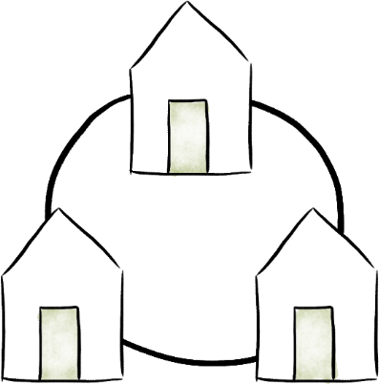
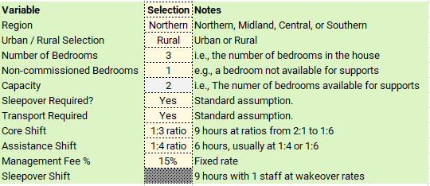
The GPT informs DSS pricing
The GPT estimates fair and reasonable prices for community residential supports using estimated costs.
It considers a range of house sizes and capacities, in different regions, with different levels of support delivered.
Providers will be expected to deliver services within the allocated funding levels and in accordance with the agreements, service specifications and performance standards.
More than 1000 combinations of the variables below are considered in the GPT.
Providers will be funded through rates that are informed by the GPT cost modelling.
Each provider has their own business model. It is not the intention to instruct providers on how to operate their businesses.
Example of variables:
For example, the management fee of 15% is a fixed assumption.
In practice, different providers will have different management structures, different resulting costs, and will even define management costs in different ways.

Slide 3
GPT assumptions
The GPT makes informed assumptions about the costs of delivering community residential support by a range of data, including:
Support worker remuneration is based on the Pay Equity levels including oncosts. Care coordinator remuneration was benchmarked using carers site data.
Sleepovers are included for all houses at the support worker labour rates (i.e., “wakeover” rates).
Food, laundry, household supplies, market rentals, telecommunications, transport, and stationary costs are benchmarked against Household Economic Survey (HES) data from Statistics NZ.
Utility costs are benchmarked against rates from major electricity retailers; insurance against major insurance companies; and water costs against utility provider rates.
Furniture and fitout have been determined based on costs sourced from major furniture retailers.
Specialist services, office equipment, and lawn mowing / maintenance are based on rates from current pricing tools, adjusted to reflect current costs.
Overheads such as facilities management, administration and accounting were benchmarked based on aggregated carers site data. Management fees are calculated at 15%, based on the overheads of similar organisations and provider engagement.
Cost groups
Staffing
Client Related Expenses
Core Housing Costs
Maintenance & Utilities
Provider Overheads
Main cost components
Salaries & wages
(Support worker, care coordinator, etc)
Food
Market rent by location
Insurance
Management staff
Pay equity (to date)
Laundry
Furniture and fitout
Property maintenance
Admin & accounting staff
Sleepovers / Wakeovers
Specialist services & therapy
Household supplies
Telecom
IT costs
Transport Costs
Water & Power
Facilities management
Additionally, some costs are augmented with provider information, reflecting their specialist nature (e.g., wheelchair-enabled vans on a 5-7 year replacement cycle).

Slide 4
Understanding the Banded Rates
Indicative Banded Rates
MSD is informed by the GPT and sets contract rates for supports.
We expect that about 90% of people will be funded on a banded rate.
There will be 6 banded rates in each of the 4 regions.
NASCs will use a tool to determine the rate that applies to each person supported.
Northern Region
Midlands Region
Band | Rate
Band 1 | $320.00
Band 2 | $410.00
Band 3 | $490.00
Band 4 | $670.00
Band 5 | $830.00
Band 6 | $960.00
Band | Rate
Band 1 | $320.00
Band 2 | $400.00
Band 3 | $490.00
Band 4 | $630.00
Band 5 | $720.00
Band 6 | $850.00
These rates replace current funding streams from:
Existing day rates
Sleepover top-ups
Support Worker Pay Equity Advance Interim Payments (AIPs)
Day Activity Contributions (YP-DAC).
Central Region
Southern Region
Band | Rate
Band 1 | $320.00
Band 2 | $400.00
Band 3 | $490.00
Band 4 | $630.00
Band 5 | $730.00
Band 6 | $840.00
Band | Rate
Band 1 | $310.00
Band 2 | $390.00
Band 3 | $480.00
Band 4 | $660.00
Band 5 | $810.00
Band 6 | $910.00
All rates are client contribution inclusive.
The following are not included in the new day rates:
Extraordinary costs agreed with MSD,
Day Activity Services (YP-DA) and Vocational Services, which will continue to be allocated and funded as per usual processes.
Other supports allocated by NASCs, such as behavioural support services.
The rates above are indicative. They illustrate the approximate rates for each band/region. The final rates will be determined once DSS completes a data validation process with providers, which is scheduled for June / July 2025.

