Slide 1
Healing, learning and improving from harm
Caroline Tilah, Senior Manager System Safety
Leona Dann, Specialist System Safety Rebekah Mitchell, System Safety Advisor
May 2025

Slide 2
We will cover:
How the policy and associated reporting to Te Tāhū Hauora is about being open to learn, share and improve
Draft Severity Assessment Code guide for disability service providers
More information and ongoing support

Slide 3
Who are we?
Tāhū
Heke
Niho taniwha
Mission:
Whakauru. Whakamōhio. Whakaawe. Whakapai ake.
Involve. Inform. Influence. Improve.

Slide 4
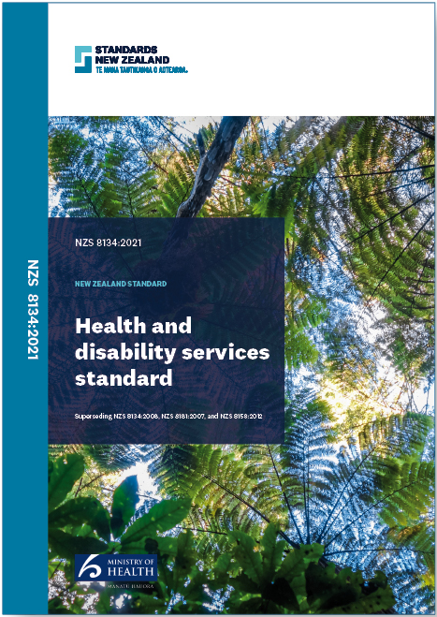
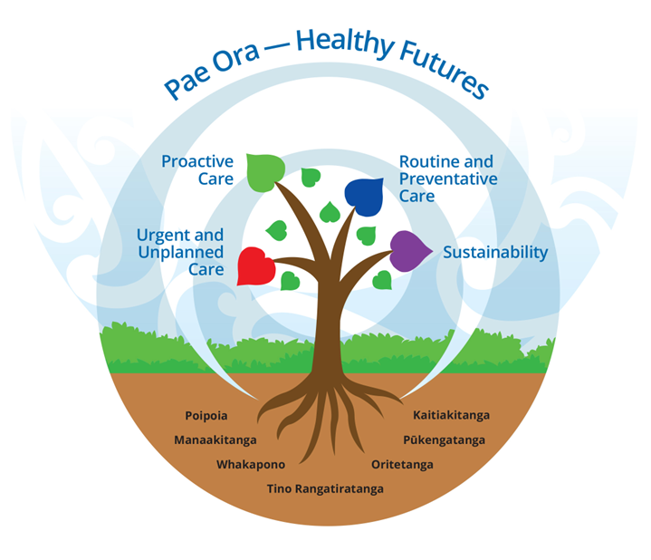
Regulatory changes

Slide 5
Healing, learning and improving from harm: National adverse events policy 2023

Slide 7
Definition of harm
Negative consequences for consumers and whānau directly arising from or associated with plans made, actions taken or omissions during the provision of care rather than an underlying disease or injury
Notes:
​

Slide 8
Forms of harm
Physical: harm that leads to bodily injury or impairment or disease. This includes limitations in cognitive functioning and skills, including communication, social and self-care skills​​
Psychological: harm that causes mental or emotional trauma, behavioural change or physical symptoms​​
Cultural: the marginalisation of a consumer’s belief and value systems​​
Spiritual: (also known as spiritual distress) – a state of suffering, related to the impaired ability to experience meaning in life through connectedness with self, others, world or a superior being

Slide 9
Policy principles
Consumer and whānau participation
Culturally responsive practice
Equity
Open communication
Restorative practice and hohou te rongo (restorative responses)
Safe reporting
System accountability
System learning

Slide 10
Why the learning review?
Suited to events within a complex system
Address the biases of traditional methods
Shifts from blame to understanding
Reduces compounded harm
Values care workers work and insights
Promotes a learning and improving culture
Shifting assumptions through new review techniques

Slide 11
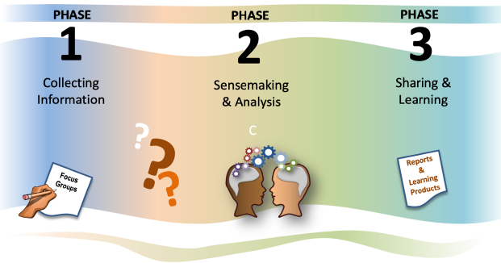
The learning review
A phased approach to understanding the event and recommending changes

Slide 12
An example from a Disability Support Service

Slide 13
Putting it all together: moving from compliance to learning
Understanding the experiences of harm
Understanding what is needed to restore relationships
Learning about what these events tell us about our systems
Using this learning to understand where best to intervene in the system

Slide 14
The role of Disability Support providers – learning and reporting
Organisational submission logins to report events
Contact: harm.event@hqsc.govt.nz
Complete and submit harm event brief part A to notify Te Tāhū Hauora of an event.
Meets the Severity Assessment Code 1 or 2.
Within 30 working days.
Undertake a review
Complete and submit harm event brief part B and the review report.
Within 120 working days.

Slide 15
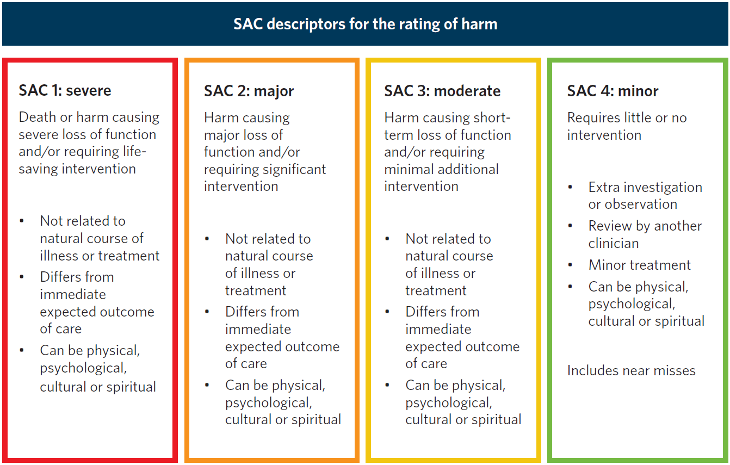
Severity Assessment Code ratings

Slide 16
DRAFT
SAC 1 – Severe: death or harm causing severe loss of function and/or requiring life-saving intervention Not related to natural course of illness or treatment Differs from the immediate expected outcome of care Can be physical, psychological, cultural or spiritual
Fall during the provision of care resulting in death or a severe loss of function (includes falls from equipment) Delay in the planned provision of care for a disabled person resulting in death, or requiring life-saving interventions (e.g cardiac arrest, aspiration) Medicine event resulting in death, or requiring life-saving interventions Departure from care plan resulting in death, or requiring life-saving interventions Death, or the need for immediate life-saving interventions during or as a result of seclusion or restraint. […]

Slide 17
DRAFT
SAC 2 – Major: Harm causing major loss of function and/or requiring significant intervention Not related to natural course of illness or treatment Differs from the immediate expected outcome of care Can be physical, psychological, cultural or spiritual
Delayed recognition of disabled person deterioration resulting in unplanned transfer to hospital for higher-acuity care Departure in the planned provision of care, resulting in the disabled person requiring significant interventions or admission to hospital (e.g. recurring aspiration pneumonia) Fall during the provision of care resulting in fractured neck of femur or major bone, head injury or laceration requiring skin graft Medicine event resulting in significant intervention (eg, anaphylaxis from a known medication allergy). Stage 3, 4 or unstageable pressure injury or a previous pressure injury that has deteriorated to this level whilst receiving care Serious harm requiring significant interventions as a result of, or during seclusion or restraint. […]

Slide 18
How can we support you?
Learning from Harm workshops
Attend an in-person workshop – Christchurch, Hamilton, Palmerston North & Auckland (see website).
Bespoke – in-person or virtual.
E-modules on Learning Review methodology and Human Factors (and other sources on our websites).
Templates for reviewing Falls and Pressure injuries
Portal submission support
Email: harm.event@hqsc.govt.nz

Slide 19
Healing, learning and improving from harm kete

