Slide 1
DSS Outcome Agreement & Standard Terms and Conditions
06 October 2026

Slide 2
Welcome and opening Karakia
Welcome and Introductions
Presenters:
  Michael Hiscox
  Director Procurement and Commercial – DSS
  Sharon O’Toole
  Principal Advisor Commercial – DSS
Opening Karakia
Kia hora te marino,
Kia whakapapa pounamu te moana,
Hei huarahi mā tatou i te rangi nei,
Aroha atu,
Aroha mai,
Haumi e, Hui e, Tāiki e

Slide 3
Introduction and Overview
The session will cover:
Item: | Speaker:
About Disability Support Services What documents make up an Outcome Agreement? | Michael Hiscox
What has changed and why | Sharon O'Toole
Support and resources for Providers Implementation ​approach | Michael Hiscox
Questions and Discussion

Slide 4
About Disability Support Services

Slide 5
Disability Support Services
DSS is responsible for providing essential support to around 55,000 disabled people, tāngata whaikaha Māori and their whānau and 100,000 people are supported through Environmental Support Services (includes Equipment Modification Services).
Priorities for DSS include:
Managing cost pressures and improving consistency, fairness and transparency.
Designing a sustainable system that provides certainty for the people, whānau, and carers receiving supports and services.
Well structured and well managed contracts are a tool that helps DSS to achieve these priorities.

Slide 6
What documents make up an Outcome Agreement?

Slide 7


Outcome agreements
Outcome Agreements are used where there is a focus is on achieving outcomes for people and communities.
New Zealand Government Procurement, part of MBIE, provides a standard Outcome Agreement framework which is used to contract social services across the public sector.
DSS has adapted the MBIE Outcome Agreement to provide greater consistency, stronger protections, and clearer expectations across DSS-funded services.

Slide 8
The Outcome Agreement Package
Outcome Agreement: Sets out the overall relationship between DSS and providers
Terms and Conditions: Sets common expectations and contractual requirements.
Service Specifications: Describe service-specific delivery expectations.
Standards, operational policies and supporting documents: Provide operational and compliance requirements

Slide 9
Outcome Agreement structure
New
SOME CHANGES
The Outcome Agreement defines the objectives, performance expectations, and intended outcomes
NZGP Outcome Agreement
DSS Outcome Agreement
Available on NZGP website
Available on DSS website
MORE EXTENSIVE CHANGES
The Terms and Conditions establish the standard expectations that apply to all contracts, regardless of the specific outcomes or services being agreed.
NZGP Framework Terms & Conditions
DSS Standard Terms & Conditions
Service Specifications
Service Specifications
Service Specifications provide information on the outcomes and processes that relate to the delivery of specific services.
Available on DSS website

Slide 10
Why Are We Making Changes?

Slide 11
Previous feedback from Providers
When DSS introduced the Residential Support Services Panel Agreement last year we received over 200 pieces of feedback on the contract.
Themes Included:
Safeguarding and delivery of services
Audit
Financial Transparency
Variation
Intellectual Property
Payments
Performance
Changes to term / pricing
H&S
Supply Chains / Subcontractors
Records

Slide 12
Other Drivers for Change
The Abuse in Care Royal Commission of Inquiry
Independent Review of Disability Support Services
Rapid Assurance Review, Commercial Management
Government expectations relating to privacy, information management, data security and cyber security
Consistency with Community Residential Support Services Panel Agreement and Panel Terms and Conditions

Slide 13
What are these changes trying to achieve?
Better for Disabled People
Safer Services
Better Quality
Stronger Safeguards
Better Outcomes
Better for Providers
Clearer Expectations
Greater Consistency
More Transparent
Reduced Uncertainty

Slide 14
Key Changes

Slide 15
Main Areas of Change
Safeguarding and quality
Performance, reporting and assurance
Privacy and cyber security
Funding and commercial arrangements
Intellectual property
Delivery of safe, person-centred services that are culturally responsive and aligned with Enabling Good Lives, Te Tiriti, and required standards.

Slide 16
Safeguarding and Quality
What is changing?
Clearer safeguarding expectations
Stronger workforce requirements
Improved incident management provisions
More clarity on the requirements for record keeping
Greater focus on continuous improvement
Why?
To prevent abuse and support safe, high-quality services and stronger safeguarding.

Slide 17
Safeguarding and Quality
What does this mean for providers?
You may need to:
Review workforce processes
Review, maintain and provide evidence of training
Ensure incidents are recorded and managed appropriately
Continue quality improvement activities
Key message
Many DSS providers already do these things.
The new agreement helps to clarify these expectations.

Slide 18
Performance, Reporting and Assurance
What is changing?
Monitoring and reporting requirements e.g.
    Financial Reporting
    Audits
Increased oversight
More structured reporting
Earlier intervention if issues arise
Why?
Earlier intervention if issues arise
Improved improve transparency accountability and assurance across publicly funded services.

Slide 19
Performance, Reporting and Assurance
What does this mean for providers?
Clearer reporting expectations
Earlier identification of risks
Better visibility of performance expectations
Key message
The focus is improvement.

Slide 20
Privacy, information and cyber security
What does this mean for providers?
Providers should consider their:
Privacy policies
Information handling practices
Security controls
Arrangements for responding to incidents
Key message
We need to keeping personal information safe secure and make sure it is only used for the purpose that was intended.

Slide 21
Funding and Commercial Arrangements
What has changed:
We have included details about:
Economic benefits
Overpayments
Extraordinary costs
Contract administration processes
Supporting Transition
What it means:
Improved transparency
Reduced uncertainty
Greater consistency
Clarified processes when issues arise

Slide 22
Intellectual Property (IP)
New intellectual property created through DSS-funded services will generally belong to DSS, while providers retain ownership of their existing intellectual property. This supports the sharing and reuse of publicly funded resources across the disability support system.
Examples:
Generally belongs to DSS
New guides and toolkits created under a DSS contract
New training materials produced for the service
New services or resources developed using DSS funding
Remains the Provider’s
Existing tools, methodologies and training programmes
Existing systems and resources
Experience, expertise and organisational knowledge

Slide 23
Using IP Created Under the Contract
Providers can ask DSS for permission to use intellectual property created through the contract.
DSS will not unreasonably withhold permission.
Examples
Using a contract-funded resource in another disability service.
Adapting a tool or guide to improve services.
Sharing resources that help improve outcomes for disabled people.
Selling publicly funded intellectual property as an exclusive commercial product.
Preventing DSS or others from using resources developed with public funding.

Slide 24
What isn’t changing?

Slide 25
What isn’t changing?
Person-centred support and services
Provider expertise and innovation
Service specifications remain the key source of service requirements
Partnership remains important
Focus on outcomes

Slide 26
Support for providers

Slide 27
DSS support for the implementation
Resources & Support
The DSS website will be the main source of information for updates and guidance. This includes:
Updated contract page
New dedicated webpage to provide information about the new contract including:
  New contract documents
  Summary of changes
  Frequently asked questions and FAQs
  Webinar slides available after the session
Contract managers are your key point of contact for additional support and communication.

Slide 28
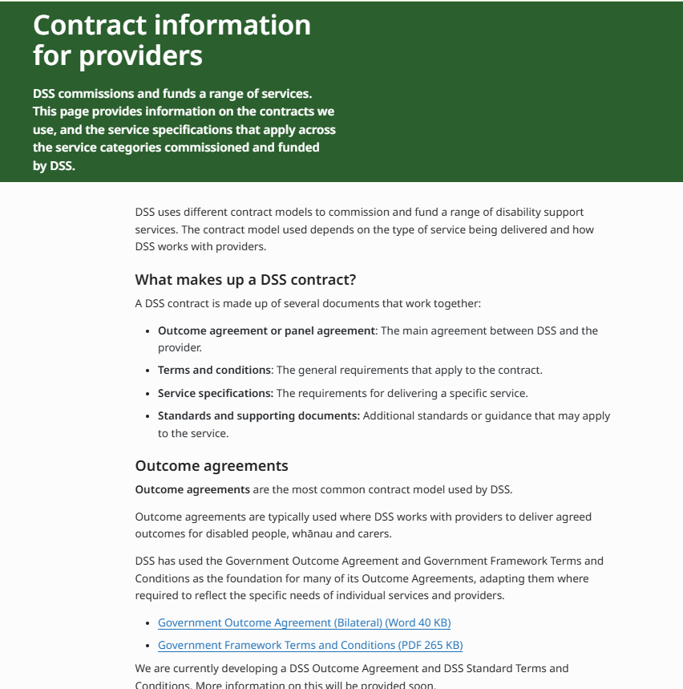
Updated DSS Contracts webpage
Contract information for providers | Disability Support Services

Slide 29
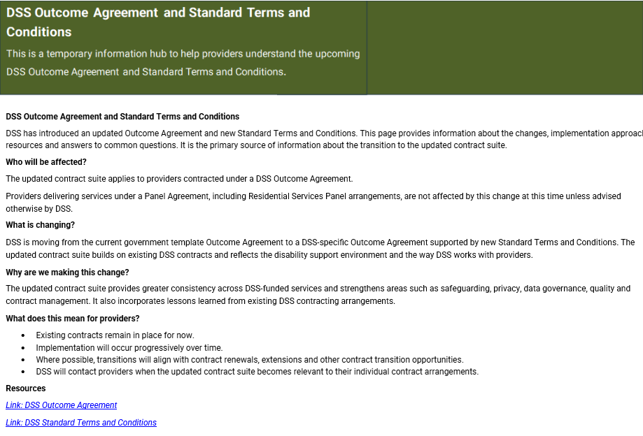
NEW
Temporary
webpage to support transition
Mock up only

Slide 30
Implementation

Slide 31
Timings
Mid Sept DSS Outcome Agreement and Terms & Conditions content finalised
10 Sept Outcome agreement details in DSS Provider Newsletter
11 Sept Providers receive Registration details of Provider webinar
6 Oct Provider Webinar
8 Oct Temporary website page goes live
November onwards - contracts will start to transition to the new DSS Outcome Agreement as renewals/externals and recommissioning activities occur

Slide 32
Only Providers contracted under an Outcome Agreement with be impacted.
(e.g. not Providers delivering services under a panel Agreement)
Where possible, transition will align with contract renewals, extensions or recommissioning activities.
Existing contracts will remain in place for now.
Implementation will occur progressively over time.
DSS will contact providers when the updated contract suite becomes relevant to their individual contract arrangements.
We will continue to work with you to make this transition clear and straightforward.

Slide 33
Patai?

Slide 34
More questions?
Closing Karakia
Kia whakairia te tapu
Kia watea ai te ara
Kia tūruki whakataha ai
Kia tūruki whakataha ai
Haumi e, Hui e, Tāiki e!
Talk to your Contracts and Funding Manager
You can also reach out to the DSS Procurement and Commercial Team at: DSS_procurement@msd.govt.nz
Notes:
MC – Catherine
Introduce yourself
Karakia
Purpose about today
Disclaimer about recording
We are recording this session to share on our website with people who could not attend today
Your voice and face will not be recorded, but your Teams avatar and name might show on screen
Feel free to not attend today if you don't consent to this recording

