Slide 1
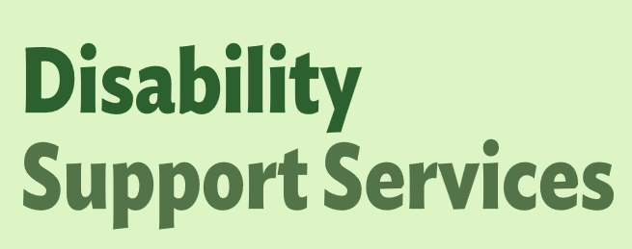
OBIR Web-App Release 3

Slide 2
OBIR Web App Release 3
In late May, a new release of the web app will introduce additional functionality for managers, improvements to the Indicative Range process, and a range of design and visual updates. These changes include:
What is it | What it does | Who it applies to | Slides
General Updates
Manager Role Enhancements | Reassign assessments/plans within your organisation. Update disabled person’s details if needed. | Managers | 3 – 10
Improved Dashboard View | See who an assessment is assigned to and filter. Filter your ‘Action Required’ tasks based on statuses (e.g. select MyDSS Funding plan only) | All roles | 11 - 13
Assessment Updates
Refining Preschool Life stage | Before school is now split into smaller age groups for (0–2, 2–3, 3–4, 4–5 years), change is only for Important Information sections. Applies to new assessments only | Assessor roles | 14
Additional Details Captured | You can now record gender and date of birth when completing a new assessment, when DOB is selected it will automatically suggest an assessment life stage. | All roles | 15
Updating Sections and Flow | Sections “Situations, Life Transitions, Support Multiplier, Tool Reliability, Override” removed to reduce duplication. Note: These sections will also be hidden on assessments with this information previously captured. The data remains and can be requested if needed, or you can download the assessments now. | Assessors / Allocator roles | 16
End Assessment | You can end an assessment and record why e.g., 'DSS no longer wanted', or 'went down the residential process.' | Assessor / Allocator roles | 17 - 20
General Improvements | Clear status colours show progress (not started, in progress, complete) of reflections, important information and support profile within the holistic section Improvements for low vision users | All roles | 21
MyDSS Funding Plan Updates
User friendly Download | A new My DSS Funding Plan download has been created to improve user experience. | Assessor / Allocator roles | 22 - 25
General Improvements | Adding in additional fields such as 'Provider' and updating dates pre-populating in the plan. MyDSS Funding Plans and service lines provided IDs. MyDSS Funding Plans will no longer be on everyones actions required lists- only those involved | Assessor / Allocator roles | 26 - 27

Slide 3
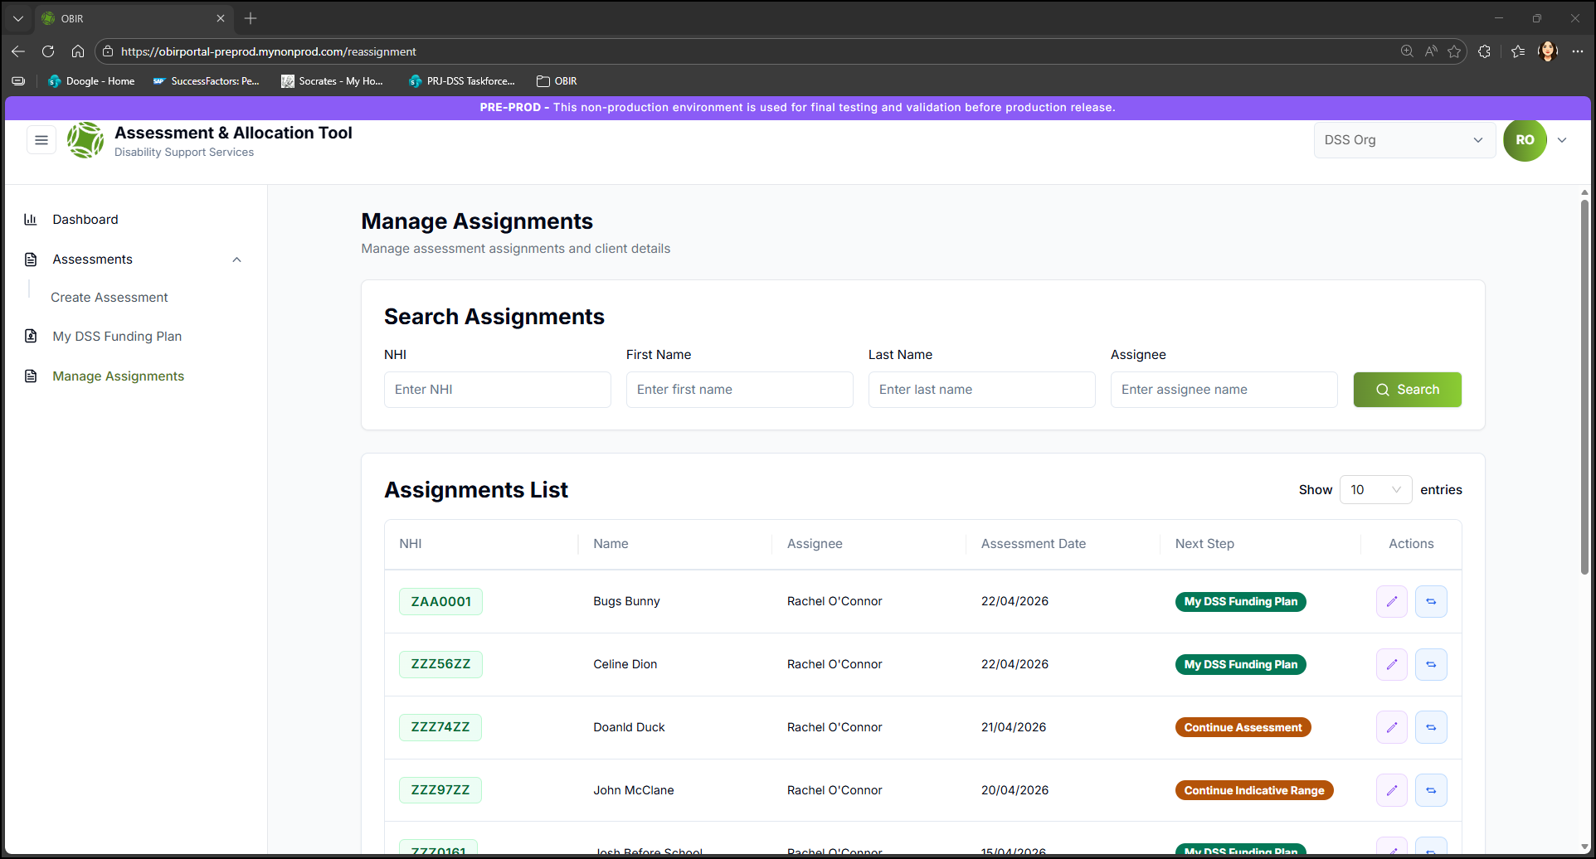
OBIR Web App Release 3
Manager Role Enhancements
Overview
A new page in the left hand navigation panel will be available to managers to help with the management of assessments.
Within this page managers will have additional actions that they can perform.
What it includes
Reassign an assessment to another user within the same organisation with the same role.
Edit personal details on assessments
Filter assessments by assignee/status

Slide 4
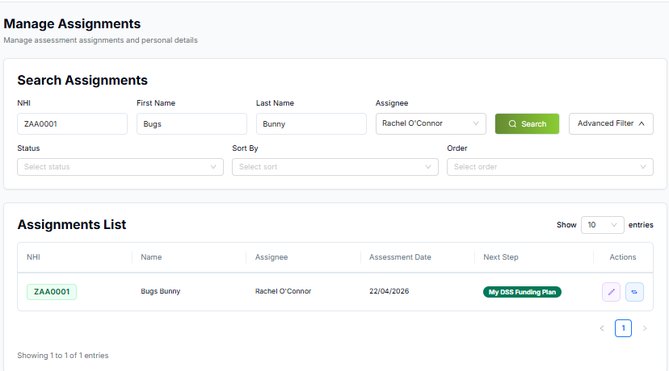
OBIR Web App Release 3
Manager Role Enhancements
Manager Role Enhancements
Assessment Reassignment
Re-assign an assessment to another user within the same organisation with the same role.
Select Manage Assignments
Enter disabled person’s information or choose assignee from the drop down list
Click Search

Slide 5
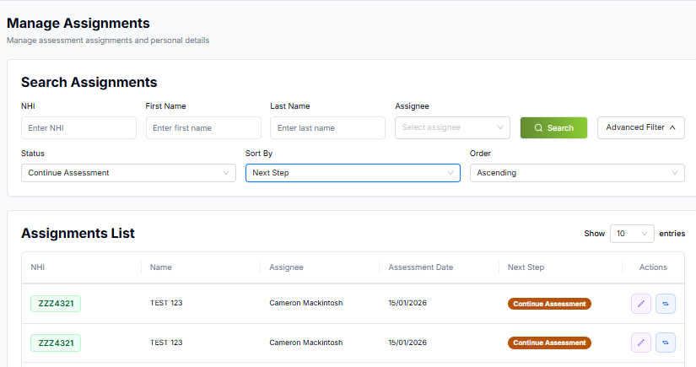
OBIR Web App Release 3
Manager Role Enhancements
Manager Role Enhancements
Assessment Reassignment
Or search for assessment status by selecting advanced filter
Choose a status from the drop down list
Click Search

Slide 6
OBIR Web App Release 3
Manager Role Enhancements
Manager Role Enhancements
Assessment Reassignment
Select the icon with the 2 arrows

Slide 7
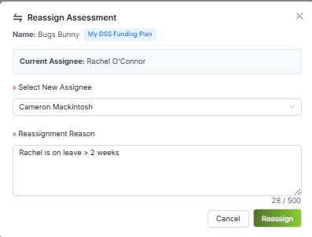
OBIR Web App Release 3
Manager Role Enhancements
Manager Role Enhancements
Assessment Reassignment
From the dropdown list select who you want to assign the assessment to
Enter a reason why you are re-assigning
Select Reassign
Note
Assessments can only be reassigned to a person with the same role.
E.g. Assessments in draft can only be reassigned to those with the Assessor tier.

Slide 8
OBIR Web App Release 3
Manager Role Enhancements
Manager Role Enhancements
Updating Personal Details
To update the personal details on an assessment
Follow the same steps as previous to find the assessment

Slide 9

OBIR Web App Release 3
Manager Role Enhancements
Manager Role Enhancements
Updating Personal Details
Select the icon with the pen

Slide 10
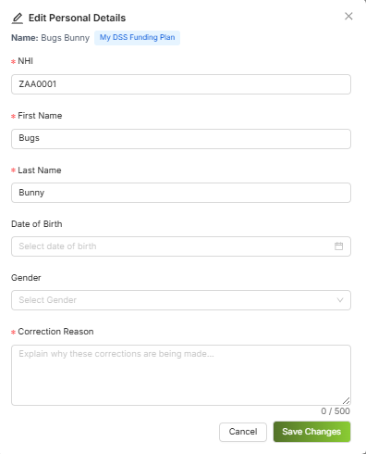
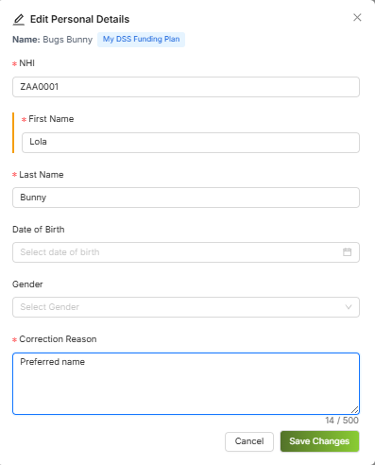
OBIR Web App Release 3
Manager Role Enhancements
Manager Role Enhancements
Updating Personal Details
2. Update the information
3. Enter the reason for the change
4. Select Save Changes

Slide 11
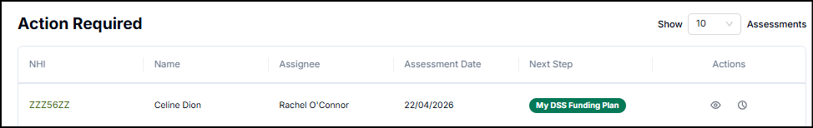
OBIR Web App Release 3
Improved Dashboard View
Overview
A new assignee column has been added to the action required table. This allows users to see who is currently working on an assessment. Users will also be able to filter the action required queue.
What it includes
New assignee column
New advanced filter for dashboard

Slide 12
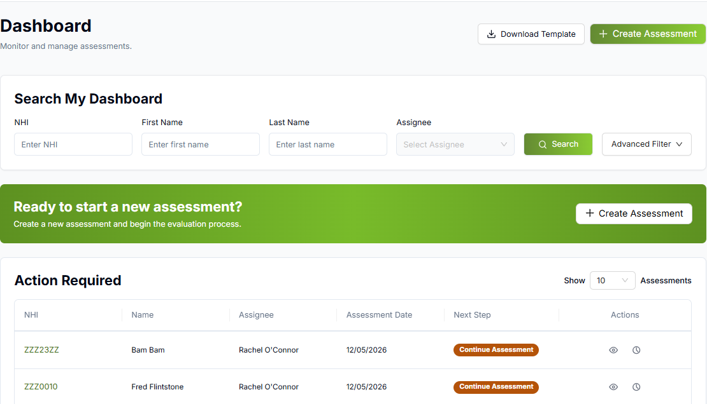
OBIR Web App Release 3
Improved Dashboard View
Advanced Dashboard Filter
Select advanced filter

Slide 13
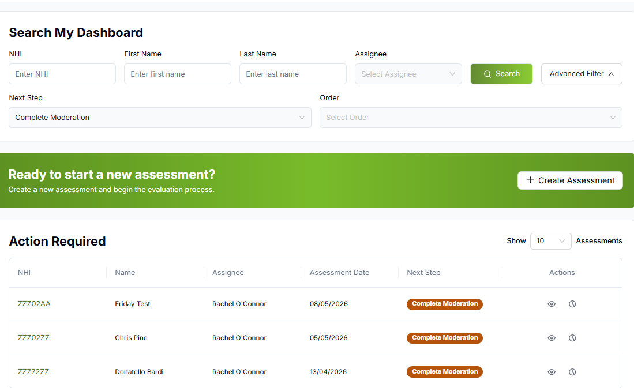
OBIR Web App Release 3
Improved Dashboard View
Advanced Dashboard Filter
Choose a status from the drop down list
Select Search

Slide 14
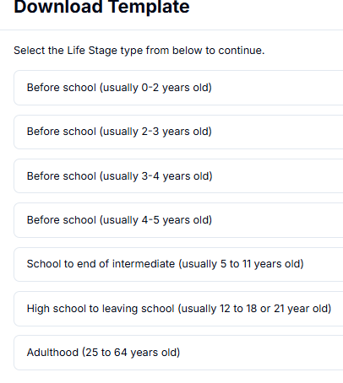
OBIR Web App Release 3
Refining Before school Life Stage and Additional Information Capture
Overview
Date of birth and gender information can be captured. Date of birth will be used to suggest the life stage for the assessment.
Before school life stage will now be separated into 4 to better represent different capabilities as children grow
What it includes
Additional fields in the personal information page
Preschool separated into four life stages for more relevant important information questions: 0-2 yrs, 2-3yrs, 3-4yrs, 4-5yrs
New offline templates

Slide 15
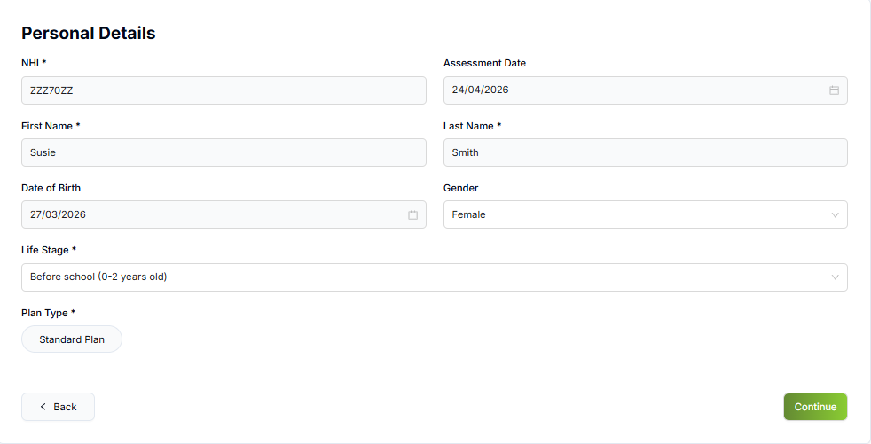
OBIR Web App Release 3
Additional Information Capture
Additional Data Fields
When entering the date of birth the Life Stage will auto populate.

Slide 16
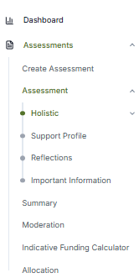
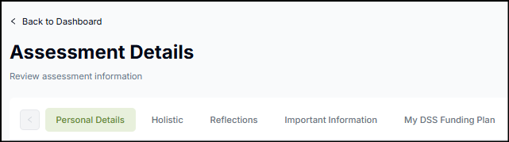
OBIR Web App Release 3
Updating Sections and Flow
Overview
The Situations, Life Transitions, Support Multiplier, Tool Reliability and Override sections have been removed to reduce the duplication of questions.
The data from previous assessments will not be available to view for the missing sections. If required please download assessments and store locally or request the data be retrieved through the support email.
What it includes
Assessment sections have been removed
The flow now goes Holistic questions > Support Profile > Reflections > Important Information > Summary

Slide 17
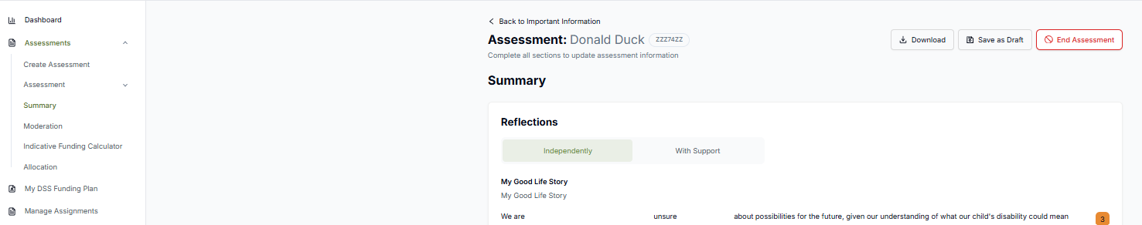
OBIR Web App Release 3
End Assessment
Overview
Assessments can now be ended with a reason captured by an assessor if no longer required in draft status.
What it includes
An End Assessment button will be available
A reason for ending the assessment will be captured
The assessment data will still be viewable within OBIR.

Slide 18
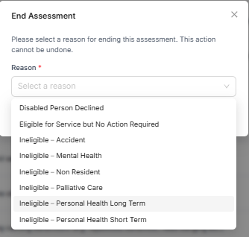
OBIR Web App Release 3
End Assessment
End assessment button
Select a reason from the drop down list
Select Submit

Slide 19
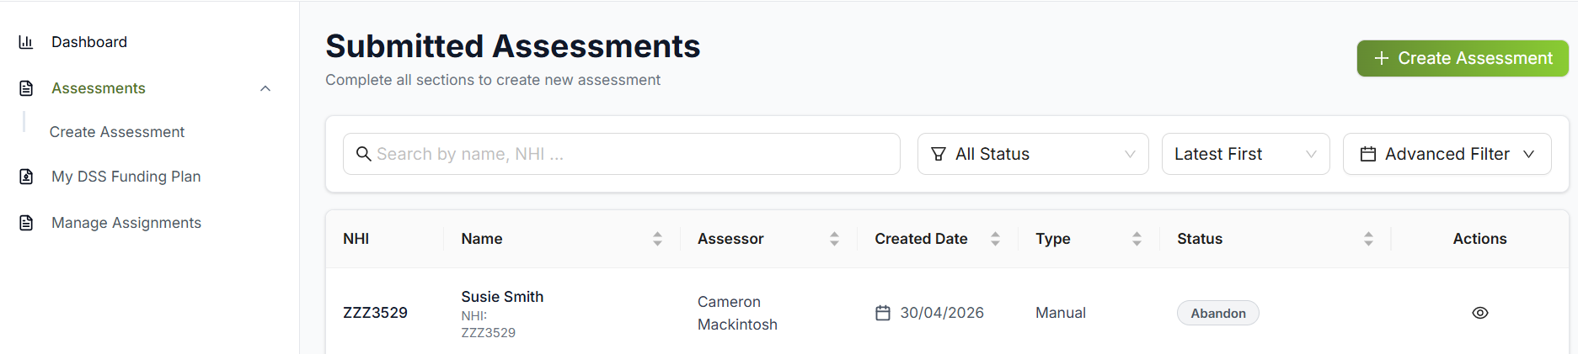
OBIR Web App Release 3
End Assessment
End assessment button
Ended assessments are available to view in the assessment page from the left hand navigation.
Currently the status is “abandon”, we will be updating this wording in later releases to properly reflect these assessments e.g., Assessment ended.

Slide 20
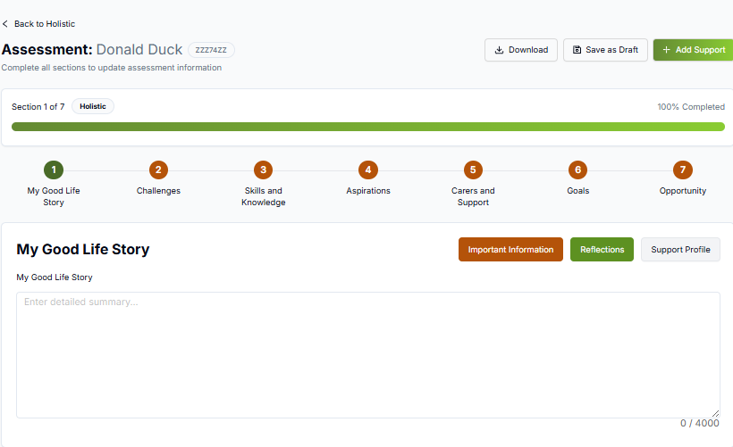
OBIR Web App Release 3
UX Improvements
Overview
Progress is highlighted through colours on the important information, reflections and support profile buttons.
What it includes
White – Not started/No questions answered
Orange – Some questions have been answered
Green – All questions have been answered

Slide 21
OBIR Web App Release 3
MyDSS Funding Plan Improvements
Overview
A more user friendly download will be available in PDF and excel format.
Funding plans and service lines will have individual IDs added to allow us to link service lines to plans and to assessments.
What it includes
Assessment can be linked to plans and service lines through IDs
A new format will be available for download

Slide 22
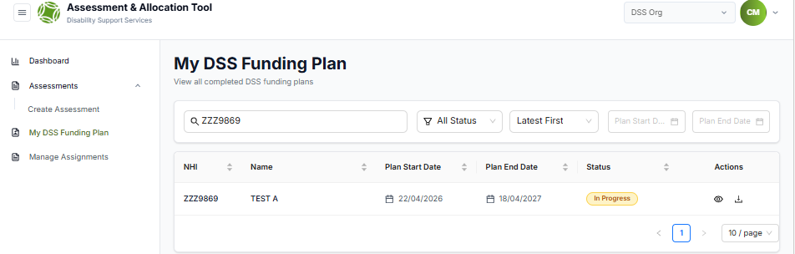

OBIR Web App Release 3
Accessible Download
New Plan Download
Select MyDSS Funding Plan from the left hand navigation
Find the disabled person’s plan
Select the download button
Choose the download format

Slide 23
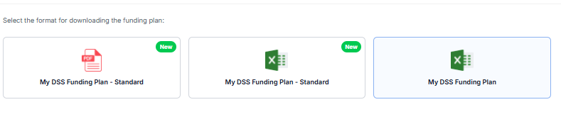

OBIR Web App Release 3
Accessible Download
New Plan Download
5. Select either ‘MyDSS Funding Plan – Standard’ in either excel or PDF format to download. The previous excel download will still be available to provide more information for hosts/providers

Slide 24
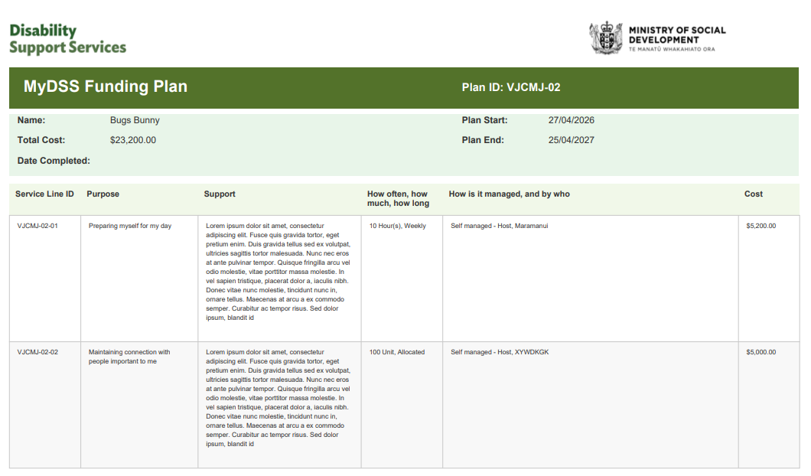
OBIR Web App Release 3
Accessible Download
New Plan Download
A more accessible download is now available in PDF- this is intended to be given to the disabled person/whanau/carer
The previous excel download will still be available to provide more information for hosts/providers

Slide 25
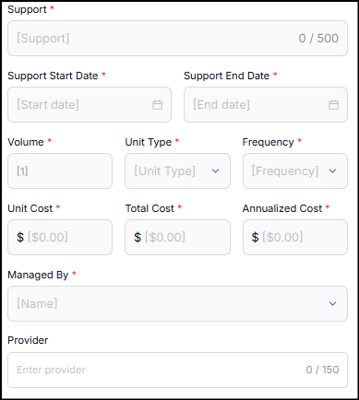
OBIR Web App Release 3
General Improvements
Overview
Additional information can be entered into supports
Plans can be dated before the assessment was completed
MyDSS Funding Plans will no longer be on everyones list
What it includes
Space for Provider names to be associated with service lines
Expanded character limit for the support line
Dates for supports no longer default
MyDSS Funding Plans can now be backdated before the assessment date if required. If > 1 week a reason for the delay is captured
MyDSS Funding Plans will only appear in the actions required of the assessor and allocator involved in the assessment

Slide 26
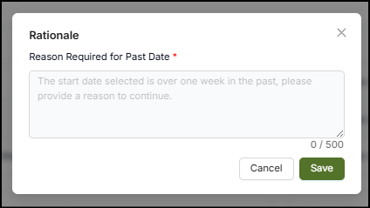
OBIR Web App Release 3
General Improvements
Back-dating funding plans
If entering a plan start date >1 week before the assessment date then when completing the plan, enter a reason for the delay.

Slide 27
Questions

