Slide 1
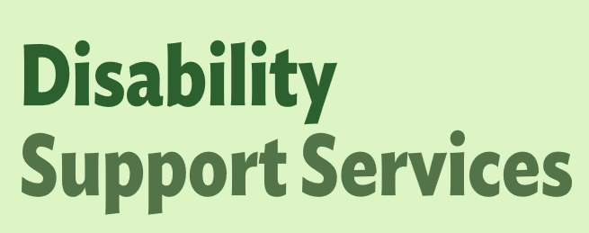
OBIR Web-App Release 2.1

Slide 2
Overview
OBIR Web-App Release 2.1
On Wednesday 15 April morning, the following functionality is being released into the web-app. Below is an overview of the items:
Assessment - Improved Download (Slides 3-6)
Populated mind map format assessments can be downloaded.
MyDSS Funding Plan – Download Updated (Slide 7-8)
Total Cost is included in the My DSS Funding Plan download instead of the Indicative Range.
IR Role – Request more Information (Slide 9-11)
IR Support Team can send assessments back to NASC/EGL for more information.

Slide 3
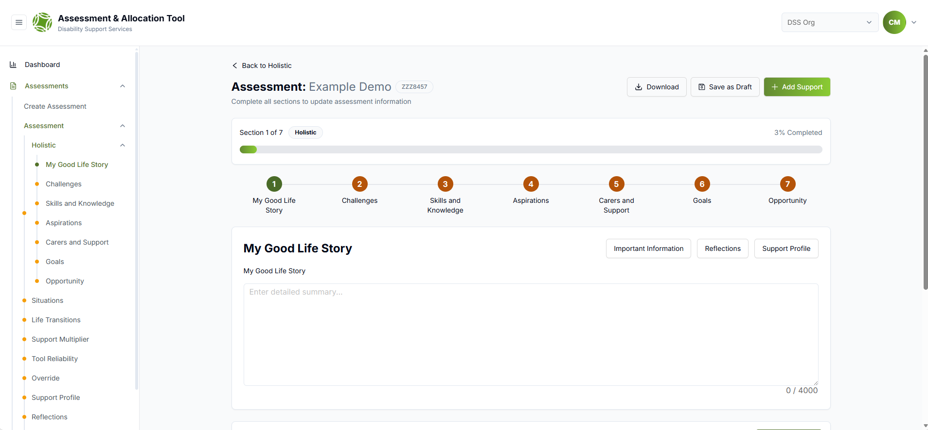
OBIR Web-App Release 2.1
Assessment – Improved Download
Navigating to the download
Select a disabled persons assessment and click the download button.

Slide 4
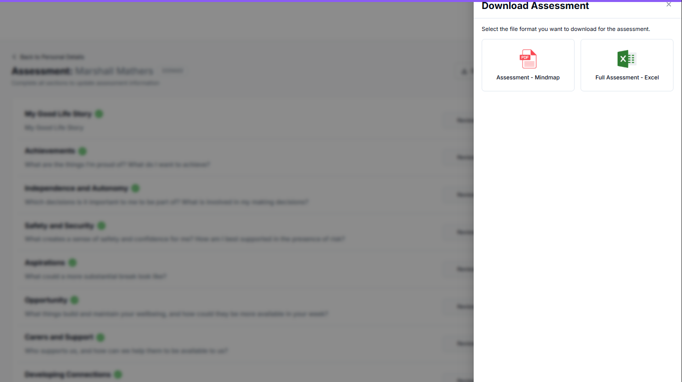
OBIR Web-App Release 2.1
Assessment – Improved Download
Select the assessment download version
Once clicked you can select either of these two options:
Assessment – Mindmap: Includes holistic information presented in the mindmap format.
Full Assessment - Excel: Current excel version that includes all documented OBIR information.

Slide 5
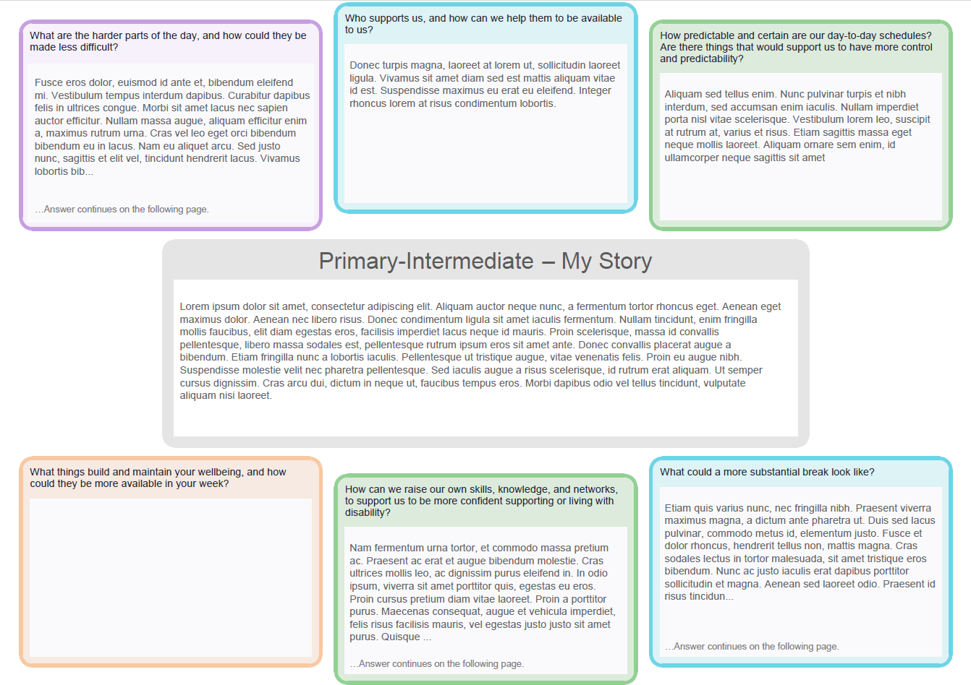
OBIR Web-App Release 2.1
Assessment – Improved Download
Downloaded Assessment - Mindmap
The information is automatically populated in the mindmap format.
Where the character limit does not fit in the box the text “…Answer continues on the following page.” is displayed.
The file name format is ‘First Name Last Name_NHI_Mindmap’ e.g., John_Smith_ZZZ0325_Mindmap.

Slide 6
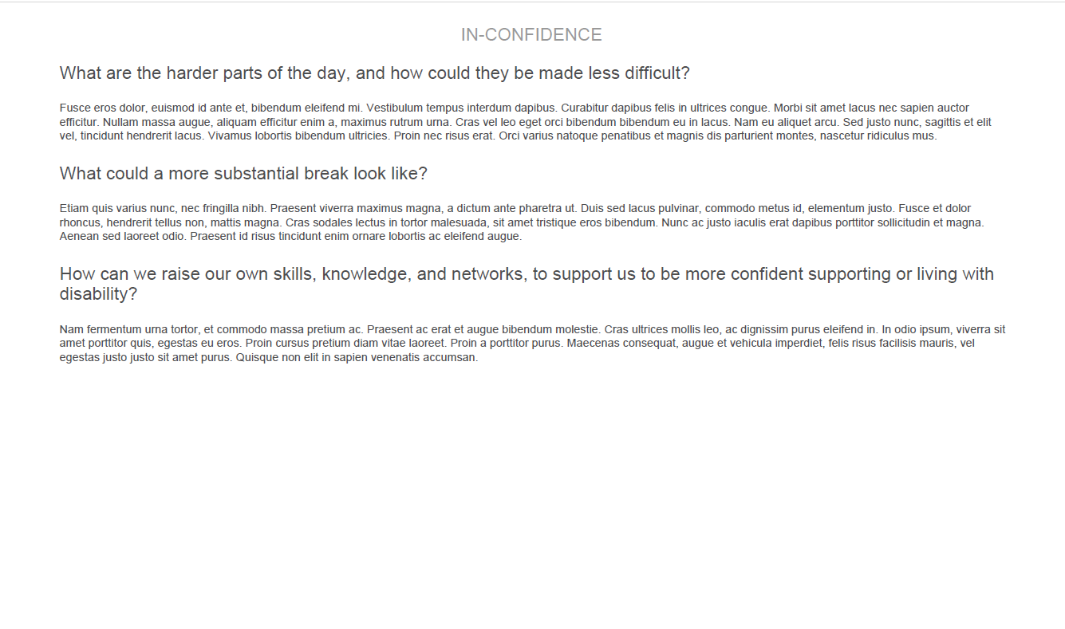
OBIR Web-App Release 2.1
Assessment – Improved Download
…Answer continues on the following page
Following pages use the same holistic question and include the spill over text, example below.

Slide 7
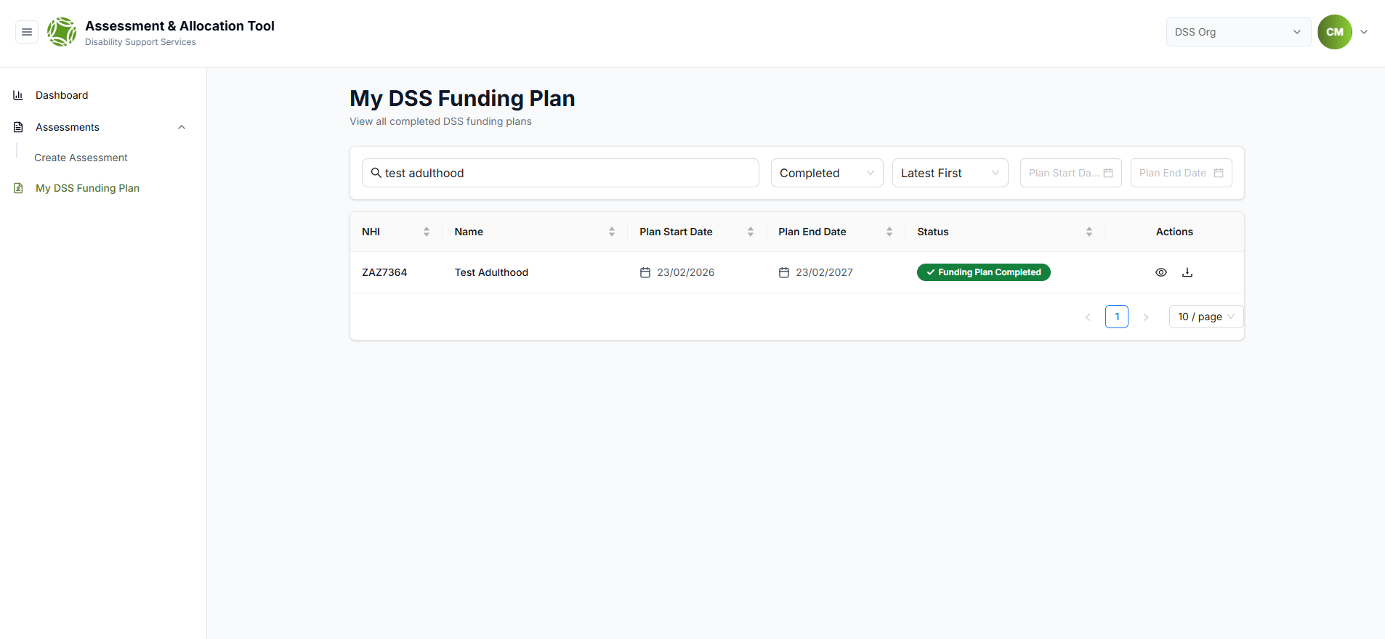

OBIR Web-App Release 2.1
My DSS Funding Plan – Download Updated
Downloaded Funding Plan
On the ‘My DSS Funding Plan’ navigation bar, you can search to find the person needing the plan downloaded.
Once found, select the download icon to download the MyDSS Funding Plan.

Slide 8
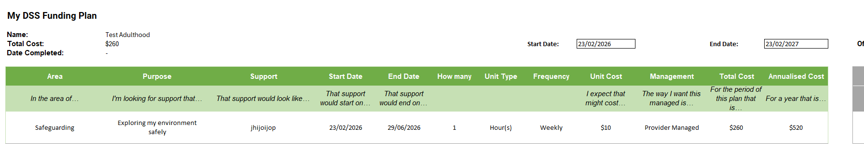
OBIR Web-App Release 2.1
My DSS Funding Plan – Download Updated
Updated Download
The Indicative Range has now been replaced with ‘Total Cost’.
If a disabled person requests their Indicative Range, this must be provided.

Slide 9
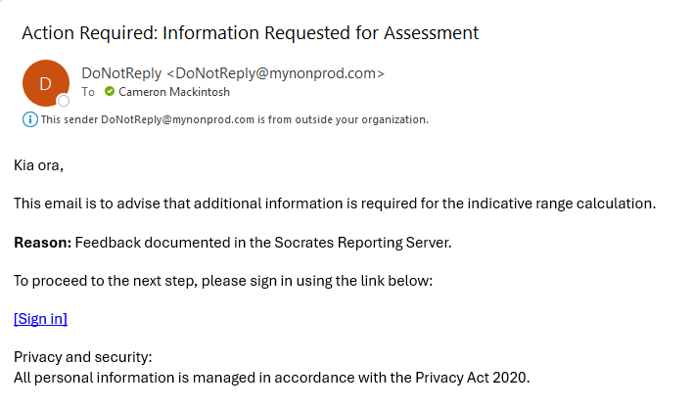
OBIR Web-App Release 2.1
IR Team – Request more info
Email Notification
An email notification should notify you during the Indicative Range process if further information has been requested.

Slide 10
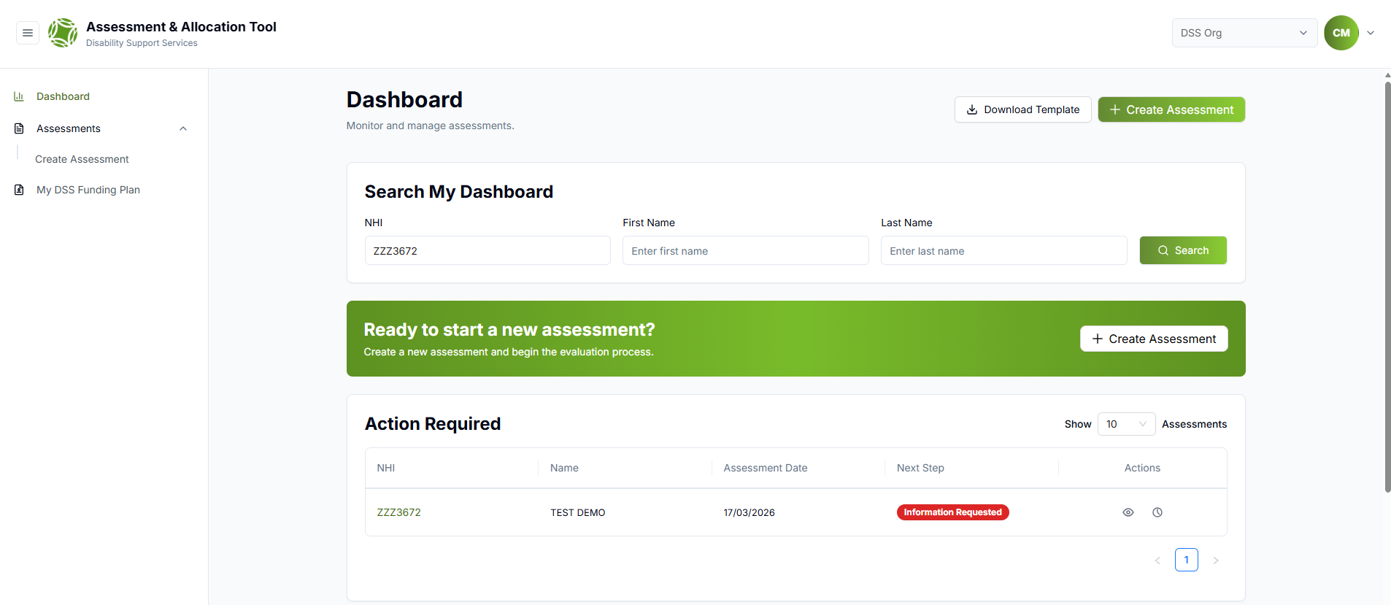
OBIR Web-App Release 2.1
IR Team – Request more info
Dashboard View
When an IR has had ‘Information Requested’ the assessment returns to the start of the workflow and will require moderation (handover to Allocator) again.
Select the ‘Clock’ icon to review the IR teams comments.

Slide 11
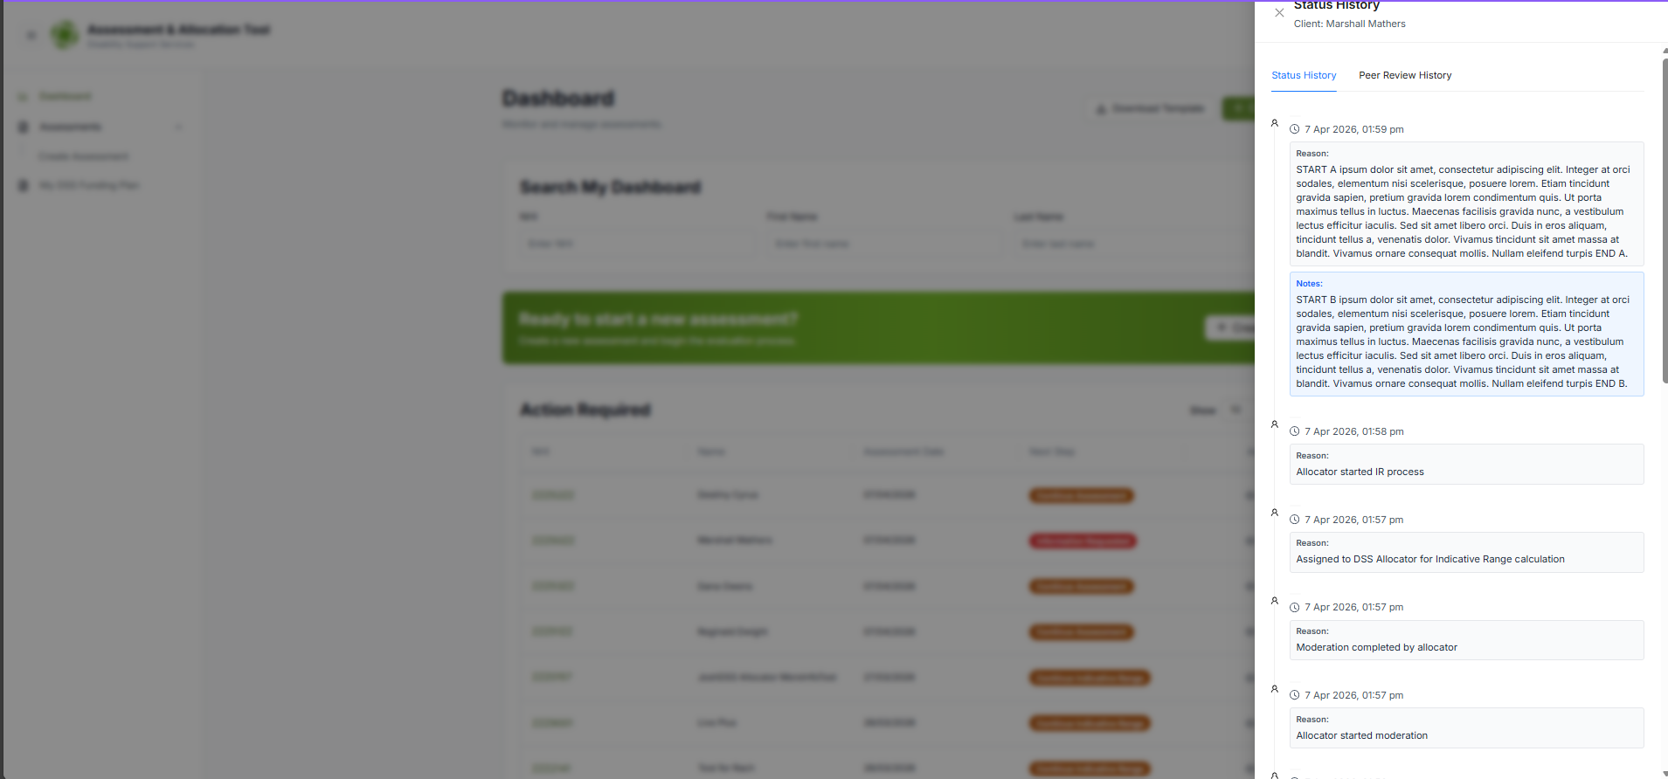
OBIR Web-App Release 2.1
IR Team – Request more info
Dashboard View
The comments will appear in the drawer under reason.

Slide 12
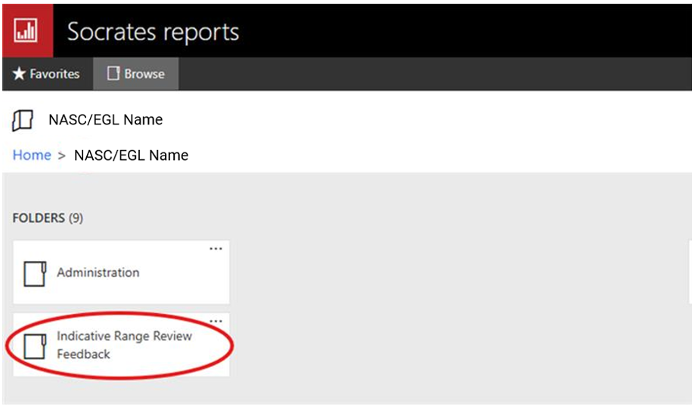
OBIR Web-App Release 2.1
IR Team – Request more info
Viewing Feedback
In the Socrates reporting server, structured feedback (if required) is stored in Socrates in the short-term. Note these folders are being created as required so may not be created until the first IR feedback is sent to your NASC.
Long-term supporting guidance/documents are being developed for sustainable practice.
If you want to discuss the feedback or ranges, please contact this email: DSS_IndicativeRangeSupport@msd.govt.nz

Slide 13
OBIR Web-App Release 2.1
IR Team – Request more info
Dashboard View
Select ‘Information Requested’ to update the assessment and progress for IR re-submission.
Note: When information is requested the assessment is reset to the beginning of the workflow where it needs to be re-moderated etc.

Slide 14
OBIR Web-App Release 2.1
IR Team – Request more info
Dashboard View
Select ‘Information Requested’ to update the assessment and progress for IR re-submission.
Note: When information is requested the assessment is reset to the beginning of the workflow where it needs to be re-moderated etc.

