Slide 1
NASC/EGL site Trainers Preparation For Delivery
Have the following ready as part of your preparation prior to delivering training to your team:
Link to the DSS Training Portal – specifically to the Detailed Training document for Hosted Flexible Funding Providers You will share this with your participants for the Prior Approval activity.
Tier Allocation Tool demonstration video – located in the training portal. Have this open and ready to play at slide 24.
Personas – have ready to share for Activity #2

Slide 2
Assessment, Allocation and Flexible Funding (AAFF)

Slide 3
Nau mai, haere mai
Presenter:
Clare Kirby, Training Facilitator & Workstream Lead
With support from:
Peggy Aerts
Sally Clayton
Anna Grenfell
Kristen D’Silva
Amber Carline
Simone Newsham - NASCA
Notes:
(5 min)
Say: Nau mai, haere mai and welcome to our workshop that will provide you with the information you need to support disabled people using hosted flexible funding, as we roll out the flexible funding part of Assessment, Allocation, and Flexible Funding (AAFF) work programme.
My name is Clare Kirby and I’ll be taking you through today’s training.
I will start with karakia:
E te Atua
Hōmai ki a mātou
Tōu māramatanga,
Tōu rangimārie,
Tōu kaha me Tōu aroha
mō tēnei ra
For those who do not know me, I have been leading this workstream for the past couple of months. Until recently I have been the National Lead for NASCs, in my role as Senior Portfolio Manager, and then moved into this project to lead the delivery of flexible funding as part of the Assessment, Allocation and Flexible Funding (AAFF) programme.
The remainder of the team joining me today are Peggy, Sally, Amber, Anna & Kristen
I’d like to give special thanks to Simone for working with us to sense check our training.
The Structure of the session will be as follows:
At any stage, you can put questions into the chat and we’ll try to cover them during the session or at the end of each section. That way, we may be able to answer some questions as the training unfolds.
Feel free to ask questions – I’ll give you opportunities to do this verbally at the end of each section as well.
We may not be able to answer every question straight away, especially if it needs a bit more checking or detail. But please keep asking – your questions are really valuable. Any questions we can’t answer today will be compiled into an FAQ that we will share with you, and you’ll have opportunities to ask further questions in the “drop-in” sessions.
We’ll be sending a follow up email which will give you access to the DSS training portal where this material can be found.

Slide 4
Today’s timetable
Welcome & Introduction | 9.15am start
Session 1 - Overview | 09.20 – 09.40
Session 2 - Roles & Responsibilities | 09.40 – 09.45
Session 3 – My DSS Funding Plan | 09.45 – 10.35
Break – 15 min | 10.35 – 10.50
Session 4 – Host Tier Framework | 10.50 - 11.50
Session 5 – Feedback Loop | 11.50 – 12.05
Session 6 – Self Determination | 12.05 – 12.15
Wrap Up & Reflection | 12.15 – 12.30
Notes:
(1 min)
Say: We have Sessions 1, 2 and 3 before a 15 minute break, and then Sessions 4, 5 & 6 before we wrap up.

Slide 5
Train The Trainer
This is designed to enable you to:
  Understand the main changes to flexible funding and their implications
  Explain and follow the new hosted flexible funding processes
  Support your staff in applying new processes and tools effectively
Notes:
(1 min)
(click)
Say: Train the Trainer is an approach for training instructors or subject matter experts so they can train other people in their organisations.
We will be sharing the workshop collateral with you, so you can facilitate your own workshops with your teams.
How you deliver this training is ultimately up to you. However it is important that you cover the same information to ensure a consistent understanding and approach in your organisation.

Slide 6
Hosted Flexible Funding Model – People assessed through OBIR from 1 April 2026
1. My DSS Funding Plan (FP) and tier allocation
Developed with NASC/EGL site using OBIR
Assigned tier level by NASC/EGL
2. Host receives My DSS FP
Host receives Funding Plan via email initially, and WebApp in medium term
3. Host meets disabled person
In person meeting with disabled person and agent (if one appointed)
Host receives Service Authorisation
4. Host set-up process
Service Agreement
5. Host supports Person to implement My DSS FP
Includes guidance on:
6. Host sets up Person in their system
IT
Claiming system
Payroll (if chooses)
how to find support workers
specific purchases want to make
managing hosted budget responsibilities
Information Pack
Contingency Planning
7. Person/Agent makes employment or purchase choices
Flexible Funding starts being utilised claims submitted and processed
8. Ongoing role of Host with Person based on Tier level
Guidance
9. Feedback loop back to NASC/EGL at review (low tech initially, then later higher tech)
Budget spent
Outcomes
Coaching
Tier level appropriate
Guidance and coaching received
Monitoring
Did spend meet purpose in FP?
NASC/EGL reviews and updates My DSS Funding Plan and tier level
Sends updated My DSS Funding Plan back to host
Meet cadence according to tier level
10. NASC/EGL review
Back to Step 7
Increase person/Agent’s confidence and proficiency
Notes:
(8 min) Say:
Before we do that, hold onto your hats, we’re jumping straight into the Hosted Flexible Funding Model. This is going to give you an around the world view in the next few minutes– then we’ll slow it down and get into some of the detail.
There are 2 overview slides that we are going to show: firstly those are new to the system, and secondly those who are already using hosted flexible funding.
This slide is the Hosted Flexible Funding Model for People, who are assessed using the new assessment and allocation model through the OBIR web app - the Outcome Based Indicative Range tool , who choose Hosted Flexible Funding from 1 April 2026.
Hosted Flexible Funding includes Individualised Funding (IF), Enhanced IF, and some hosted EGL Personal Budgets (including FDS Providers in Christchurch, and a hosted provider in Mana Whaikaha).
(click)
1. My DSS Funding Plan and tier allocation
The My DSS Funding Plan is developed between the Person and the NASC /EGL site using the new assessment and allocation process (OBIR) , which identifies purposes of the funding directly linked to the assessment, as well as a description of the initial supports intended to meet those purposes
Using the host tier framework, which indicates the appropriate level of guidance and monitoring for each person managing their hosted funding responsibilities, the NASC/EGL site will assign a tier, using a Host Tier Allocation Tool, which considers 3 weighted and rated factors: The Experience a person has in managing flexible funding (likely to be a “new user”, for those first entering the host system), the total amount of flexible funding allocated in dollars, and the engagement with the host (for new people entering the host system; the assumption will be that a “new” person “will engage appropriately” in the first instance).
There are 4 tier levels:
Tier 1 is the very low tier, with the least amount of host support and guidance provided, and the host meets with the person annually. Self-Verification of claims occurs in this Tier.
Tier 2 is the low tier, with some support and guidance provided by the host. The host will meet with the person 6 monthly.
Tier 3 is the medium tier, with regular support and guidance provided by the host. The host will meet with the person 3 monthly
Tier 4 is the high tier, with a high level of support and guidance provided by the host. The host will meet with the person each month
There is common guidance across all tiers
The Host Tier Framework and Allocation Tool has been developed to support the tier decisions
The tier is kept and recorded in Socrates (click)
(click)
2. The Host receives My DSS Funding Plan (FP)
You (NASC/EGL site) send the My DSS Funding Plan to the host via email initially, together with Service Authorisation. This is a short to medium term solution.
In the medium to long term, DSS is intending to further develop the OBIR Web App, where the My DSS FP is held. The intention is to allow hosts access and provide feedback directly into the My DSS FP. The timeline for this development is not yet known, but is a priority. (click)
(click)
3. The Host meets the disabled person (and Agent if one appointed), preferably in-person for the first meeting. This is to ensure, that all parties understand the roles and responsibilities associated with managing flexible funding (click)
(click)
4. There is the usual Host set-up process in which:
Person/Agent and host complete a Service Agreement, the host provides an Information Pack, with all the relevant information, and talks about any Contingency Plans that may need to be put in place, should things not go according to plan (click)
(click)
5. The Host supports the Person/Agent to implement the My DSS Funding Plan
This includes providing guidance and support on:
How to manage the hosted flexible funding budget and employment responsibilities
How to find support workers
Supporting the Person/Agent to look at any specific purchases they want to make (click)
(click)
6. The Host then sets the Person/Agent up in their relevant systems eg IT, claiming system, or payroll if they choose (click)
(click)
7. The Person/Agent makes employment or purchase choices
They start using their flexible funding and submit their claims to the host, along with the relevant receipts and/or invoices
For those in Tier 1, a self-verification template will be used which categorises purchases against the purpose of the support (click)
(click)
8. The host has an ongoing role with the Person/Agent based on their Tier level. This includes Guidance, Coaching, and Monitoring, and how often they meet. The purpose of this is to increase a Person/Agent’s confidence and proficiency in managing their hosted funding. (click)
(click)
9. There is a Feedback loop back to you (NASC/EGL site) at Annual Review. The host will send you information which includes:
How the funding was used within each of the purposes
What outcome was achieved, if the funding met it’s intended purpose and the impact it had on the individual
If the tier was appropriate, and the rationale for any suggested changes
A summary of any guidance or coaching provided during the funding period (click)
(click)
10. At the NASC/EGL site Review:
You will take into account the feedback provided by the host, and the Person/Agent
You will update the My DSS Funding Plan, within the indicative range, if necessary
You will update the tier level, if required
You will send these both back to the host, and the cycle repeats back to Step 7 onwards, until the next Re-Assessment (click)
Documentation has been developed to support this Host Model for People assessed through OBIR from 1 April 2026

Slide 7
Hosted Flexible Funding Model – Existing People on 1 April 2026
1. Person assigned a budget and tier level by DSS
2. Funding Plans (FP)
Individualised Funding:
3. Host receives My DSS FP
Host receives Funding Plan via email and then WebApp in longer term
Based on tier logic:
Experience managing hosted funding
Flexible funding Budget
Host engagement
Overrides
Host ISP to be FP until NASC review, then NASC Service Auth is FP, until new assessment using OBIR
Hosted EGL:
EGL Funding Plan until new assessment using OBIR
Host receives Service Authorisation
4. Host supports person/Agent to implement FP
Includes guidance on:
5. Person/Agent makes employment or purchase choices
6. Ongoing role of Host with person/Agent based on Tier level
Guidance
Flexible funding utilised
managing hosted budget responsibilities
how to find support workers
specific purchases want to make
Coaching
Monitoring
Meeting cadence according to tier level
tiers levels
Claims submitted and processed
Increase person/Agent’s confidence and proficiency
7. Feedback loop back to NASC/EGL at review (low tech initially, then later higher tech)
Budget spent
Outcomes
Did spend meet purpose in FP
Tier level appropriate
Guidance and coaching received
8. NASC/EGL review or reassessment
NASC Review: add goals & purposes to Service Auth
Reassessment for NASC/EGL: create My DSS FP using OBIR
EGL Review: update EGL plan
Notes:
(8 min) Say:
This is the Hosted Flexible Funding Model for existing People in the system who are already using Hosted Flexible Funding on 1 April 2026.
Again, Hosted Flexible Funding includes Individualised Funding (IF), Enhanced IF, and some hosted EGL Personal Budgets (including FDS Providers in Christchurch, and a hosted provider in Mana Whaikaha)
(click)
1. The first step is that DSS assigns the Person/Agent a tier (however, the allocated budget now remains the same):
The DSS tier segmentation is based on the dollar value of the flexible funding budget, and some assumptions that DSS has made on: how experienced a Person/Agent is in managing their flexible funding based on the length of time they have used flexible funding for, as well as, the assumption that People/Agents mostly engage with their host currently, with prompting.
Hosts have provided additional information to DSS to support with the segmentation into tiers, of People who already use hosted flexible funding as of 1 April 2026. This included People/Agents who are not engaged, engage with high frequency of more than 1/week, and if there are People who have Safeguarding or Financial Budget Management concerns. Definitions of these groups were provided.
The tier level is recorded in Socrates. (click)
(click)
2. People will have a Funding Plan from April. This will initially look different for the various groups using hosted funding.
For those using IF/EIF:
The Host Individual Service Plan (ISP) will initially be used until the next NASC Review
You (the NASC) will then transfer the goals and purpose for the allocated funding, from your systems and from your discussion with the Person at the Review, onto the Service Authorisation
You will do this using the “notes” section under each of the relevant service lines (Personal Care, Household Management, Respite, EIF or EGLPB).
This will serve as the My DSS Funding Plan, until the Person has a Re-Assessment
At the Re-Assessment, the My DSS Funding Plan will be updated using the new assessment and allocation OBIR process
For those who use Hosted EGL:
The EGL Funding Plan will serve as the My DSS Funding Plan until the new assessment and allocation OBIR process occurs. (click)
(click)
3. The Host receives My DSS Funding Plan (FP)
You (NASC/EGL site) send the My DSS FP and/or the Service Authorisation to the host via email initially, which is the current process. This is a short to medium term solution. (click)
(click)
Steps 4 to 7 were covered in the previous slide, and I won’t go through those again. (click)
4. Host supports the Person/Agent to implement their My DSS Funding Plan
This is the same as what was covered in the previous slide
5. The Person/Agent makes employment or purchase choices
This is the same as what was covered in the previous slide
6. The ongoing role of the host with the Person/Agent is based on their Tier level.
This is the same as what was covered in the previous slide
7. Feedback loop back to NASC/EGL site at Review
This is the same as what was covered in the previous slide
(click)
8. What happens at the NASC/EGL Review or Re-Assessment depends on if a Review or Re-assessment is occurring:
If a NASC Review occurs: The goals and purposes are transferred to the Service Authorisation and this serves as My DSS Funding Plan, as detailed in Step 2.
If an EGL site Review occurs: The EGL Plan will be updated, and serves as My DSS Funding Plan
If a Reassessment occurs for either NASC or hosted EGL site, the My DSS Funding Plan will be updated using the new assessment and allocation OBIR process, which identifies purposes of funding directly linked to assessment, as well as a description of the initial supports intended to meet those purposes
When any of the above occur, the Tier needs to be considered
Using the host tier framework, which indicates the appropriate level of guidance and monitoring for each person managing their hosted funding responsibilities, you (NASC/EGL) site will assign a tier, using the Host Tier Allocation Tool, which considers 3 weighted and rated factors: The Experience a person has in managing flexible funding, the total amount of flexible funding allocated in dollars, and the engagement with the host (more detail on this coming later in the presentation)
The Host Tier Framework and Allocation Tool has been developed and approved to support the tier decisions, and is kept and recorded in Socrates.
(click)
The process repeats from Step 3 onwards
We’ll pause now for any questions you may have. Some of the deeper, technical ones might be answered as we work through the session today, so we’ll focus on high-level questions for now. And if you need detailed guidance later, the Operational Policies and training documents will help – we’ll give you a link after the training.

Slide 8
Roles & Responsibilities
Disabled People
Agents or Welfare Guardians
Hosts
NASCs & EGL sites
DSS
Notes:
1 min) Say:
Hosted flexible funding involves a range of people who have responsibilities relating to hosted flexible funding, which are broadly described in DSS’s Operational Policy called the Management of Hosted Funding Arrangements, which will be available 1 April 2026. These include disabled people, their Agents or Welfare Guardians (if they have one), hosts, NASCs/EGL sites and DSS.
Understanding the roles of each group of people, helps ensure clarity, consistency and confidence in how hosted flexible funding is used. The following section describes these responsibilities in more detail to support the use of flexible funding.

Slide 9
Disabled People
Evidence how disability supports are delivered
Alignment to funding plan
Engagement requirements within tier
Advise in writing what Agent’s responsibilities are if changing
Notes:
(3 min)
Say:
(click)
The process that a disabled person/Agent follows when selecting a host and working with them will mostly stay the same. However, there will be a few additional steps designed to strengthen the disabled person’s choice and control throughout the process. These include:
The disabled person/Agent needing to manage how their disability support is delivered, consistent with expectations detailed in the My DSS Funding Plan - the support they receive and when it happens
The disabled person/Agent must engage with the Host to complete any annual reviews and check-ins identified in the allocated tier
The disabled person/Agent should promptly discuss any changes to support services or intended supports that were agreed to in their Funding Plan, with the Host. Any change in disability need or purpose of the allocated supports, should be discussed with you (NASC or EGL site)
The disabled person will need to advise, in writing, what the Agent’s responsibilities are if there is a change in agent
The host’s role is to guide and support disabled people/Agents, to manage their allocated budget confidently and sustainably. This includes providing coaching and monitoring, so the funding lasts for the funding period and is used in line with what it was intended for.
They also play a key part in helping people keep good records. This means supporting them to make and retain full, accurate documentation of all funds received and expenditure made, and ensuring they understand the relevant legislative or policy requirements that apply to them.
We’ll explore the expectations of flexible funding hosts in more detail shortly.

Slide 10
Agents/Welfare Guardians
Advise Host & NASC/EGL site in writing
Will receive support, coaching and monitoring from Host
Management of Hosted Funding Arrangements Operational Policy
Notes:
(2 min)
Say:
(click)
Sometimes a disabled person chooses, or needs, someone else to help manage their flexible funding, and corresponding responsibilities.
When this happens, an Agent or Welfare Guardian may be appointed by the person, to act on their behalf. It’s important that everyone involved understands the scope of that role, so the disabled person’s will and preference can remain central to decision making processes, and funding can be managed safely, transparently and in line with DSS policy.
If the Person has appointed an Agent, they need to tell the Host and NASC/EGL site, in writing, the extent of the Agent’s responsibilities. It is the responsibility of the NASC to let the host know, who the identified Agent is.
The role of the host is to support, coach and monitor the Agent in the same way they would usually support the Person – while ensuring the level of oversight matches the Person’s tier level and the expectations set out in DSS policies.
More information about who can be an Agent is covered in the Management of Hosted Funding Arrangements Operational Policy.

Slide 11
The Role of Flexible Funding Hosts
IF & EIF Hosts, Hosted EGL Providers e.g. FDS in Christchurch and a hosted provider in Mana Whaikaha
Support the person to manage flexible funding effectively
  Set up advice, information, coaching & guidance
  Monitor quality and hours of support services
  Coaching on employment of support workers
  Building networks
  Offering flexible service options when requested
Notes:
(2 mins)
Say:
(click)
Flexible funding hosts help people use their funding in ways that are meaningful, sustainable and aligned with a disabled person’s personal goals.
Flexible Funding Hosts consist of: IF & EIF Hosts, Hosted EGL providers such as those provided through Flexible Disability Supports (FDS) in Christchurch and a hosted provider in Mana Whaikaha.
(click)
A key element of Host responsibilities is providing support to the disabled person/Agent to manage their flexible funding responsibilities effectively, according to their tier (more in tiers later in this session).
This means:
Providing set-up advice, information, guidance and ongoing coaching to establish and support the person/Agent to manage their flexible funding
Monitoring the quality and hours of support services, including the provision of relevant information
Coaching and guiding the person/Agent about who they could employ or contract as support workers.
Building networks to allow for sharing of supports
Offering choice and delivery of Flexible Service Options when requested by the person/agent
Checking, that if the disabled person has a disability allocation of Carer Support, that it is considered alongside the hosted flexible funding allocation. The host should explore if combining the Carer Support allocation with the Hosted Flexible Funding, would be of benefit to the disabled person. If it would be of benefit, the host needs to let the you (NASC/EGL site) know, so that you can make the required changes. An example of this would be if the carer does not know how to use their Carer Support, and that combining this into the hosted flexible funding, would mean that the person or their carer could access relevant respite supports more easily (This is new to hosts)
The Host role is critical to support, coach and monitor how people use their flexible funding, to ensure they meet their responsibilities – that it aligns with their funding plan, tier, and disability-related needs.

Slide 12
NASCs & EGL sites responsibilities
Management of Hosted Funding Arrangements Operational Policy
Assess and review need for disability funding
Develops a My DSS Funding Plan with the person/Agent
Assign appropriate host tier guidance
Share funding plan with host & person
Complete annual review
Complete scheduled re-assessment 3 – 5 years
Notes:
(3 min)
Say:
(click)
NASCs and EGL sites have a number of responsibilities, related to hosted flexible funding, as outlined in the Management of Hosted Funding Arrangements Operational Policy (this is a new Policy)
During the new needs assessment and allocation process, you (NASC/EGL site) will develop the My DSS Funding Plan with the disabled person/agent. Additionally, you will allocate an appropriate tier for People that choose to have a hosted flexible funding budget. You (NASC/EGL site) will share the My DSS funding plan with the disabled person/agent and host, so that they can work together to begin implementation of the supports as outlined in the plan.
NASCs/EGL sites will complete an annual review of supports and will factor in feedback provided by the host, which will assist in informing the allocation of funding and tier for the following year. We’ll cover this in more detail, later in the session.
Scheduled Reassessments will continue in the current timeframe of 3 – 5 years, but you (NASCs & EGL sites) will still be able to complete an earlier reassessment if the person’s disability support needs change prior to the scheduled reassessment. (Note: most scheduled NASC re-assessments are paused until October, unless they have capacity).
Overall, the responsibilities of NASC/EGL sites is to ensure that funding decisions are well-informed, regularly reviewed, and responsive to changes in a person’s disability support needs. The collaboration and information sharing between yourselves (NASC/EGL site) and the host is essential – for example sharing the My DSS Funding Plan and discussing any concerns. This partnership will help to ensure disabled people receive the right level of support and that their hosted flexible funding arrangements continue to meet their needs over time.

Slide 13
DSS
Setting policy & guidance
Contracting with hosts and providers
Notes:
(3 min)
Say:
Before we move on, it’s important to recognise the role that DSS plays in the broader hosted flexible funding system. Here’s what DSS is specifically responsible for. (click)
Setting policy and guidance
DSS is responsible for developing and maintaining the Operational Policies, Operational Procedures, Detailed Training Document, and any relevant tools, that apply to hosted flexible funding. These documents set the expectations for how flexible funding should be managed, how support should be delivered and the standards that ensure safety, accountability and good practice are met. (click)
Contracting with hosts and providers
DSS also contracts with NASCs, Hosts and other providers who support the management of flexible funding.
So, in short, DSS provides the overarching policy settings and contracts that shape how hosted flexible funding operates. This guidance and expectation creates consistency across the system, so everyone involved understands their role and the standards they need to meet.
Next up we’ll revisit My DSS Funding Plan, and then tiers later in the session. Before we wrap up roles & responsibilities, now would be a good time to ask any questions. Remember that some of the more detailed ones might be answered later in the session, so try to keep things high level for now. If you’re after the finer details, the Operational Policies and Guidance documents are great resources and we’ll make sure you have the link afterwards.

Slide 14
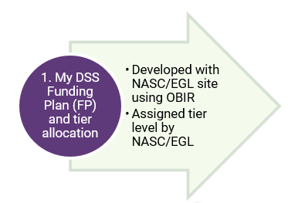
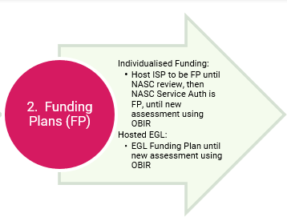
My DSS Funding Plan
New Flexible Funding
Flexible Funding for Existing
Notes:
(2 min)
Say:
You will have some familiarity on the My DSS Funding Plan, from previous trainings, and we briefly touched on it earlier in this training – now we’re going to take a closer look. The plan is an important document because it outlines the disability support needs identified through the assessment, the funding that has been allocated, and how that funding can be used to achieve the person’s goals.
In this next section, we’ll look at My DSS Funding Plan through two different lenses. First, we’ll explore how flexible funding works for people who have been assessed using the new assessment and allocation model- OBIR. Then we’ll look at how flexible funding applies to people who are already in the system and currently using hosted flexible funding.
This will help you feel confident supporting people in either group.
But first we’re going to look at what the My DSS Funding Plan is.

Slide 15
Development of My DSS Funding Plan
Why the plan matters
Phased implementation
Feb ‘26
New & urgent reassessment
Feb ‘26
New & urgent reassessment
Feb & March‘26
New to flexible funding
Urgent reassessments
Apr ‘26
Existing flexible funding
Introducing Tiers
2026-2027 NASC/EGL annual review
Transition to My DSS Funding Plan
NASC/EGL Reassessment
Complete new assessment and allocation process
Feb ‘26
New & urgent reassessmnt
Allocated budgets for flexible funding will stay the same
Notes:
(10 min)
Say:
Supporting people to use flexible funding well, begins with understanding the foundation it is built on – the My DSS Funding Plan. The plan is developed by disabled people with you (NASCs/EGL sites), outlining the person’s disability support needs, the purpose of the funding, what supports will help realise any outcomes identified, how much each support will cost, and the total cost. Hosts will need to have a clear grasp of what the plan represents and how it guides decision-making, ensuring they can coach, advise and monitor in a way that supports the person. You have already had some training on My DSS Funding Plan and why it plays such a central role.
(click)
Why the plan matters
By identifying purposes and supports, it will be clear to all parties (Hosts, disabled people, agents, and NASCs/EGL sites) exactly what DSS is funding, and the reasoning behind it. This transparency helps reduce misunderstandings, supports good budgeting decisions and ensures funding is used in a way that is consistent with the person’s goals and needs.
There will be a Phased implementation:
(click)
The rollout of the My DSS Funding Plan, developed though OBIR, for people who are new to the system, along with those having any urgent reassessments, will begin in March 2026. For disabled people who have chosen to use a hosted flexible funding budget, once you have completed the My DSS Funding Plan with them, you will send these through to the host. Once the host receives the plan, they will make contact with the person/Agent, and arrange an in-person meeting (for the first meeting) – ensuring the disabled person is present so that everyone can understand their roles and responsibilities associated with managing flexible funding.
In April, People who already use hosted flexible funding, will also have a funding plan. This will initially look different for the various groups using hosted funding.
For those using IF:
Initially, they will continue to use their existing Host Individual Service Plan (ISP) until their next NASC review. If an ISP is not yet in place or needs updating, this can be worked through between the host and the disabled person/Agent to ensure there is a clear understanding of the intent of the funding and how they intend to use it.
At the person’s next NASC review, you (NASC) will transfer the goals and purpose for the allocated funding, from the information you hold and discussions with the person, onto the Service Authorisation.
You will do this using the “notes” section under each of the relevant service lines (Personal Care, Household Management, Respite, EIF or EGLPB).
This will serve as the My DSS Funding Plan, until the person has a Re-Assessment
When meeting with a disabled person for a Re-assessment, you (NASCs) work through the updated assessment and allocation process (OBIR), and My DSS Funding Plan is refreshed as part of that conversation. A person’s reassessment may not be due for another 3 – 5 years but earlier reassessments may proceed if the person’s needs change. (Just a note that NASCs have the option to pause non-urgent re-assessments until October 2026, to allow time to embed the new tools and processes.)
For those using Hosted EGL:
The EGL Funding Plan will serve as the My DSS Funding Plan until the new assessment and allocation OBIR process occurs.
At whatever stage of the process outlined here, the My DSS Funding Plan will help the disabled person or Agent plan and understand how their flexible funding can be used – with support from the host.
In April 2026, people who already use hosted flexible funding will be assigned a Tier. This Tier will indicate the expected level of guidance, support, oversight and monitoring that the host will provide as part of their hosting responsibilities. The Tier system is designed to ensure that support is matched appropriately to the person/Agent’s: experience in managing flexible funding, level of engagement with their host, and their total flexible funding budget.
We will go into more detail about the Host Tier Support Framework in the next session, including what each Tier means in practice.
(click)
In case you did not hear about the Minister’s update. (click) The Minister announced earlier this month that allocated budgets for flexible funding will stay the same as they are now. This will allow disabled people and their carers, to continue using their flexible funding, without disruption to support arrangements. The period that the flexible funding was allocated for on the Service Authorisation, will remain unchanged.
Lets now take a look at the removal of purchasing rules.

Slide 16
Removal of Purchase Rules
Flexible funding follows the approved funding plan
Plan funding use
Purposes and intention of funding
Prior Approval
Equipment
Complementary therapies
Overseas travel
Repeat purchases of similar items
Purchases of one-off items above specified value
Notes:
(5 min)
(Click)
With the current purchase rules being removed in April, disabled people will have more choice and control around what supports they can purchase, that works best for them, but they must still use their flexible funding in line with the purpose it was allocated for.
The Funding Plan indicates the purpose of the funding and the proposed supports to achieve that purpose.
Purchases still need to relate to a person’s disability, and there is a requirement that services available from other government agencies have been explored before supports of similar intent are claimed.
(click)
There will be occasions where a host or NASC/EGL site will be required to provide a prior approval, before the person’s claim is approved, either by the host or by the Carer Support payments team. (HNZ Sector Ops)
Where a person uses hosted flexible funding the host will give the prior approval, and where the person has Carer Support, the NASC/EGL site will give the prior approval.
Hosts, NASC/EGL sites, and the Carer Support Payments Team, consider claims for payment and are expected to approve payment of those claims, unless a claim is for a support that is clearly inconsistent with the new Purchasing Operational Policy.
There are certain types of supports that require prior approval.
These include purchases for:
(click)
Equipment
If a NASC/EGL site reaches a view that the equipment does not pose a high risk of harm to the person or;
Receives advice from a registered health professional operating within scope of their practice confirming that the equipment is safe, supported by evidence and any risks are appropriately managed
(click)
Complementary therapies
There is a clear link to the funding plan and that it does not pose a high risk of harm
The NASC/EGL site receives advice from a registered health professional operating within their scope of practice which shows that:
that the complementary will be used in ways that are consistent evidence;
that there will be ongoing oversight by a health professional;
alternative support plans have been developed in the event that the complementary therapy is not effective for the person.
Where independent evidence is not available, a trial may be required to demonstrate effectiveness before the complementary therapy can be approved.
Further detail is covered in the new Purchasing Operational Policy (available 1 April) – including what Complementary therapy is.
The degree of risk associated with equipment or complementary therapies will usually be affected by a range of factors, such as the equipment or therapy itself, the circumstances in which it will be used, and the particular challenges that a disabled person has.
(click)
3. Lets move now to Overseas travel – and what needs to be considered:
the travel costs are related to the person’s disability need
that the travel is consistent with the purpose of the funding
that approving the travel will not compromise the person’s ability to access future supports
That support is not used overseas for a period of more than 3 weeks - in line with the Health and Disability Services Eligibility Direction 2011 Policy
the disabled person is responsible for arranging their own supports while overseas.
(click)
4. For Repeat purchase of items of a similar nature or intent, before the expected life of a previously purchased item has expired
The aim is to determine if the purchases are necessary, continue to be appropriate for the person and/or whether another type of support may be more appropriate.
(click)
5. For Purchase of items above specified values that are published on the DSS website. These thresholds are:
$1500 for Tiers 1,2 & 3
$500 for Tier 4
$1500 for those with Carer Support
Even if supports in the Prior Approval list have been included by you (NASC/EGL site) in the My DSS Funding Plan, the responsibility for providing this prior approval, sits with the host, if the person has hosted flexible funding, and with yourselves (NASCs) if the person has Carer Support.
Giving a prior approval, for those on Carer Support, has not been done by you (NASCs) before.
How this will work:
You will be contacted by the disable person or the Main Carer to discuss the purchase, requiring prior approval, that they want to make. If you (NASC/EGL site) give this approval (or part approval), you will send this in writing, back to the Person or their Carer, who will attach this to their claim for the Carer Support payments team.
The Carer Support payments team will provide the Person or their carer, a reason if a claim is declined claim e.g. if there are repeat purchases of similar intent, when they submit a claim, without the required prior approval. The Person or carer will need to pass this information on to you (NASC/EGL site), so that you can look at the individual circumstances in which the prior approval is being sought.
There has been a Detailed Training document developed for Hosts to support these prior approval decisions, that NASCs/EGL sites can also refer to, to support this decision making, and we’ll complete an activity on this shortly.

Slide 17
Consider Wellbeing of Carers
Respite
Emotional and Social Support
Sustainability
Perspective
Safety
Practical Support
Notes:
(3 mins)
(Say)
Some points that NASCs/EGL sites should consider when thinking about the wellbeing of carers, such as the parent or spouse of a disabled person are:
(click)
Respite: Does the current plan enable unpaid carers to have regular, breaks, considering short-term, and longer-term breaks. Are paid carers planning and taking regular breaks, using their annual leave? Has the carer’s perspective been considered when allocating funding for respite. Are there practical, everyday changes that could be made, that would help to alleviate stress and prevent burnout?
(click)
Emotional and Social Support: Does the person’s carer have access to support groups and/or peer support? Connecting with others can help to validate their role and to create connections that help to reduce a sense of isolation. Hosts will be able to support with this.
(click)
Sustainability: Has there been changes for the carers that impact on their ability to maintain the current levels of support? Consider wider demands in the carer’s life, alongside their physical and mental wellbeing. Is there a need for planned or immediate action to ensure their wellbeing? Is the current package of care sustainable or do alternatives need to be explored?
(click)
Perspective: Has the disabled person taken time to consider the viewpoint of the carers when considering funding?
(click)
Safety: are there any unmanaged safety concerns for the carer(s)?
if there is a need for training /equipment to reduce the risks associated with lifting or moving
is the carer at risk of harm from others
mental health – just asking how they are is validating. Many carers experience high stress, anxiety, and burnout. Key strategies could include setting boundaries, utilising respite care, maintaining social connections, and seeking professional support.
Prioritising self-care is essential for sustained caregiving
(click)
Practical support: Does the person’s carer know what supports are available to them?

Slide 18
15 Minute Break
Notes:
Say:
We’re going to take a 15 minute break now and when we come back, we’ll go straight into an Activity. During the break we’ll need to assign you into breakout groups – please stay logged in.

Slide 19
Activity #1: Prior Approval
Equipment
Complementary therapies
Overseas travel
Purchase of one-off items above specified values that are published on the DSS website and are within the tier level
5 key insights
2 min presentation back to the wider group
Notes:
(30 min)
Trainer: to help participants build familiarity with the main areas that require Prior Approval by engaging them in a short breakout activity. Each group will explore one area in depth and then teach the others through a 2 minute presentation back at the wider group. By the end, the whole group will have a working understanding of key points across all Prior Approval sections.
Producer: Activity set up
Share the DSS Training portal link to Detailed Training Document for Hosted Flexible Funding Providers for training in chat to the participants
Create 4 breakout groups in Teams
Assign each group one Prior Approval area:
Group 1: Equipment
Group 2: Complementary therapies
Group 3: Overseas travel
Group 4: Purchase of one-off items over the tier threshold
Ask each group to:
Locate the relevant section in the Detailed Training Document – give hint to go to the “How we think about…” section in Appendix 1
Read through the information together
Identify the Top 5 Key Points – what your peers absolutely needs to know
Groups will return to the main meeting and provide a 2 minute presentation summarising their key points
Trainer, Say:
Next, we’re going to spend some time exploring the main areas of Prior Approval in the Detailed Training Document for Hosted Flexible Funding Providers – this was emailed to you in the lead up to todays session. As you can see, there’s a lot of content, so rather than reading it all individually, or listening to me read through it, we’re going to divide and conquer. You’ll become the experts on your section and when we come back into the wider group will share your learnings with the others.
We’ll be putting you into breakout groups. Each group will be assigned one of the Prior Approval categories. Go to Appendix 1 in the document.
Here are the four areas we’ll be covering – each group will be assigned one:
(click)
Equipment – Group 1
Complementary therapies – Group 2
Overseas travel – Group 3
Purchase of one‑off items – Group 4
Trainer: check that the groups understand which topic is theirs before sending them into the breakout groups.
Say:
In your group, please locate your assigned Prior Approval section in the document. (Click)
Assign your spokesperson early – so they have time to work out what they will present back to the wider group.
Read through carefully and agree on the 5 most important key points that your peers should know about that section.
There’s a lot there, so you don’t need to capture everything – only what you think matters the most.
When we come back to the main room, each group will present their Top 5 Key Points in a short 2 minute presentation. The aim is to share your learning so that by the end, the whole group understands the essentials of all Prior Approval areas.
It is to be a brief and informal presentation – not polished. Remember to nominate your spokesperson early so they can prepare their presentation.
You will have 10 minutes in your breakout group to read, discuss and decide your key points. We’ll send you a 1 minute warning before we return, so keep an eye on the time.
Any last minute questions before you head into your breakout groups?
Make sure you know your topic before you go. See you shortly.
Producer/Trainer: Give a mid way reminder and pop in to see how they are progressing.
When you give them the 1 minute to go reminder, bring them back.
Trainer: High energy once they return.
Say:
Welcome back! Each group has been exploring a different Prior Approval area, so now we get to learn from each other. Let’s kick off the presentations and start sharing your 5 key insights. Starting at the top with Equipment.
Trainer thank each person for their presentation and move onto the next group so all subjects are covered.
Say:
Excellent work everyone. By pooling your insights, we’ve now built a shared picture of what Prior Approval involves. Let’s carry that clarity forward as we move into our next topic – the Host Tier Framework. Before we move on, do you have any questions about My DSS Funding Plan?
Producer: stop recording

Slide 20
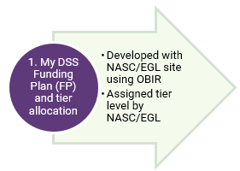
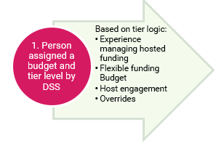
Host Tier Framework
Notes:
(2 min)
Say:
As we move into the next part of the training, we’re going to look at the Host Tier Framework.
This framework sets out the different levels of guidance and monitoring that hosts will provide, based on the tier assigned by the you (NASC/EGL site) using the Host Tier Allocation Tool.
Understanding the tier system is important because it helps ensure that the right amount of support is matched to the person.
In this section we’ll cover what each tier means, why a person may be assigned a particular tier.

Slide 21
Introduction
Right level of guidance
Shared accountability for funding
Spending aligns to plan
Budget meets needs across the year
Guidance varies by person/Agent
Notes:
(2 min)
Say:
(click)
The Host Tier Framework helps make sure each person or their agent receives the level of guidance and monitoring they need when using hosted funding (IF, EIF, and hosted EGL Personal Budgets). Its aim is to match people with the right level of input so they can successfully manage their flexible funding – both in terms of staying within their budget and, where relevant, managing their responsibilities as an employer.
Everyone involved (disabled people/Agent, Hosts, NASCs, EGL sites and DSS) shares accountability for how funding is used. This includes being able to show that spending aligns with the purposes in the My DSS Funding Plan, and that there is planning in place, to ensure the allocated budget meets disability-related needs across the year.
The amount of guidance people require from their host will differ. Some may need minimal input, while others may benefit from more support in managing their responsibilities.

Slide 22

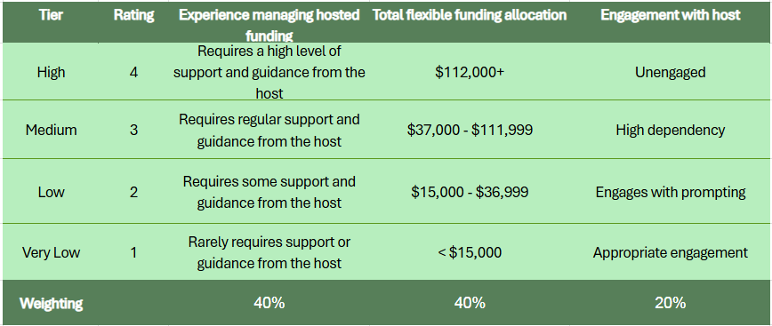
Tier Matrix
Tier assigned at assessment
Tier communicated to all
Tool guides tier decisions
Notes:
(5 min)
Say:
(click) During the NASC or EGL site review, or assessment process, a tier of host support is assigned. This tier is then communicated to the disabled person /Agent, as well as to the host, so everyone is clear on the level of guidance expected.
To help make tier decisions consistently, the Host Tier Allocation Tool is used. This tool applies ratings and weightings across 3 key factors, supporting decisions about allocating people to a tier and when a change in tier may be needed. (click)
The 3 factors are:
The Experience a person/Agent has in managing their hosted funding. It will vary from “requires a high level of support and guidance from the Host” at the high tier to “rarely requires support or guidance from the host” at the very low tier. (click)
(click)
2. The Total flexible funding allocation, varying from smaller to larger budgets. (click)
(click)
3. The level of engagement between the person/Agent and the IF Host, varying from unengaged to appropriate engagement. (click)
(click) The weightings used were developed through mathematical modelling, where multiple weighting scenarios were tested to see which combinations best reflected the distribution of people across the tiers. This was to ensure that the tool placed an appropriate and realistic number of people into each tier. (click)

Slide 23
Tier Descriptions for Experience
Tier 4 – High
Tier 3 – Medium
Tier 2 – Low
Tier 1 – Very Low
Notes:
(5 min)
Say:
The Tier Descriptions for Experience are:
(Click)
Tier 4:
A person/agent in tier 4 requires a high level of guidance and coaching from the host to become confident and skilled in managing the responsibilities related to their hosted funding.
They may not be sufficiently skilled in managing all or most aspects of hosted funding and require support from the host to gain this proficiency, and oversight to ensure they meet their responsibilities, while they are developing these skills. They may not be confident and need support to build that confidence.
This tier should be selected for people needing the greatest level of support. Typically, someone who is new to hosted funding would be in Tier 3.
(Click)
Tier 3:
A person/agent in tier 3 requires regular support and guidance from the host to become confident and skilled in managing the responsibilities related to their hosted funding.
They may be new to hosted funding or not fully managing some aspects of their hosted funding confidently.
The expectation is that people in this tier will be supported by the host so they can gain the required skill and confidence, so they can transition to Tier 2.
If a person is not managing at Tier 3, they may transition to Tier 4.
(Click)
Tier 2:
A person/agent in tier 2 requires some support and guidance from the host, but is generally managing most aspects of hosted funding confidently and proficiently.
A person in this tier has some experience managing hosted funding and has a plan for how they will use it, in alignment for what the funding was allocated for.
They are mostly confident and proficient in managing the flexible funding.
(Click)
Tier 1:
A person/agent in tier 1 rarely requires support or guidance from their host, as they are confident and proficient in managing all aspects of their hosted funding.
They are experienced and skilled, have a plan, and meet their responsibilities without more than occasional guidance or support from their host.
The main difference between Tier 1 and Tier 2 is overall experience, confidence and skill. A person in Tier 1 is unlikely to require much support; a person in Tier 2 requires occasional support.

Slide 24
Demo: Understanding the Tier Allocation Tool
Meet “Tracey”
Tracey is a 30-year-old woman who lives in her own flat with her cat (Remi). Tracey has an intellectual disability.
Tracey has previously held a part time job at a local supermarket but is currently unemployed. She needs support in the morning and evening to complete her daily personal care routines, for the purpose of preparing herself for her day, and setting-up her evening routine. Tracey enjoys being responsible for her home and can do most tasks with prompting from her support worker.
Tracey’s mum is her IF Agent
Tracey receives an IF Personal Care annual allocation of $26,936, to employ a support worker for 14 hours per week, and has an IF Household Management annual allocation of $5,772, to employ a support worker for 3 hours per week. Her total annual flexible funding allocation is $32,708. In the future she would like to purchase a Thermomix at $2100 to support her with making meals, so, she can become more independent in this area and potentially need less support in the future. This fits within her Indicative Range and her DSS Funding Plan.
Tracey has been using hosted flexible funding for 3 years, and the host has advised that her mum is not that confident in managing the hosted funding, and requires regular support to help her with managing it.
Tracey’s mum provides the host with timesheets on request, but sometimes needs reminders when to send these in.
Notes:
(5 min)
Say:
You (NASCs and EGL sites) will be using the host tier allocation tool to work out the person’s tier and communicating it to the disabled person/agent, and to the Host.
We’ll take a few minutes to watch a video demonstrating the Host Tier Allocation Tool.
TTT: NASC Trainer – now play the section from the TTT video demonstrating the Tier Allocation Tool
Say:
Next we’ll have a look at where you can locate the Host Tier Allocation Tool and after that we’ll move into an activity where you can begin to make some decisions when inputting into the tier tool.

Slide 25
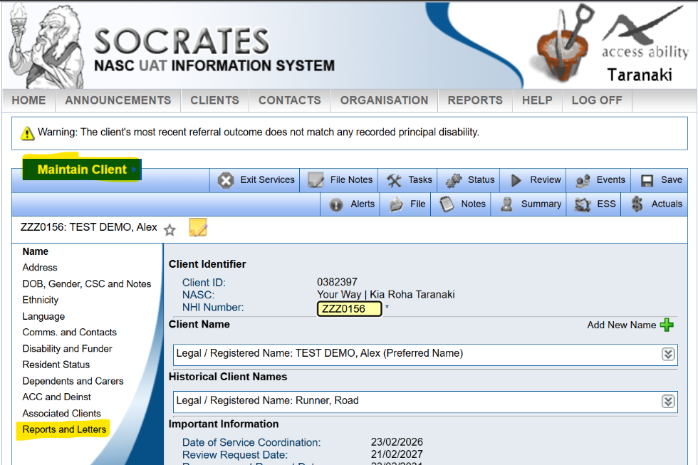
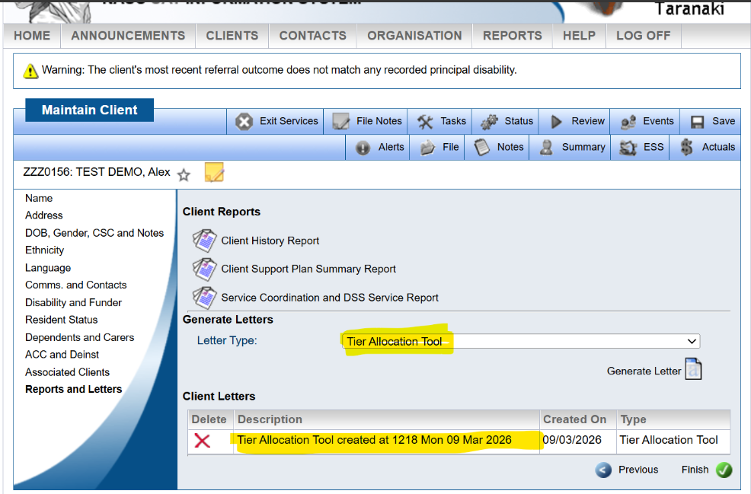
Locating the Host Tier Allocation Tool
Notes:
(2 min)
Say:
To access to the Host Tier Allocation Tool is in Socrates:
(click) Select Maintain Client (click)
(click) Select Reports and letters (click)
(click) Click drop-down in letter type, and select “Host Tier Allocation Tool” (click)
(click) Select “Generate Letter” (click)
(click) Click the generated “ Host Tier Allocation Tool” link and complete it (click)
6. (click) Once finished, save it, and then assign the tier in the Service Coordination (click)

Slide 26
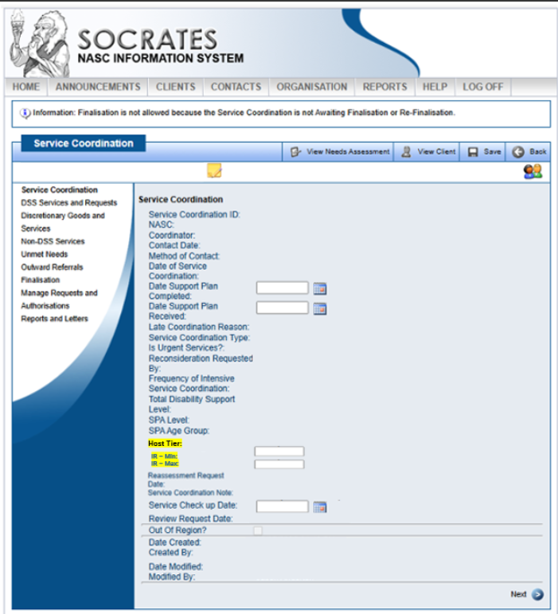
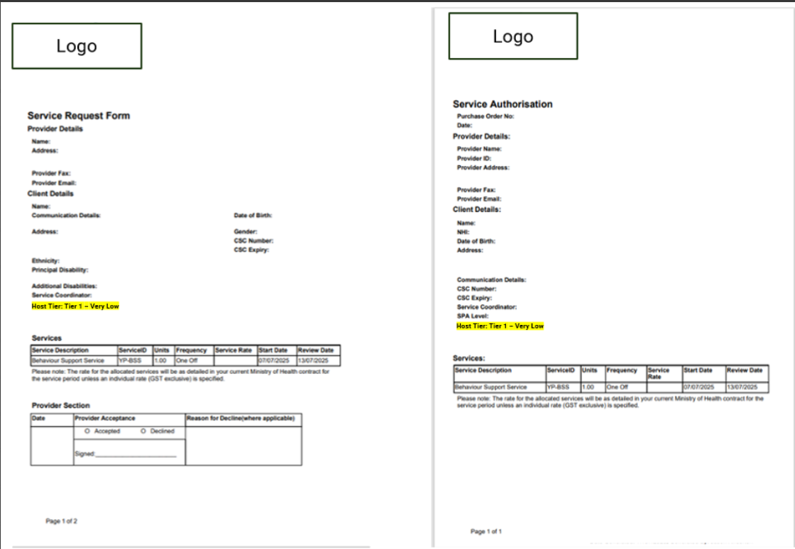
Notes:
(1 min)
Say:
(click)
This “Host Tier” field will be completed (via a drop down box) on the main Service Coordination screen and automatically pulled across into the Service Request, and Service Authorisations
It is a mandatory field for all Service Co-ordinations, but if it’s not applicable ie for those not on Hosted Flexible Funding, select N/A in the drop down box.
Please write that an Override has been applied (if applicable,) and the reason for this in the “notes” section on the SA. This is important for the hosts to know, as this may impact on how they work with someone, and the feedback they provide back to you at review.

Slide 27
Activity #2: Understanding the Host Tier Allocation Tool
Understand the logic behind tier decisions
Present back to the wider group:
  Key factors influencing tier decision
  Any assumptions you had to make
  Areas of uncertainty or interpretation
  Anything that sparked discussion
  Your final tier level
Notes:
(25 min)
Say:
(click) In this session, we’re going to move into a breakout activity to help you get familiar with how the Host Tier Allocation Tool works.
Say:
Here’s how the breakout activity will run:
Shortly we are going to break you into 3 groups and we will send you into separate virtual rooms so you can discuss the scenario and persona we’ve provided to you in your invitation to today’s session. When we move you into the breakout groups, we’ll advise which persona you are to use for this activity.
Together, you’ll read through the persona’s outline and step through the Host Tier Allocation Tool . Your goal is to reach a tier level.
Be sure to make a note of your reasonings and key insights because when you come back we’ll be asking you to share back with the full group.
Each group will have a different scenario, so you will have different outcomes.
Don’t worry about being perfect – it’s about understanding the process, not testing you.
Say:
Understanding how the tool works will help you to:
Make sense of the tier levels
Understand the factors that went into it
Notes for trainer:
Producer will operate break out groups.
XXXX will need to join Group 1 (persona – Adam)
XXXX to join Group 2 (persona – Tāne)
XXXX to join Group 3 (persona – Tracey)
The breakout leaders will need to have the tier tool open and be ready to share their screen to firstly read through the background persona and then complete the tier tool
Provide instructions to the participants about what they are to cover in their break out session – copy and paste the below points FROM THE SPEAKER NOTES into chat.
Key factors influencing your tier decision
Any assumptions you had to make
Areas of uncertainty or interpretation
Anything that sparked discussion
Your final tier level
Say:
I’ll give you 15 minutes to understand your persona and input into the tier tool. Use your experience to make assumptions if you need to. You’ll have a lot to discuss, so keep an eye on the time and we’ll give you a count down as time is running out.
Then once we’re all back, each group will have an opportunity to share their findings – 2 minutes for each group.
Producer: pause recording when everyone goes to break out groups
Producer: start recording when everyone back
Notes for trainer:
Remain on this page when participants come back from breakout groups so you can use the bullet point prompts as a guide to their presentation.
Remember to encourage the sharing of their thinking and why their persona ended up in their tier.
When wrapping the activity up thank them for their participation.

Slide 28
Tier Review
New to flexible funding – allocated tier from April by NASC/EGL site
Already using flexible funding –initial tier allocation by DSS
Feedback loop
Host provides tier feedback to NASC/EGL site 4 – 6 weeks prior to review
NASC/EGL site relies on Host information provided
Notes:
(3 min)
Say:
As we move into the new assessment allocation & flexible funding approach, there are two key groups of disabled people you need to be aware of:
(click) First, people who are new to hosted flexible funding from April will go through the new assessment and allocation process with you (NASC/EGL site), using OBIR, and will be allocated a Tier by you. This will happen as part of their initial engagement with the system.
(click) For people who are already using hosted flexible funding, the transition is a little bit different.
They will receive an initial Tier allocation by DSS. The information gathered from hosts and the assumptions that DSS made for this tier segmentation, were advised in the previous “Host Model for Existing People” slide, towards the beginning of the slide pack. This is only a starting point. If you (NASC/EGL site) feel that the initial Tier allocated to a person is not appropriate, you can discuss this with the host, and the rationale for requiring a change. Then this can be adjusted when you are reviewing the person’s support needs. We’ll talk more about the feedback loop, between hosts and NASCs, shortly.
Generally, at the NASC/EGL site annual review, the Host will provide feedback to you on the appropriateness of the tier, if it needs to change, and why. You will take this information provided into consideration when assigning the tier for the upcoming year.
You will be reliant on the information that Hosts provide you prior to the review. In addition to advising if the tier is appropriate or not, they will provide information about the person’s experience in managing their flexible funding, and if they had any difficulty in managing their budget or employment responsibilities, as well as how engaged the person is with them (ie if they engage appropriately or not)

Slide 29
Tier Changes
Clarity and implementation of the plan
Spending aligns with the plan
Records accurate and consistently supplied
Understand pre-engagement purchase requirements
Understand prior-approval documentation requirements
Spend matches available funds
Responsible employer
Engagement and responsiveness to Host
Safeguarding or financial concerns
Notes:
(5 min)
Say:
As we look at how individuals move through the tiers, it’s important to recognise that movement isn’t fixed or one-directional.
On this slide we’ll walk through how movement up or down the tiers occurs, and what information the host will need to supply to the NASC/EGL site, to enable you to make informed decisions about a possible change in tier.
Some factors to take into consideration when moving up or down a tier will include:
(click)
Does the person/Agent have a clear plan on how the funding will be used? Is it being successfully implemented? (click)
Is the disabled person/agent spending their funding on purchases that align to the My DSS Funding Plan? Is the spending disability related and the purchase related to specific parts of the purposes agreed in My DSS Funding Plan? (click)
How are the record keeping practises? Receipts, invoices, timesheets, bank records (if relevant). Are they reflective of how the budget is being spent? Is the information being supplied to the Host? (click)
Do they know when a pre-engagement discussion for purchases is required, for those in Tier 4? (click)
Do they know when, and what documentation for prior approval purchases, is required? (click)
Are they ensuring that spending doesn’t exceed available funds – are they managing funding across the allocation period? (click)
Are they a responsible employer? (click)
What’s their engagement with the Host like? How responsive are they to information the Host has requested? (click)
Are there any safeguarding or financial management concerns? (click)
The new Hosted Flexible Funding Detailed Training Document and Operational Policy will give you more guidance on this, and you will get a link to the publication on the DSS website as part of our post-training support.

Slide 30

Talking About Tiers
Tier 1
Tier 2
Tier 3
Tier 4
Rarely needs guidance from host
Experienced in managing hosted FF
Confident & skilled
Meet responsibilities
Self verify claims
Yearly contact
Needs some guidance from host
Have some experience
Mostly confident
Building skills in managing hosted FF
6 monthly contact
Regular guidance from host
New to hosted FF
Meets some of responsibilities
Need guidance in making plan happen
Building confidence & skills
3 monthly contact
Frequent & high level of guidance
Could have used FF for purposes not in plan
Audited with fraudulent findings
Currently under audit – case-by-case, and escalate to DSS
Used budget early in past
Safeguarding concerns
Significant coaching required
Monthly contact
Notes:
(15 min)
Say:
By now you’ll know that the tier tool provides a continuum of support over 4 levels.
Let’s take a moment to look at the type of information you could cover when explaining the tier system with a disabled person/agent. A conversation with them, about the tiers will be relevant, when the person is new to hosted flexible funding, when they need less guidance in managing their budget – e.g. when they go down a tier level, or when they need more guidance managing their budget – e.g. when they go up a tier level.
(click) People in Tier 1:
rarely needs guidance from their host
are experienced in managing hosted flexible funding
are confident and skilled in managing their hosted flexible funding - including how to make their plan happen
meet all the responsibilities of managing their hosted flexible funding
Are able to self verify claims (For those in Tier 1, a self-verification template will be used, which categorises purchases against the purpose of the support. Self verification is to ensure something is true. It means that the disabled person/agent will need to make sure their claims for use of hosted flexible funding, meets the purposes in their Funding Plan.)
Hosts will have conversations with the disabled person/Agent in Tier 1 at least once a year, but not limited to that, and will occur 4 – 6 weeks prior to their NASC/EGL site review.
Some of the things that will be discussed at that time are:
How they have used their flexible funding
How the funding meets the purposes in their My DSS Funding Plan
If they are having difficulty with managing flexible funding – talk about the possibility of moving to a higher tier
The guidance and coaching the Host has provided and if more or less is required in the following year
Any changes they would like to make to their supports in the following 12 months
(click) People in tier 2:
need some or occasional guidance from their host
have some experience managing their hosted flexible funding, and are mostly skilled in meeting their responsibilities
feel mostly confident making their hosted flexible funding plan happen
are working on building their confidence and skills in managing their hosted flexible funding
Hosts will have conversations with the disabled person/Agent Hosts in Tier 2 every 6 months, however more regular conversations can occur if requested or needed.
Hosts will discuss:
How they’ve used their flexible funding
How spending aligns with the My DSS Funding Plan
The plan for the next 6 months
(click) People in tier 3:
need regular guidance from their host
may be new to hosted flexible funding
meet some of the responsibilities of managing their hosted flexible funding, but are not managing some aspects confidently
need regular guidance making their plan for their hosted flexible funding happen
are working on building their confidence and skills in managing their hosted flexible funding
Hosts will have conversations with the disabled person/Agent every 3 months, however more regular conversations can occur if the person requests/needs it.
Every 3 months the host will discuss:
How they’ve used their flexible funding
How spending aligns with the My DSS Funding Plan
The plan for the next 3 months
(click) People in tier 4:
need frequent and a high level of guidance from their host to manage their responsibilities of their hosted flexible funding
may have been identified as having used flexible funding that does not meet the purposes in their plan despite guidance from their host
may have been audited in the last five years with fraudulent findings
may have previously used their budget early, that was not planned, resulting in a review despite no changes in disability support need
may have been identified as experiencing safeguarding concerns
need significant coaching to work on building their confidence and skills in managing their hosted flexible funding
are currently under audit (looked at case-by-case, and the NASC/EGL must escalate to DSS to endorse their recommendation on what the Tier should be- we’ll talk more about this shortly.)
Hosts will have conversations with the disabled person/Agent on a monthly basis with more frequent engagement if the person requests or needs it.
Each month the host will discuss:
How they’ve used their flexible funding
How spending aligns with the My DSS Funding Plan
The plan for the next month
Pro-actively coach, guide and monitor budget and employer responsibilities, and record keeping
Tier information sheets will be available and can be shared with the disabled person/agent, by yourselves.
Hosts will be advising people what their tier will be from 1 April.
Before we move on to the feedback loop do you have any questions about the Host Tier Framework?

Slide 31
Feedback loop

Slide 32
Feedback Loop
Provide timely feedback
Summarising:
  Use aligned to purpose
  Outcomes achieved this period
  Funding spent
  Tier level appropriateness
Request reassessment when needed
Provide early summary
NASC/EGL site
Host
Notes:
(5 min)
Say:
We will now look at the feedback loop between Hosts and NASCs/EGL sites. This loop keeps both parties connected, supports consistent actions, and ensures that updates and clarifications continue to align the My DSS Funding Plan with the person’s disability support needs.
(click)
For now, Hosts and NASCs will continue sharing feedback through the usual communication channels. Until a dedicated technology solution is introduced, it’s important that all information is exchanged using your organisation’s approved process. It includes following your usual protocols for maintaining privacy practises.
(click)
Hosts will need to provide feedback to the NASC/EGL site around 4 – 6 weeks before the person’s scheduled annual review. In some situations, this may have to happen earlier if a review is required sooner. To prepare this feedback, the host will meet with the disabled person or their agent ahead of time to discuss progress, identify any changes and ensure the information reflects the person’s disability support needs and purposes of funding. While this builds on aspects of current practice, it is now part of the new process.
(click)
The feedback to the NASC/EGL site should summarise:
How the funding was used and how it aligned to the intended purpose
The outcomes that were achieved during the funding period
The funding spent per purpose/service line
The total funding spent
If the support from the Host was at an appropriate tier or if it needs to be adjusted, and why
You’ll need to think about what the best way to receive this information is. For example, set up a separate email, spreadsheet, or direct to the service coordinators. The hosts will be happy to work with you, to make this work.
(click)
When a person’s circumstances change or the original My DSS Funding Plan purposes are no longer suitable, a host or disabled person/agent can request a reassessment from the NASC or EGL site. In these situations, the Host will also need to provide an early summary of key information so the NASC or EGL site can understand what changes might be required.
The key takeaway is that strong, consistent communication between Hosts and NASC/EGL sites helps everyone stay aligned, respond early to any concerns and ensure the person’s support remains safe and effective.
The feedback loop isn’t just a requirement – it’s what allows the system to stay responsive and centred on the person, rather than the process.

Slide 33
Escalation Pathway
Budget non-compliance
Dispute handling
Escalating complaints
Suspected fraudulent use of funding
Notes:
(5 min)
Say:
(click)
Lets now take a look at the approach to managing escalations.
The points described here apply to: situations involving budget non-compliance, disputes between parties, complaints, and suspected fraudulent use of funding.
This is to ensure that concerns are addressed promptly, transparently and in accordance with organisational policies, contractual obligations and relevant legislation.
By adhering to the following processes, everyone involved can be confident that issues will be managed objectively and respectfully, with appropriate oversight at each stage.
For Budget non-compliance – The host will meet with the person/Agent to discuss the issue. If a genuine mistake or misunderstanding has occurred, further information and/or coaching will be provided by the host to build capability to rectify the situation. If there is non-compliant budget management or spending, the host or NASC will refer to the Operational Policy: Restrictions on Access to Hosted Budgets and apply where applicable. Then the host will also need to notify you (NASC/EGL site) of either what their suggested solution is or discuss another solution with you.
For Dispute handling – this is when a person/Agent/carer/legal guardian doesn’t agree, and remains dissatisfied with the outcome/situation. The NASC/EGL site will attempt to resolve this, using your internal peer review process, then if required, undergo an external peer review. Disputes may relate to, funding allocation, funding purposes, tiers, or My DSS Funding Plan. Refer to the host if it’s related to a prior approval dispute, or payment of claims etc.
For Escalating complaints - If the Person/Agent is still dissatisfied following the dispute handling pathway, the Person/Agent will need to make a complaint through your NASC’s usual complaints process. If a resolution is still not reached, the Person/Agent can escalate their complaint through the DSS complaints process. (which can be found on the DSS web page). They can also make a complaint to the HDC.
Suspected fraudulent use of funding – If you (NASC/EGL site) receive notification of suspected fraudulent use or you suspect there may be fraudulent use of funding, you will need to notify the Audit and Assurance team at Health NZ. This can be done through email, or through The Health and Integrity Line. Once a referral to the HNZ Audit and Assurance team is made or an investigation is in progress, you may need to implement the Restrictions Policy to minimise the risk of further potential fraud. If you (NASC/EGL site) are going to implement the Restrictions Policy for this reason, you need to notify DSS through a new Assurance Process – so that DSS can endorse your decision, validating it. This will include what tier the person should be on (if applicable). (We will let you know what this new Assurance Process is).
More detail will be located in the Operational Policy document.
Any questions about the feedback loop before we move to the wrap up?

Slide 34
Self Determination
Notes:
(1 min)
Say:
When we think about having conversations with people, we need to set the tone right from the start, and take care not to accidently tip choice and control away from the disabled person.
By engaging in a natural, respectful, mana-enhancing conversation, we uncover the person’s values, experiences and aspirations rather than collecting just the facts.
This approach aligns with EGL principles, which emphasise building relationships, listening deeply and supporting people to share what truly matters to them. When we use curiosity and empathy to explore statements further, we gain richer insights that lead to better decisions and outcomes for both the person, their whanau and DSS.

Slide 35
Self Determination
Disabled people:
Have the right to have their voice heard
Preferences honoured
Are central decision-makers
Will and preference
Understand what a person truly wants
Express choice and control
Communicate differently across different settings
The principles of Enabling Good Lives should be considered the foundation of planning & decision making
Notes:
(5 min)
Say:
(click)
Self-determination is centred on recognising each person’s right to have their voice heard, and to be supported to make decisions that are right for them.
It asks us to shift from making decisions for someone, to working with them, honouring their preferences, communication style, and autonomy.
We’ll explore what that looks like and what your role is in enabling it.
At the heart of our approach, is a commitment to ensuring that disabled people are the central decision‑makers in their own lives.
We support disabled people to make decisions to the best of their capability, recognising that with the right information, tools, and people around them, most individuals can make decisions that reflect their own values, identity, and aspirations.
Self-determination is built on the understanding, that many people can make their own decisions when provided with appropriate help, such as accessible information or assistance to weigh up options.
This aligns strongly with our values of maximising autonomy and ensuring disabled people can act as self‑determining individuals.
DSS philosophy reinforces that an individual’s participation and preferences must remain central, even when formal supports or court‑appointed roles are involved.
This means working alongside people—not speaking for them—so that every decision reflects what matters most to them.
A person’s will and preference is understanding what the person truly wants, values and is striving for.
This helps ensure that every decision made, and every support offered, meaningfully reflects their own vision for their life.
People communicate what they like, dislike, enjoy and hope for – though not always in ways that are immediately obvious, or aligned with the systems and processes we’re used to.
Sometimes preferences only becomes clear through experience, connection and supported exploration.
As NASCs and EGL sites, it is important to notice these expressions, create opportunities for the person to show what matters to them, and adapt your approach as more is learnt.
By staying open, flexible and curious, about how each person communicates their goals, they can be better understood. You have an opportunity to empower the person, to exercise real choice and self-determination.
(click)
The principles of Enabling Good Lives should be considered the foundation of any planning and decision-making process. They remind us that every conversation and every decision starts with the person – what matters to them, what a good life looks like in their eyes, and how we can support them to get there.

Slide 36
Wrap Up and Reflection

Slide 37
What We Covered Today
Hosted flexible funding model
Roles & responsibilities
My DSS Funding Plan
Host Tier Framework
Feedback loop
Self determination
Notes:
(3 min)
Say:
What we’ve covered today should round out the big picture of the Assessment, Allocation and Flexible Funding changes. We have discussed:
(Click)
Hosted Flexible Funding Model
Understanding how the model supports autonomy, choice, and tailored support.
Roles & Responsibilities
Clarifying who does what, where accountability sits, and how we work together effectively.
My DSS Funding Plan
How the plan is developed, used, and updated to reflect each person’s goals and support needs.
Host Tier Framework
What each tier means, the expectations for hosts, and how the framework guides consistency and quality.
Feedback Loop
How continuous feedback between Hosts and NASCs/EGL sites will improve how we collectively support disabled people.
Self Determination
Centred on recognising each person’s right to have their voice heard and supported to make decisions that are right for them.

Slide 38
Reflection
What new insights or perspectives did you gain?
What felt most useful or relevant to your role?
How will you apply today’s learning in your day-to-day work?
Notes:
(5 min)
Say:
Before we finish, lets take a moment to reflect on what stood out for you. (Click)
Trainer: take a few minutes to discuss reflections from the participants & advise them that FAQ’s will be up on the DSS website soon. Pick say 3 people to ask.
Say:
As you move forward:
Embed today’s information – refer to the supporting documents when they come out to you.
Keep the feedback loop active – look at how your processes can streamline
Stay curious and connected – ongoing learning is key to supporting these changes that are ultimately going to give disabled people more choice and control over their flexible funding
Come along to our drop in sessions as any questions come up and keep an eye on our FAQ’s – this will be a living document that will be updated frequently

Slide 39
Questions
DSS_Testing@msd.govt.nz
Notes:
(5 min)
Say:
We have time for any last questions. You can put them into chat, email our DSS Testing team or ask now.
We will be running drop in sessions specifically around the content we’ve covered today. Invitations will be forwarded to you shortly. Note that hosts will be attending these drop in sessions too.
Take a few minutes to answer questions and then close with Karakia
(Say):
Thank you all for your active participation today. The training material and a recording of this session will be available on the DSS Training Portal shortly. We hope the resources we’ve shared support you in delivering your upcoming sessions with confidence, and that they help address any questions your teams may have along the way.
Now one final ask of you – would you mind letting us know how we did by putting into chat how you would rate this training, on a scale of 1 – 10 with 1 being very bad and 10 being very good. Plus one word to describe the day.
Thanks again for your engagement – best of luck with your trainings!
We’ll finish with a closing karakia:
Kia tau ki a tātou katoa
Te atawhai o tō tātou Ariki, a Ihu Karaiti
Me Te aroha o te Atua
Me te whiwhingatahitanga
Ki te wairua tapu
Ake, ake, ake, Āmine

