Slide 1
Introduction to Residential Pricing changes
Additional Information

Slide 2
Nau mai, haere mai Welcome

Slide 3

What this session will cover
The funding allocation process
The process related to dealing with exceptional rate calculations
How to access training and support material, and what’s available
Suggestions on what to do next
Notes:
[IMAGE CREDIT Photo by Marissa Grootes on Unsplash]

Slide 4

Learning Goals
The funding allocation process
The process related to dealing with exceptional rate calculations
How to access training and support material, and what is available
Notes:
[IMAGE CREDIT Photo by Kelly Sikkema on Unsplash]

Slide 5
Recap – The funding allocation process

Slide 6
Allocating funding using BAT
A simplified end-to-end view
Needs Assessment Completed
Choose Provider, Region and Service ID in Socrates
Document in Socrates
Finalise Service Coordination
Update individual’s address in Socrates
Discuss/advise on providers
Generate Service Authorisation
END
Contact providers
Discuss facilities
Send Service Request
Accept Service Request
Review Panel endorsement
not required
Receive Service Authorisation
Use BAT/GPT to calculate rate
END
Review Panel endorsement required
Decision reviewed
Disabled Person
NASC/EGL sites
DSS Review Panel
Service
Providers

Slide 7
Exceptional Rates

Slide 8
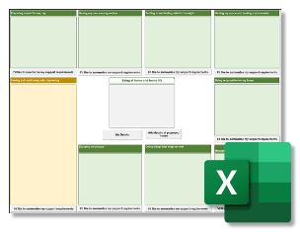
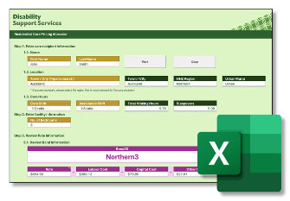



Dealing with exceptional rates
Below or
above
bands
(Exceptional
Rate)
Dual
funded
(Exceptional
Rate)
Review Panel Application
NASC Manager
EGL Director/Lead
Review
DSS
Assurance
Outcome
Review Panel

Slide 9
Exceptional rates process
Funding above or below the standard bands/dual funding - Exceptional rate. Review with a NASC Manager or EGL Director/Lead Connector.
NASC Manager or EGL Director/Lead completes Review Panel Application form.
DSS Assurance reviews and triages it for Panel consideration. Urgent applications dealt with differently. If information is outstanding, the application will remain ‘on-hold’.
Review Panel review the application and the NASC Manager or EGL Director/Senior Connector will be informed of the outcome.
If endorsed, the exceptional rate or band is confirmed, with notes and conditions outlined.
If the exceptional rate or band is not endorsed, the NASC Manager or EGL Lead/Director will be informed of the outcome with reasons citing the non-endorsement.

Slide 10
Training and support material

Slide 11

Where to find support
A hidden page on the DSS website https://www.disabilitysupport.govt.nz/training-and-support
BAT Exemplar files on Socrates (which is also where you access the BAT and GPT tools) to support self-paced learning activities
DSS_submissions@msd.govt.nz
Note the underscore
disabilitysupport.govt.nz/training-and-support
Notes:
[IMAGE CREDIT Photo by Jonas Jacobsson on Unsplash]

Slide 12

Try to ALWAYS access the website for the latest versions of support material.
Always create new files from Socrates instead of reusing a saved copy.
Notes:
[IMAGE CREDIT Photo by Muhammad Daudy on Unsplash]

Slide 13


BAT Practice Scenarios
There are 4 self-paced learning scenarios you can download from the hidden training and support page on the DSS website
Everything you need to know is in that document, including the others steps to take:
Using the BAT tool in Socrates
Using the GPT in Socrates
Downloading the exemplar response for the scenario to compare to your BAT response

Slide 14
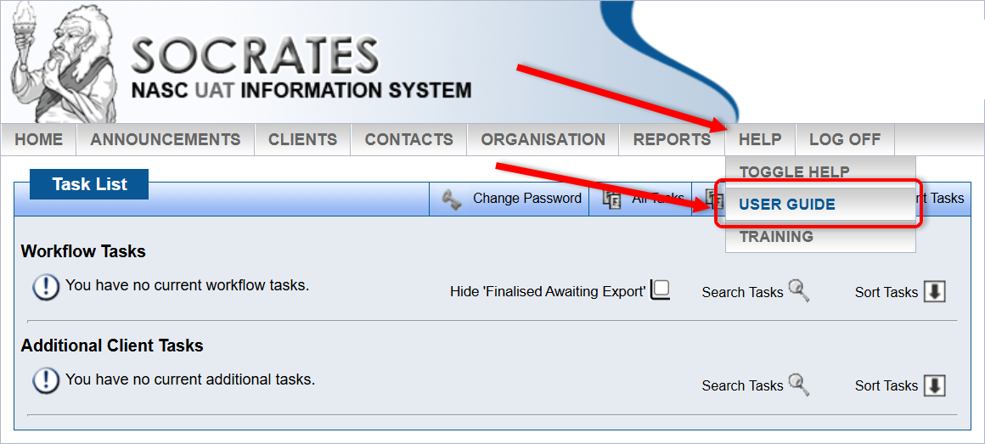
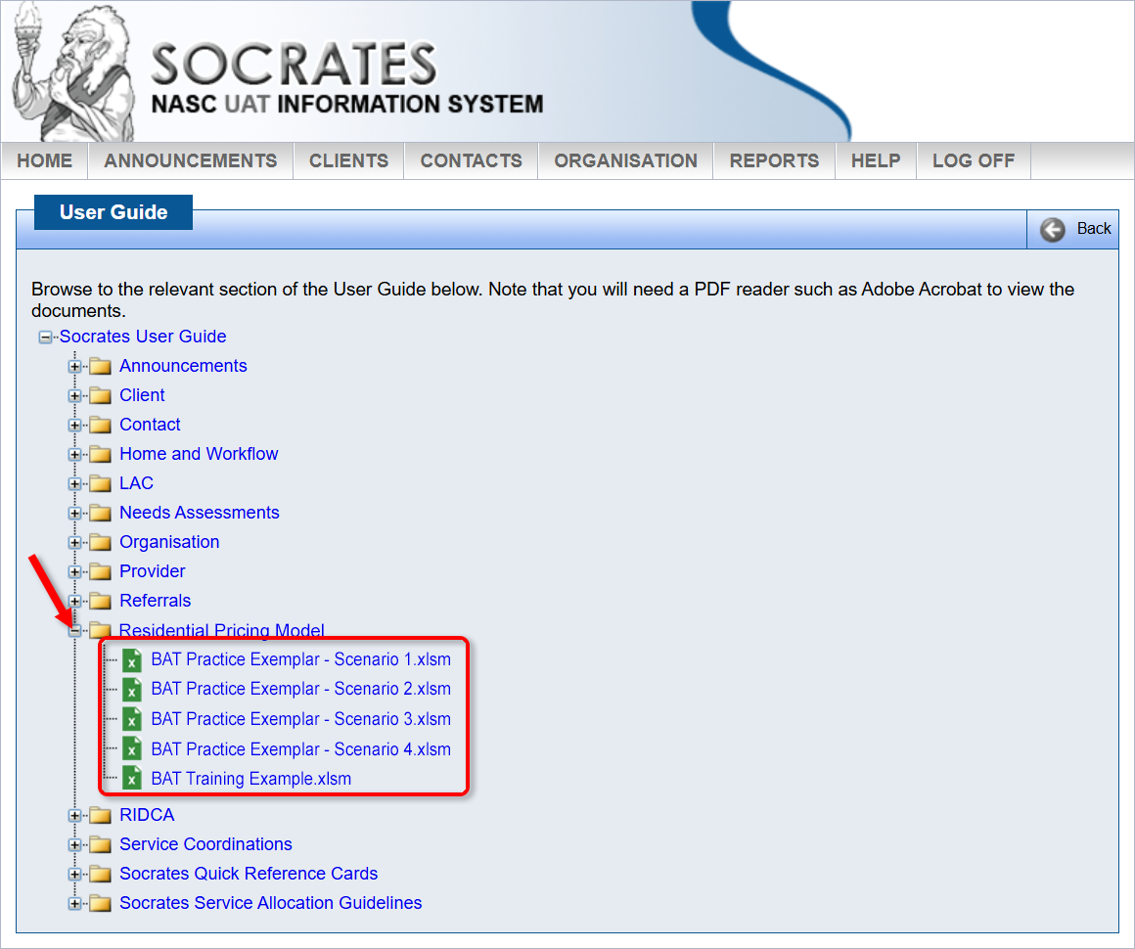
Where to find the BAT Practice Exemplars
Socrates → Help → User Guide
Click on ‘+’ next to the Residential Pricing Model folder
Each of the exemplar files are here to open and save a copy to your PC. You can use these files to compare with the BAT that you create when working through each scenario.

Slide 15
What’s next for you?

Slide 16

What’s next for you? (cont)
Take a breather. Grab some coffee.
Read the BAT User Guide.
Download the BAT Practice Scenarios. If your band allocation outcome does not match with the scenario results, discuss with colleagues.
DSS intends to arrange virtual 'drop-in' sessions in the lead-in to 1 December to answer any questions.
Try completing the BAT based on your experience with a disabled person you know.
Read the BAT User Guide again (you’ll pick up more), the Cheat Sheets and FAQs.
Check out other resources on the hidden training and support page on the DSS website.
Training
(Structured learning)
Learning
from others
Learning from experience (on the job learning)
Notes:
[IMAGE CREDIT Photo by Glen Carrie on Unsplash ]

Slide 17
Wrap Up / Q&A

Slide 18
Learning Goals (cont)
The funding allocation process
The process related to dealing with exceptional rate calculations
How to access training and support material, and what is available
Notes:
[IMAGE CREDIT Photo by Kelly Sikkema on Unsplash]

Slide 19

Questions?
Notes:
[IMAGE CREDIT Photo by John Cardamone on Unsplash]

Slide 20

Thank You
Notes:
[IMAGE CREDIT Photo by Wilhelm Gunkel on Unsplash ]

