Slide 1
Introduction to Residential Pricing changes
BAT in action

Slide 2
Nau mai, haere mai Welcome

Slide 3

What this session will cover
How to access the Facilities List
How to access the BAT tool
The Purpose, Plan View and List View tabs
Entering and sharing information (using a scenario example) in Plan View
Entering and sharing information in List View
Entering information into GPT and Socrates
Notes:
[IMAGE CREDIT Photo by Marissa Grootes on Unsplash]

Slide 4

Learning Goals
The reasons for using the BAT tool and GPT
How to access the BAT tool, ready to enter information
The Purpose, Plan View and List View tabs and when best to use each tab
The ways in which you can enter information into and share information in the BAT
What information in the BAT needs to be transposed into the GPT tool and Socrates
Notes:
[IMAGE CREDIT Photo by Kelly Sikkema on Unsplash]

Slide 5
Conversations with the disabled person and their whanau

Slide 6

Using BAT in conversations
Through the service specification, disabled people are provided with a number of choices. The use of the BAT tool is intended to assist you to explore those choices.
Not all of these choices will play a direct role in pricing the service.
Planning is intended to make clear what the disabled person and their family are looking for, and what the provider is committing to.
It’s intended to support you to capture the information needed to price residential care packages appropriately.
Notes:
[IMAGE CREDIT Photo by Kelly Sikkema on Unsplash]

Slide 7
Using BAT in conversations (cont)
Supports you to capture and summarise service needs, before that information is entered into GPT to generate a daily rate.
BAT does not include pricing information. Instead, it captures:
The location, size and support arrangements of the house a person will live in
The support requirements of the person in question, across:
the busy times of the day (morning and evening)
through the middle of the day, when they may be out and about, and
overnight.
Notes:
[IMAGE CREDIT Photo by Kelly Sikkema on Unsplash]

Slide 8
Accessing the Facilities List

Slide 9

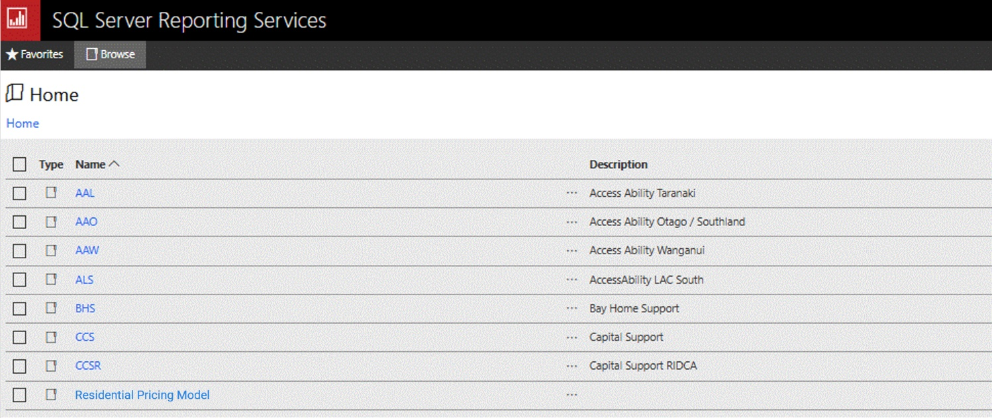
Socrates reporting server

Slide 10

ALWAYS open the Facilities List on Socrates.
Do NOT save a copy and reuse it.
Notes:
[IMAGE CREDIT Photo by Muhammad Daudy on Unsplash]

Slide 11
Accessing and saving a BAT tool copy

Slide 12
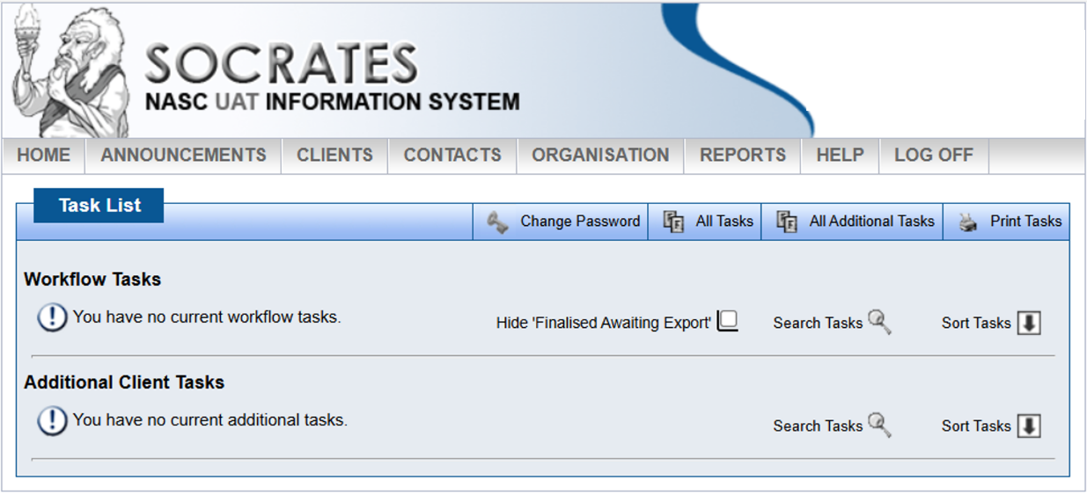
Socrates – Task List

Slide 13
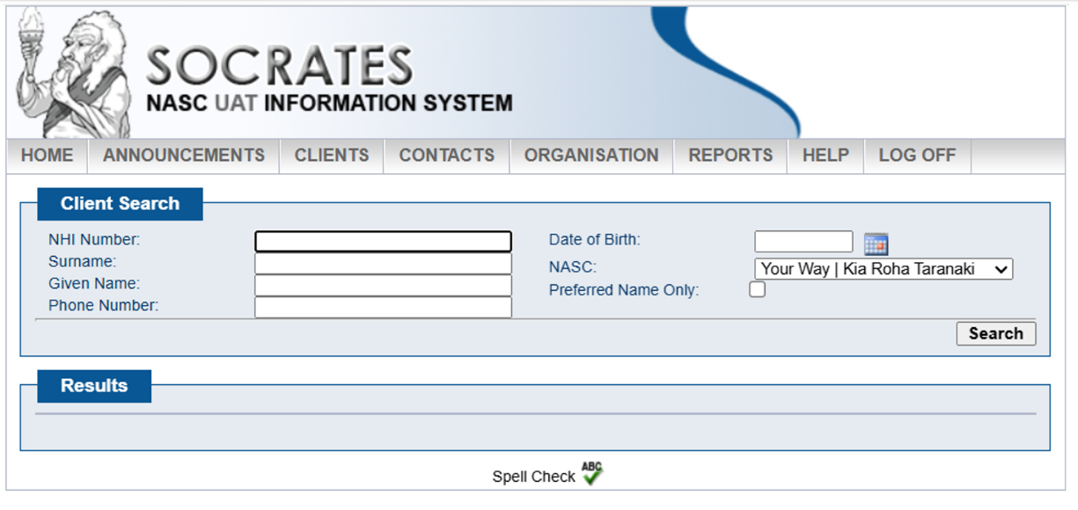
Socrates Client Search
Notes:
In the assessment screens the NASC enters information used for the personal plan and allocation weightings.

Slide 14
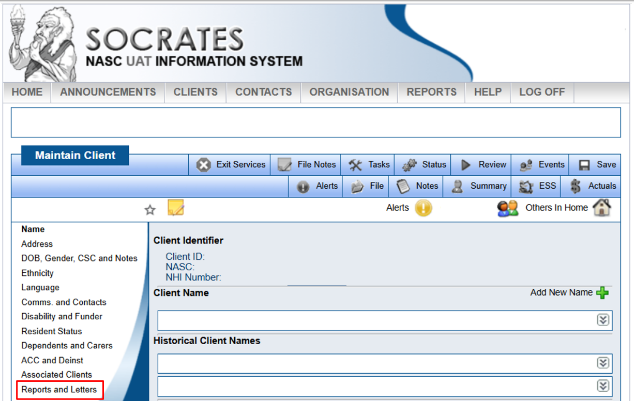
Socrates – Reports and Letters

Slide 15
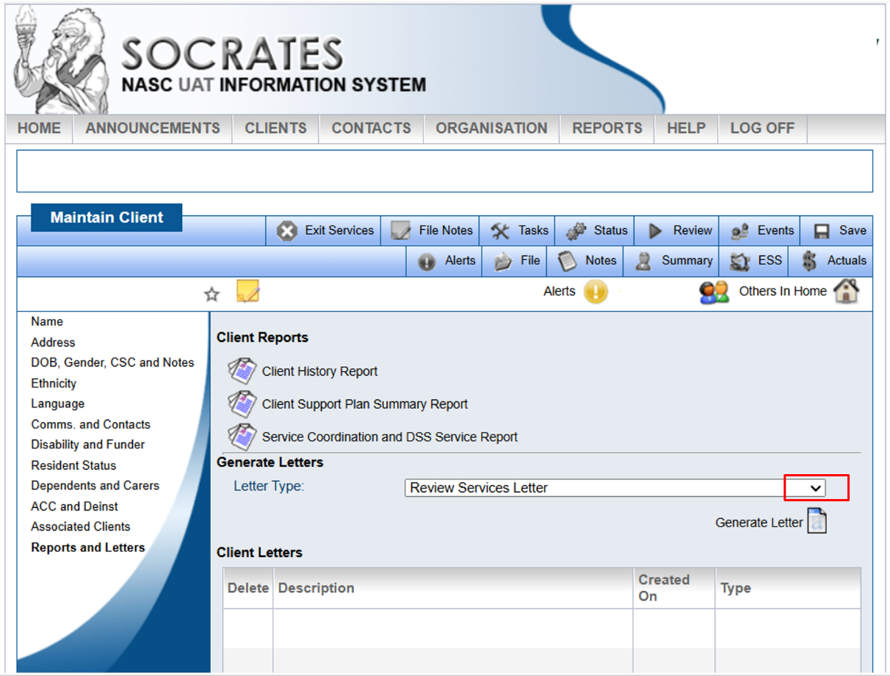
Socrates – Review Services Letter

Slide 16
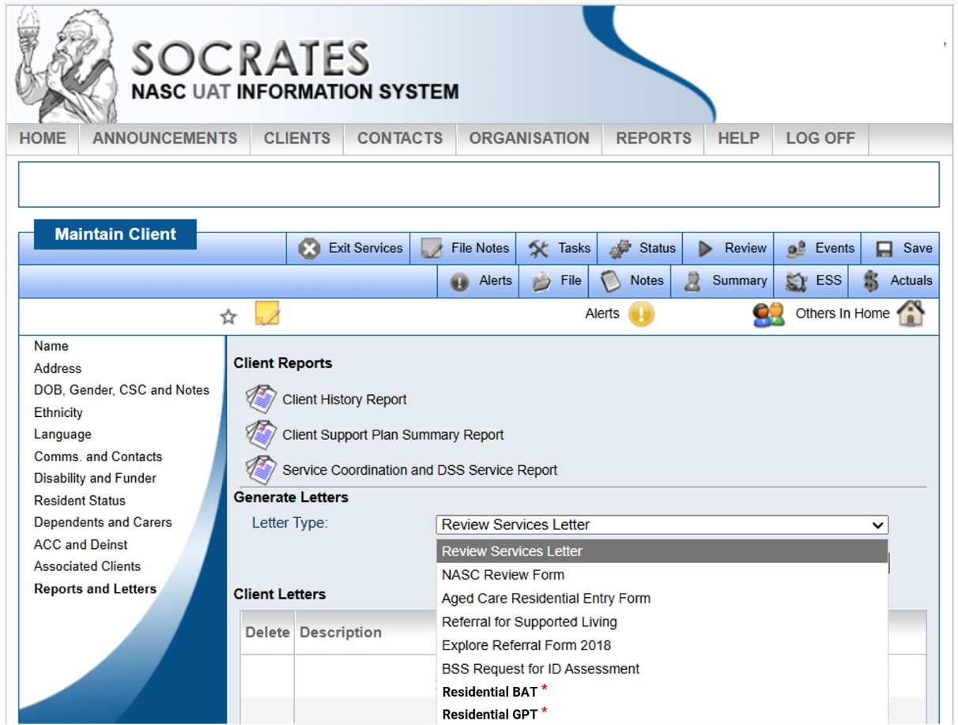
Socrates – files in client area

Slide 17
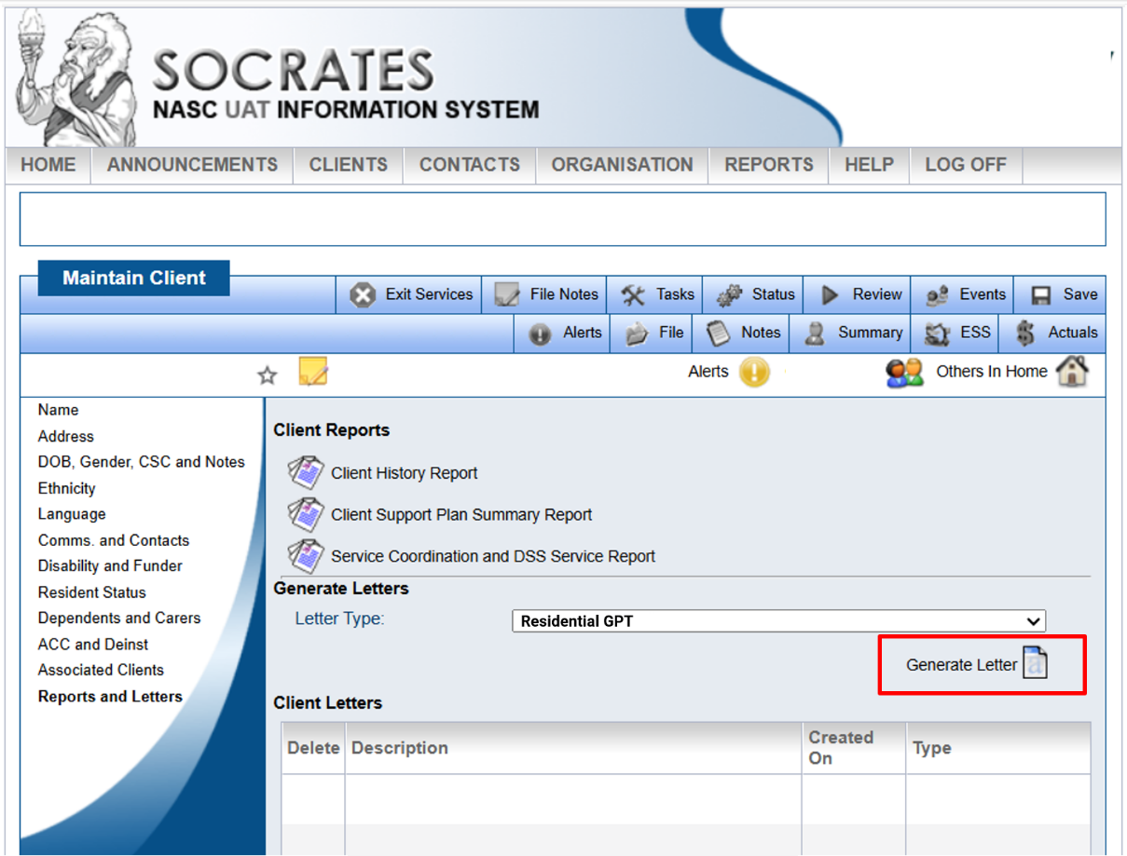
Socrates – Generate Letter

Slide 18
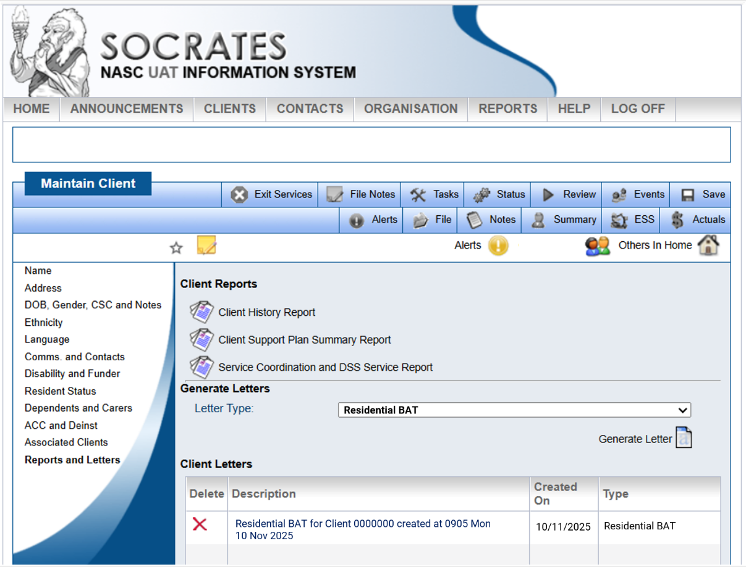
Socrates – Select saved BAT

Slide 19
ALWAYS create a new BAT in Socrates.
Do NOT duplicate a copy that you already have and reuse it.
Notes:
[IMAGE CREDIT Photo by Muhammad Daudy on Unsplash]

Slide 20
Exploring the Purpose, Plan View and List View tabs

Slide 21
Plan View Entering & sharing information

Slide 22

Plan View Entering & sharing information (cont)
Notes:
[IMAGE CREDIT Photo by Simone Secci on Unsplash]

Slide 23
List View Entering & sharing information

Slide 24
List View Entering & sharing information (cont)
Notes:
[IMAGE CREDIT Photo by Simone Secci on Unsplash]

Slide 25
Entering information into GPT and Socrates

Slide 26

Recording the funding allocation in Socrates
All individual funding allocations must first be discussed and agreed with the Provider to ensure the Provider has the capability to support the person in a CGH service.
Once the allocation is agreed, the NASC organisation or EGL site must enter a service allocation under Service Coordination in Socrates, ensuring that:
the service ID corresponds to the person's region, and GPT output,
the correct provider region is selected,
the BAT rationale is copied and pasted.
In client documents the following are saved:
The completed BAT and GPT files,
the rationale for the allocated funding rate, including peer review, Quality Assurance and Review Panel outcomes.

Slide 27
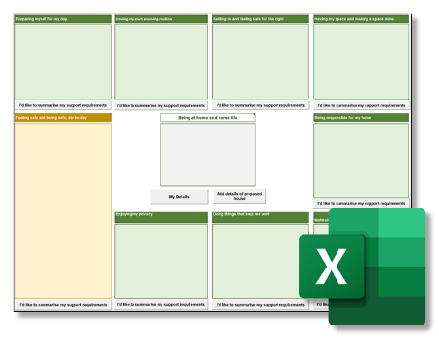
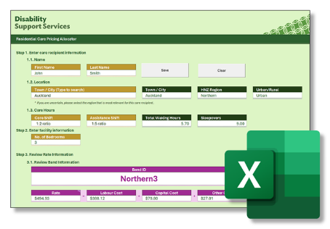
Entering data
Generate a copy of the GPT in Socrates
Copy the Inputs for GPT from the BAT to the GPT to determine the rate that should be offered to the provider
Allocate a service in Socrates, choosing the appropriate Service ID
Close the GPT
Copy the Data string for Socrates from the BAT into the BAT Rationale in Socrates
Close the BAT file in Socrates
Update the disabled person’s address in Socrates
Inputs for GPT
BAT Tool
GPT Tool
Data string for Socrates
Allocated Band
Disabled person’s address

Slide 28
Socrates – Select BAT and GPT files

Slide 29
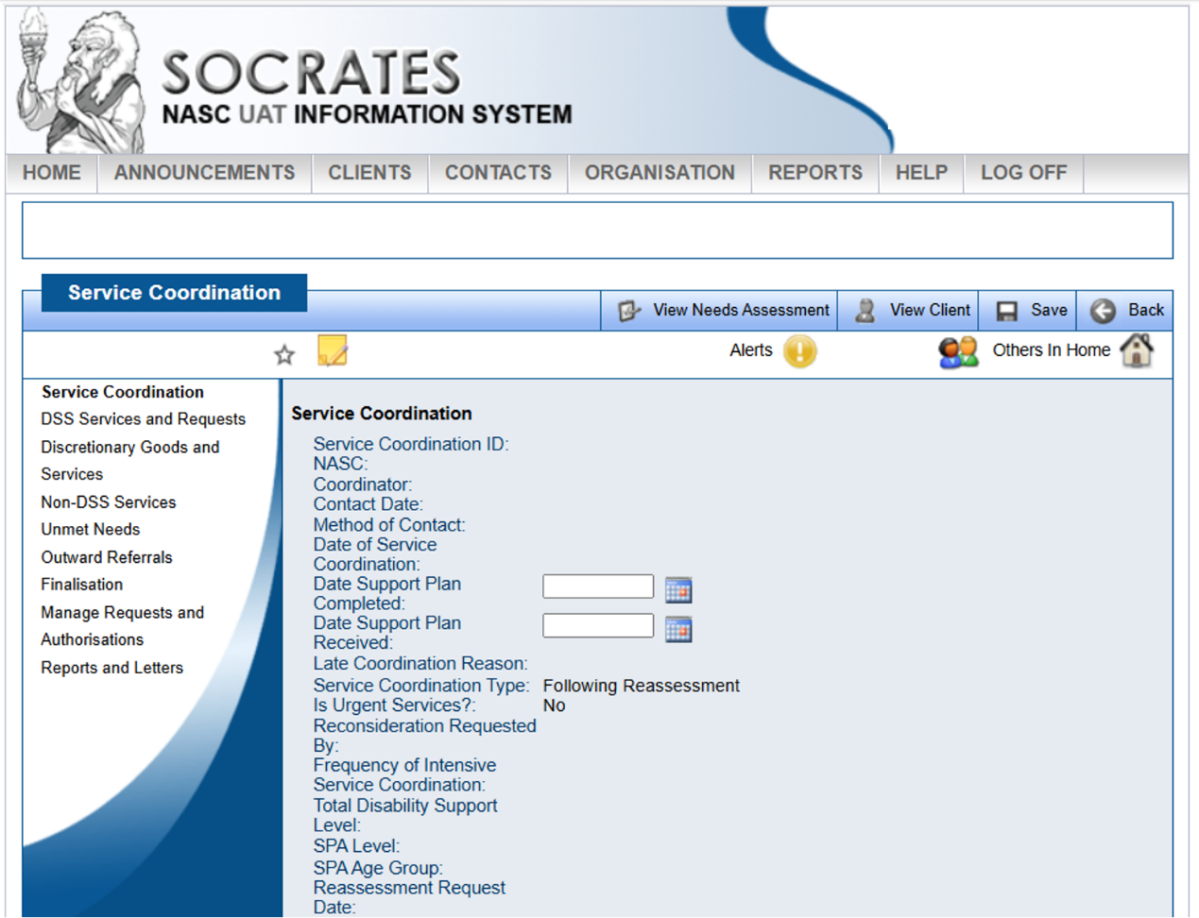
Socrates – Service Coordination

Slide 30
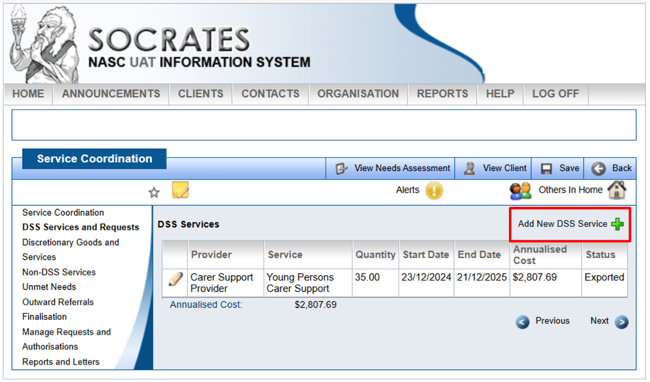
Socrates – Add New DSS Service

Slide 31
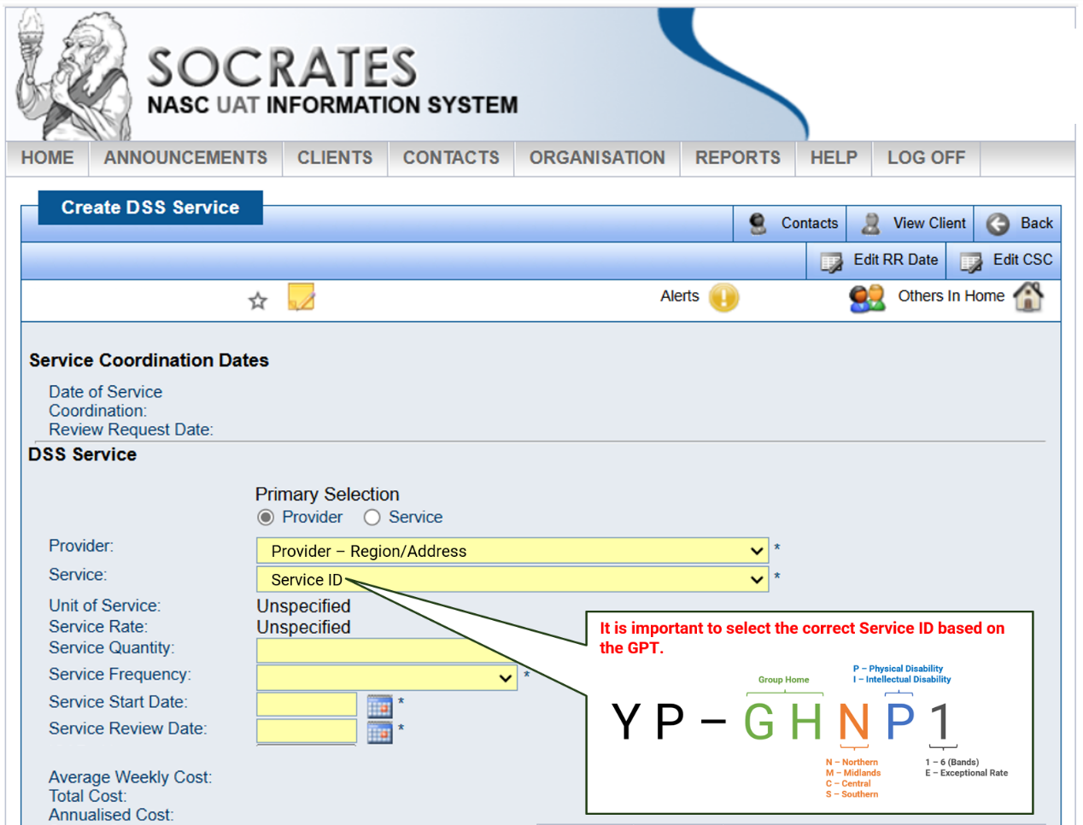
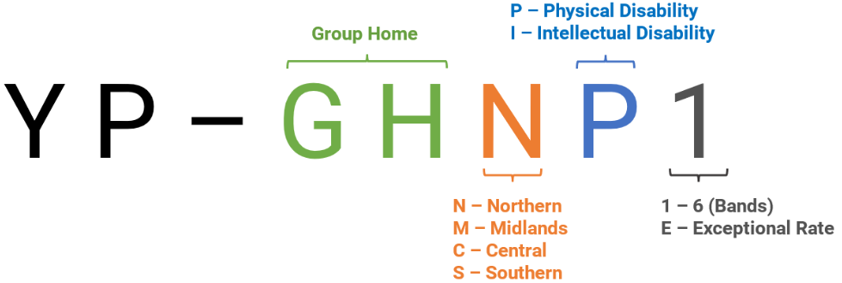
Socrates – Service ID

Slide 32
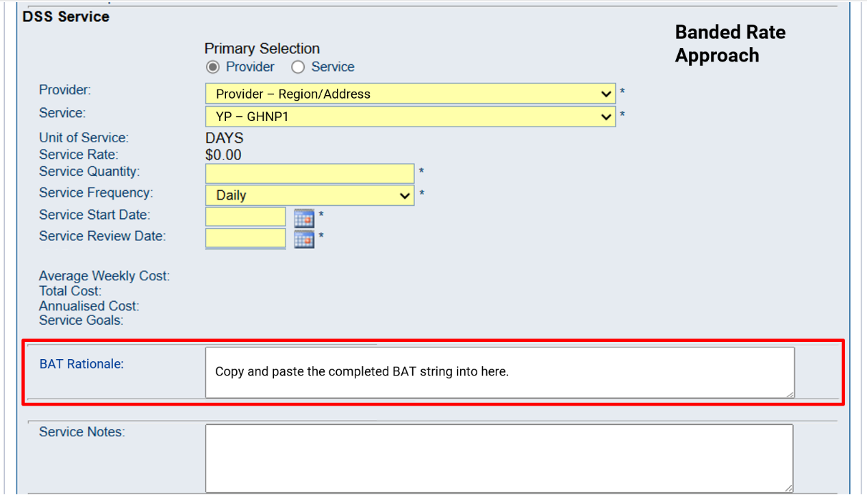
Socrates – BAT Rationale

Slide 33
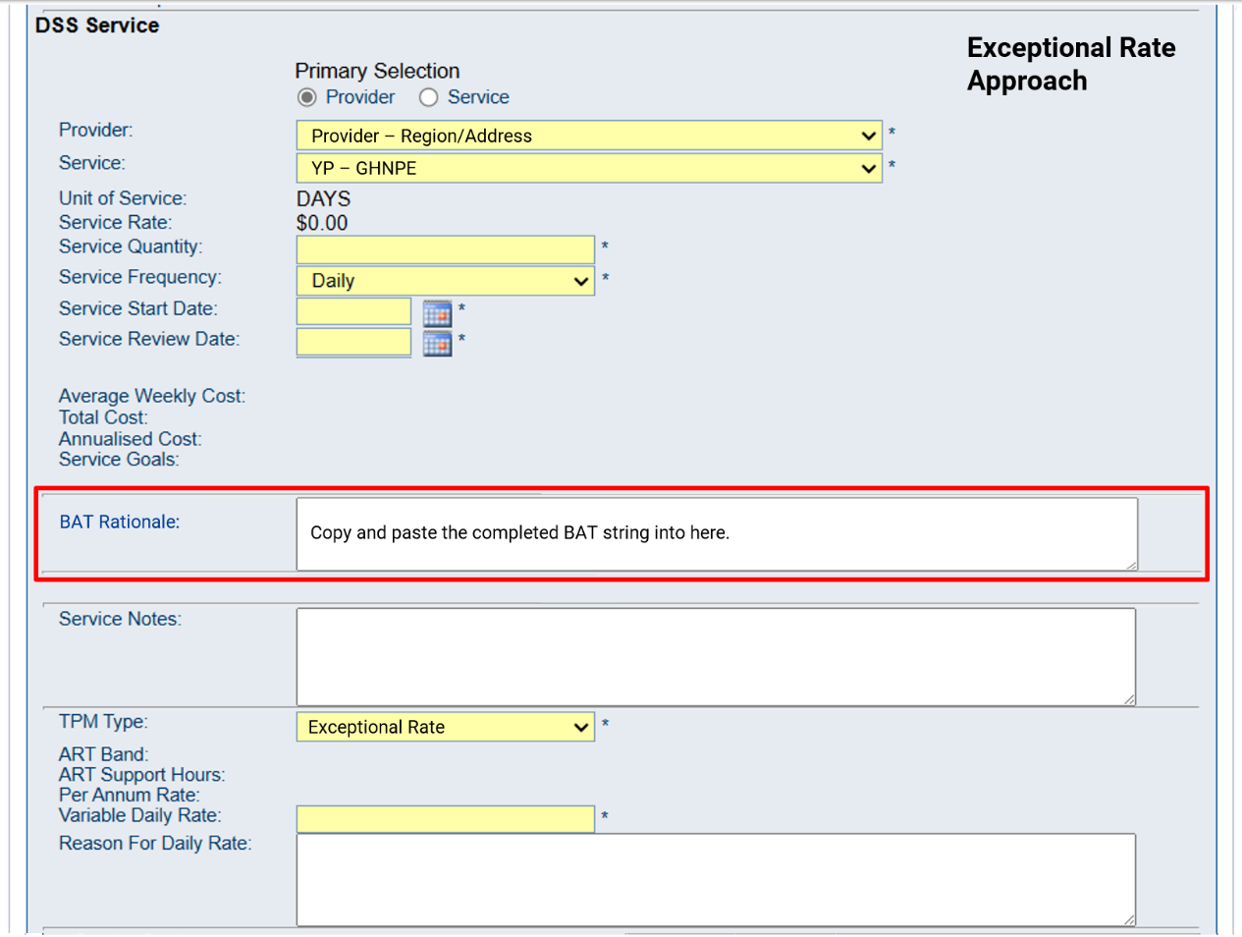
Socrates BAT Rationale

Slide 34
ALWAYS open GPT from Socrates.
Do NOT save a copy and reuse it.
Notes:
[IMAGE CREDIT Photo by Muhammad Daudy on Unsplash]

Slide 35
Questions?
Notes:
[IMAGE CREDIT Photo by Simone Secci on Unsplash]

Slide 36
Wrap Up / Q&A

Slide 37
Learning Goals (cont)
How to access the Facilities List
How to access the BAT tool
The Purpose, Plan View and List View tabs
Entering and sharing information (using a scenario example) in Plan View
Entering and sharing information in List View
What information in the BAT needs to be transposed into the GPT tool and Socrates
Notes:
[IMAGE CREDIT Photo by Kelly Sikkema on Unsplash]

Slide 38

Questions? (cont)
A lot of what you have seen in this session is covered in the User Guide. We also suggest you work through a self-paced learning activity to become more familiar with the tools.
Notes:
[IMAGE CREDIT Photo by John Cardamone on Unsplash]

Slide 39

Thank You
Next session:
Recap – The funding allocation process
Exceptional Rates
Where to access training and support material
What’s next for you?
What’s on the Radar?
Training conclusion
Notes:
[IMAGE CREDIT Photo by Wilhelm Gunkel on Unsplash ]

