Slide 1
Introducing the BAT
Introduction to Residential Pricing changes
Introducing the BAT

Slide 2
Nau mai, haere mai Welcome

Slide 3

What this session will cover
Why the BAT tool was created
The testing process used in the development of BAT
How to access the BAT tool and when to use it
Where it fits in relation to other processes
Notes:
[IMAGE CREDIT Photo by Marissa Grootes on Unsplash]

Slide 4

Learning Goals
How and why the BAT tool was created, including the testing process used.
Where you will be able to access the BAT and GPT and when to use it
How the BAT tool fits into the Community Group Home pricing model
Notes:
[IMAGE CREDIT Photo by Kelly Sikkema on Unsplash]

Slide 5
Why the BAT tool was created

Slide 6

The Residential Care Service specification
The Ministry purchases community residential support services (the Services) for people with disabilities who need this level of support, so that they can enjoy a good quality of life and live in a place that feels like home.
Putting people at the centre of support enables them to have greater choice and control over their home and environment.
home [that] is accessible, homely, clean, well maintained and provides privacy and autonomy
Home

Slide 7
The Residential Care Service specification (cont)
To deliver on the service specification, we take the approach of working through:
What makes for a good home, in general and specifically for this person
What the disability-related challenges someone might experience to living well in a residential care home are
What is necessary to support the disabled person to overcome those challenges and “enjoy a good quality of life and live in a place that feels like home”

Slide 8
Domains used in the BAT
Settling in and feeling safe for the night
Having my space and making a space mine
Preparing myself for my day
Having my own evening routine
Feeling safe and being safe, day-to-day
Being responsible for my home
Doing things that keep me well
Maintaining connection and sharing connection
Enjoying my privacy

Slide 9

What is the BAT Tool
Supports NASCs and EGL-sites to fund Community Group Home service allocations at the correct rate within the new CGH Pricing Model.
Replaces existing TPM tools and iCare with a nationally consistent tool.
Comes into effect from 1 December 2025 alongside other operating changes.
Used from 1 December 2025 for new community group home entries and re-assessments.
Will not be used for services outside of the community group home service specification, such as Aged Residential Care, High and Complex (Forensics) services, or Choices in Community Living.
Notes:
[IMAGE CREDIT Photo by Possessed Photography on Unsplash]

Slide 10
Testing and development of BAT

Slide 11

Testing methodology
Existing service allocations
Pre-selected group of NHI’s– to ensure testing was broadly representative
Testing wanted to understand
Tool usability, time/resource impacts
Understandability, ability to reflect the range of situations supported in residential care
Net movements – what moves individuals to a new rate, and who is moving.
Potential grouping or ‘herding’ of funding towards certain band
NASC representation in testing
North and South Island
Urban and rural
Māori and Pacific representation
Various sizes of regions and NASCs
Notes:
[IMAGE CREDIT Photo by Kevin Canlas on Unsplash]

Slide 12

Changes based on testing
Plan View was further refined, with Help updated to reflect changes where the NASCs requested additional guidance.
Prompts added that asked for answers to be checked if very high supports or high risks are triggered.
‘It’s important that you know’ sections became definitive yes/no selections.
Wording in the day programmes section revised.
Significant updates to the hazard management weightings and guidance, risk adjustor calculation, and assistance shift calculation.
Testing ultimately showed little variation in terms of calculations between current funding and the results achieved by using the BAT, which confirms the accuracy of the tools.
Notes:
[IMAGE CREDIT Photo by Kevin Canlas on Unsplash ]

Slide 13
How to access BAT and when to use it

Slide 14

Accessing the BAT
Access to the BAT and GPT is via Socrates from the Letters drop-down.
Once the BAT is completed, information from the BAT is transferred to the Global Pricing Tool (GPT). This is used to determine the correct funding band.
Notes:
[IMAGE CREDIT Photo by Radu Prodan on Unsplash ]

Slide 15
Accessing BAT examples
BAT Practice Exemplars will be available in Socrates.
These files relate to self-paced learning scenarios that will be on a hidden page of the DSS website.
BAT-Training Example.xlsm
This is a partially complete BAT that is used in training sessions
BAT Practice Exemplars (for self-paced learning)
BAT Practice Exemplar – Scenario 1.xlsm
BAT Practice Exemplar – Scenario 2.xlsm
BAT Practice Exemplar – Scenario 3.xlsm
BAT Practice Exemplar – Scenario 4.xlsm
Notes:
[IMAGE CREDIT Photo by Radu Prodan on Unsplash ]

Slide 16

When to use the BAT tool
Primarily a service coordination tool. It assumes that the person is eligible to receive disability supports and that residential care is right for them.
BAT supports the planning of a residential care service, and estimating the resource required.
BAT is intended to operate within the current needs assessment and service coordination process.
Supports capturing information, summarising it into service variables, before entering into GPT and a band or other price is allocated.
Notes:
[IMAGE CREDIT Photo by charlesdeluvio on Unsplash ]

Slide 17
How the domains are used in the BAT
Settling in and feeling safe for the night
Having my space and making a space mine
Preparing myself for my day
Having my own evening routine
Feeling safe and being safe, day-to-day
Being responsible for my home
Doing things that keep me well
Maintaining connection and sharing connection
Enjoying my privacy

Slide 18
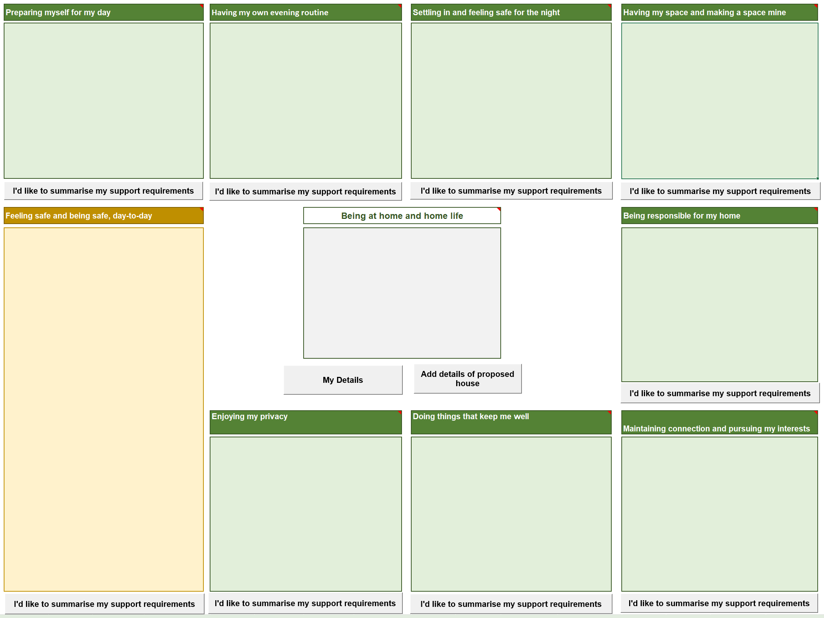
How the domains are used in the BAT 2
Settling in and feeling safe for the night
Having my space and making a space mine
Preparing myself for my day
Having my own evening routine
Feeling safe and being safe, day-to-day
Being responsible for my home
Doing things that keep me well
Maintaining connection and sharing connection
Enjoying my privacy

Slide 19
BAT and the CGH pricing model

Slide 20
Allocating funding using BAT
A simplified end-to-end view
Needs Assessment Completed
Choose Provider, Region and Service ID in Socrates
Document in Socrates
Finalise Service Coordination
Update individual’s address in Socrates
Discuss/advise on providers
Generate Service Authorisation
END
Contact providers
Discuss facilities
Send Service Request
Accept Service Request
Review Panel endorsement
not required
Receive Service Authorisation
Use BAT/GPT to calculate rate
END
Review Panel endorsement required
Decision reviewed
Disabled Person
NASC/EGLs
DSS Review Panel
Service
Providers

Slide 21
Wrap Up / Q&A

Slide 22
Learning Goals summary
How and why the BAT tool was created, including the testing process used.
Where you will be able to access the BAT and GPT and when to use it
How the BAT tool fits into the Community Group Home pricing model
Notes:
[IMAGE CREDIT Photo by Kelly Sikkema on Unsplash]

Slide 23

Questions?
Notes:
[IMAGE CREDIT Photo by John Cardamone on Unsplash]

Slide 24

Thank You
Next session:
A demonstration of the BAT tool
Exploring the interface layout and functionality
How to access the tool, use information from the BAT in GPT, and how to use them to determine the appropriate band.
Notes:
[IMAGE CREDIT Photo by Wilhelm Gunkel on Unsplash ]

