Slide 1
Introduction to Residential Pricing changes
Setting the Scene

Slide 2
Nau mai, haere mai
Welcome

Slide 3

What this session will cover
The Independent Review findings and recommendations
The Government response
What has been achieved so far
The Community Group Home pricing model
  The pricing model and the bigger picture
  What’s changing in the system?
  Changes affecting NASCs and EGL sites
Notes:
[IMAGE CREDIT Photo by Marissa Grootes on Unsplash]

Slide 4

Learning Goals
The Independent Review findings and recommendations
The Government response
What has been achieved
The pricing model and the bigger picture
What’s changing in the system?
Changes affecting NASCs and EGL sites
Community Group Home pricing model
Notes:
[IMAGE CREDIT Photo by Kelly Sikkema on Unsplash]

Slide 5

70/20/10 learning model
Your greatest learning will happen in the real world.
10% of learning happens in training
20% through interaction with others
70% of your learning occurs on the job
Embedding what you learn here will come from
when you're working with colleagues and with the
disabled person and their whanau.
Training
(Structured learning)
Learning
from others
Learning from experience
(on the job learning)
Notes:
[IMAGE CREDIT Photo by Mario Dobelmann on Unsplash]

Slide 6
Background to Change/The Independent Review

Slide 7
Background to change
Around 54,000 people receive DSS.
More people are using DSS, their needs are more complex, and the costs of services are rising.
From 2015/16 onwards, nine out of the following 10 years saw DSS require more funding than it was allocated.
In 2024, the Government announced an Independent Review into the disability support system.
The Independent Review into DSS

Slide 8
Independent Review findings
Delivery was inconsistent.
There was inadequate budgetary control and commercial rigour.
The two largest areas of cost growth were residential care and flexible funding.
Policy settings and service design did not allow the effective administration and delivery of DSS.

Slide 9
Government Response

Slide 10
The Government response
The Government accepted the 7 recommendations of the Independent Review.
The Government also decided:
MSD would become responsible for delivering DSS.
The Ministry of Disabled People – Whaikaha would be upgraded to a stand-alone government department.
A Taskforce would lead implementation of the recommendations and help facilitate the transfer of DSS to MSD.

Slide 11
Independent Review
Recommendations
Budgets for NASCs, EGL sites and EMS providers (Completed).
Freeze funding for residential care and review of contract and pricing models (December 2025).
Take no action on a price increase for providers in 2024/25 (Completed).
Monitor NASC and EGL sites (Completed).
Update assessment and allocation settings.
Establish Flexible Funding criteria and review guidelines.
Strengthen how we work with other agencies (Completed).

Slide 12
What has been achieved?

Slide 13

What has been achieved
Invested in staff capability and developed systems and processes to increase efficiency.
Worked closely with the sector and key stakeholders across the system to understand what is working well and where improvements can be made.
Cleared ¾ of the waitlist for specialist equipment.
Commenced an internal change process to boost capability as commissioner, funder and steward.
Worked with other agencies to improve interagency processes and joint funding.
Consulted with the community on changes to assessments, allocations and flexible funding.
Notes:
[IMAGE CREDIT - Photo by krakenimages on Unsplash ]

Slide 14
What has been achieved (continued)
Established prioritisation of entry into residential care.
Provided certainty of funding for NASCs, Enabling Good Lives sites and providers.
Improved and strengthened practices in forecasting, reporting and ensuring that prioritisation supports those in need.
Improved monitoring of services and funding to enable better understanding of the drivers of change/ increase in the number and the cost of people supported.
Improved practices for commercial procurement.
Introduced a Review Panel to provide assurance that people are receiving appropriate support packages and residential care entitlements for high-cost packages.
Notes:
[IMAGE CREDIT - Photo by krakenimages on Unsplash ]

Slide 15
CGH - Community Group Home Pricing Model

Slide 16
Community Group Home Pricing Model
New residential pricing model.
CGH pricing model came into effect 1 July. System and contract changes from 1 December 2025.
Pricing model sets a nationally consistent approach to pricing.
Most people supported in CGHs funded on banded rates (about 90%).
About 10% have rates above/below bands and funded by exceptional rates.
The new pricing is considered all-inclusive.
NASCs will continue to determine which banded or exceptional rates are paid to providers for individuals.
Incorporating Recommendation 2

Slide 17

How the new pricing model was developed
A tool was developed that helped understand the true costs of delivering community residential services today, as well as a matrix of possible support scenarios.
The support scenarios and costs were matched to the existing population to develop a full list of refreshed day rates.
The new rates were divided into break points, reflecting an average price for services. These became the banded rates for the system.
Service and cost assumptions were tested with a subset of existing providers and NASC representatives in March.

Slide 18
How the new pricing model was developed (cont.)
The first version of the model was based on a 2024 residential data set.
In July 2025 up-to-date facility and support information was collected from providers. This generated an updated list of rates based on a more accurate understanding of current service arrangements.
These rates are reflected in the new Community Group Home Service Agreement.
The rates will fund most (about 90 percent) of those accessing Community Group Home services.
The model recognises that some people, given the level of support required, will need funding at levels that fall outside of the banded rates range.

Slide 19
The Rates
Northern
Midlands
Central
Southern
Band​ | Rate​
Band 1​ | $327.81​
Band 2​ | $414.57​
Band 3​ | $494.93​
Band 4​ | $643.75 ​
Band 5​ | $842.06 ​
Band 6​ | $893.61 ​
Band​ | Rate​
Band 1​ | $320.77 ​
Band 2​ | $424.40​
Band 3​ | $531.32​
Band 4​ | $654.72​
Band 5​ | $855.44​
Band 6​ | $939.00​
Band​ | Rate​
Band 1​ | $324.31 ​
Band 2​ | $438.99​
Band 3​ | $528.79 ​
Band 4​ | $661.55​
Band 5​ | $847.99​
Band 6​ | $905.70​
Band​ | Rate​
Band 1​ | $318.08​
Band 2​ | $408.66​
Band 3​ | $494.85 ​
Band 4​ | $635.00 ​
Band 5​ | $838.23 ​
Band 6​ | $911.54 ​
Client Contribution inclusive
GST Exclusive

Slide 20


Included in the rates
Advanced Interim Payments (pay equity top-ups)
Sleepover payments
Day Activity Contributions
Client Contributions
Notes:
[IMAGE CREDIT Photo by Ali Rezaei on Unsplash ]

Slide 21

The Global Pricing Tool
– A Deeper Dive
The Global Pricing Tool (GPT) is what estimates costs of service to determine fair and reasonable prices for community residential supports.
It considers a range of house sizes and capacities, in different regions, with different levels of support delivered.
Notes:
[IMAGE CREDIT Photo by Jakob Boman on Unsplash]

Slide 22
Underpinning costs
Staffing
Client Related Expenses
Core Housing Costs
Maintenance & Utilities
Provider Overheads
Cost groups
Main cost components
Salaries & wages
(Support worker, care coordinator, etc)
Food
Market rent by location
Insurance
Management staff
Pay equity (to date)
Laundry
Furniture and fitout
Property maintenance
Admin & accounting staff
Sleepovers / Wakeovers
Specialist services & therapy
Household supplies
Telecommunications
IT costs
Transport Costs
Water & Power
Facilities management

Slide 23

Setting individual day rates
The Band Allocation Tool (BAT) is a tool that will be used by the NASCs and EGL sites (alongside a disabled person) to generate the outputs that determine the funding levels needed.
The outputs from the BAT are inputted into the GPT to generate the rate that should be offered to the provider.
Dual funded arrangements, or funding levels outside of the band structure, are called "Exceptional Rates" and will be subject to a DSS-led quality assurance process.
Notes:
[IMAGE CREDIT - Photo by Markus Winkler on Unsplash]

Slide 24
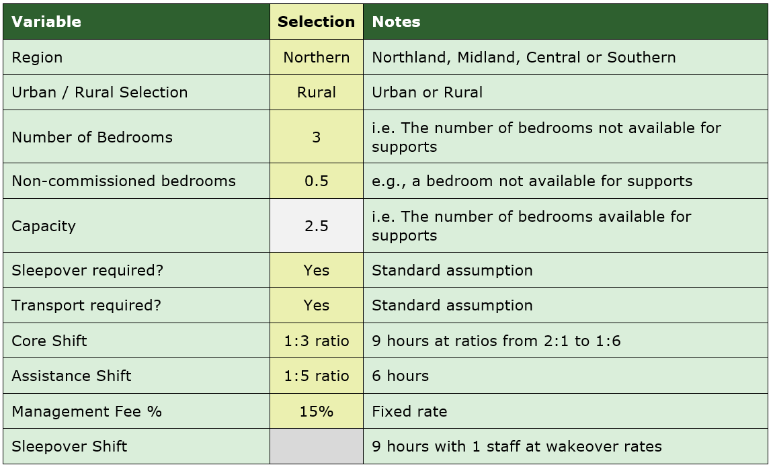
Setting individual day rates (continued)
Example of service variables
Notes:
[IMAGE CREDIT - Photo by Markus Winkler on Unsplash]

Slide 25
The Pricing Model
- The big picture

Slide 26










The pricing model and
the bigger picture
DSS "Commissioner"
GPT Model
Informs
Rates agreed with Providers
DSS is the Commissioner. It uses the GPT model to inform banded rates. Exceptional rates are endorsed through the DSS Review Panel. Agreed rates are included in provider contracts, along with any auditing requirements.
Providers deliver care to DSS clients based on the agreed contracts and service co-ordinations from NASCs. They are responsible for supporting audits when required.
NASCs and EGL-sites manage their assigned budgets and report required information to DSS. When allocating services, they use the BAT tool or apply for endorsement of an exceptional rate decision via the DSS Assurance Team and Review Panel process.
DSS Calculates Band Rates
Sets Monitoring Requirements
Creates Policy
Informs
Audits Services
Creates Contracts
(Incl Service Specs)
Sets NASC Budgets
BAT Tool
DSS Panel
Disabled person
Exceptional Rates
Banded Rates
Manages Budget
Delivers Care
Reports
Service Co-Ordination
& Allocation
Signs Contract
NASCs and EGL-sites
Informs service required/agreed
Providers
Sector
Operations
Manages Payments

Slide 27


What's changing in the system from 1 December?
DSS "Commissioner"
GPT Model
Informs
Prices agreed with Providers via Procurement Process and panel
DSS Calculates Band Prices
Sets Monitoring Requirements
Creates Policy
The CGH Pricing Model programme delivers:
A credible pricing model for CGH services
Supporting operational policies
A new contracting arrangement with CGH providers with an updated funding schedule
Updates to Socrates
Updated payment schedule
A funding allocation tool and process to support consistent pricing nationally
Updated data requirements for providers and NASCs
Scripting of all existing rates to new rates by 1 December
Ongoing monitoring and reporting
Audits Services
Creates Contracts
(Incl Service Specs)
Sets NASC Budgets
BAT Tool
DSS Panel
Disabled person
Exceptional Rates
Banded Rates
Informs data requirements
Manages Budget
Delivers Care
Reports
Service Co-Ordination
& Allocation
Signs Contract
Informs service required/agreed
Providers
NASCs and EGL-sites
CCPS
Payments
CMS
Socrates
Data
Whanau Tahi / Health Sector Operations

Slide 28
Changes impacting NASCs and EGL-sites
DSS "Commissioner"
GPT Model
Informs
Prices agreed with Providers via Procurement Process
DSS Calculates Band Prices
Sets Monitoring Requirements
Creates Policy
Audits Services
Creates Contracts
(Incl Service Specs)
From 1 December 2025:
New rates will be administrable in Socrates
The GPT, BAT and exceptional rates process will come into effect
New data requirements for providers and NASCs
Exceptional Rate endorsement processes
Other supporting operational policy will be in place
Updated NASC budgets
Sets NASC Budgets
BAT Tool
DSS Panel
Disabled person
Exceptional Rates
Banded Rates
Informs data requirements
Manages Budget
Delivers Care
Reports
Service Co-Ordination
& Allocation
Signs Contract
NASCs and EGL-sites
Informs service required/agreed
Providers
CCPS
Payments
CMS updated
Socrates
Data
Whanau Tahi / Health Sector Operations

Slide 29
Wrap Up / Q&A

Slide 30
Learning Goals summing up
The Independent Review findings and recommendations
The Government response
What has been achieved
The pricing model and the bigger picture
What’s changing in the system?
Changes affecting NASCs and EGL sites
The Community Group Home pricing model
Notes:
[IMAGE CREDIT Photo by Kelly Sikkema on Unsplash]

Slide 31

Questions?
Notes:
[IMAGE CREDIT Photo by John Cardamone on Unsplash]

Slide 32

Thank You
In the next session…
Why the Band Allocation Tool, or BAT tool was created, including how it was developed and tested.
Guidelines on how to access it, as well as explaining where the BAT fits in, in relation to other tools and processes.
Notes:
[IMAGE CREDIT Photo by Wilhelm Gunkel on Unsplash ]

